Slide 1
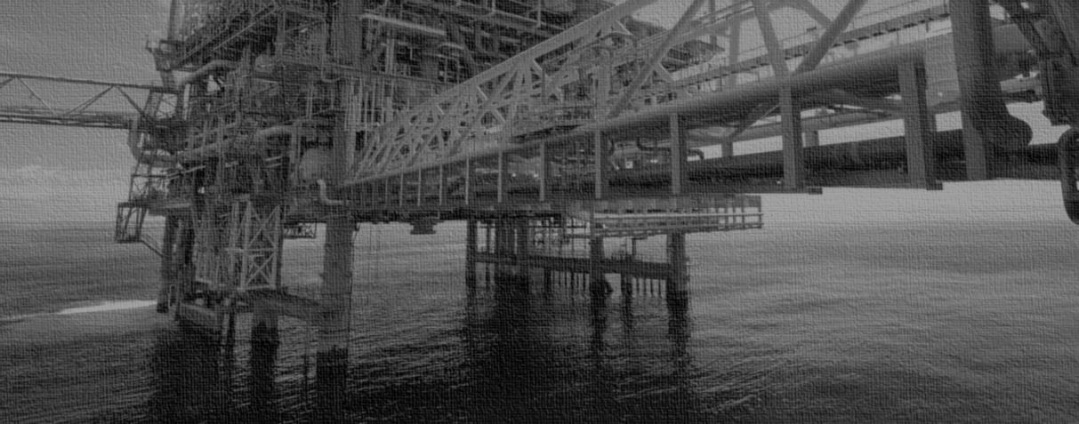
Conductor Integrity
Hidden Risks and Mitigations
Delivering safe, reliable, cost effective solutions to the Oil & Gas Industry.
Notes:
Evening ladies and gentlemen
Thank you for coming out on a cold January evening

Slide 2
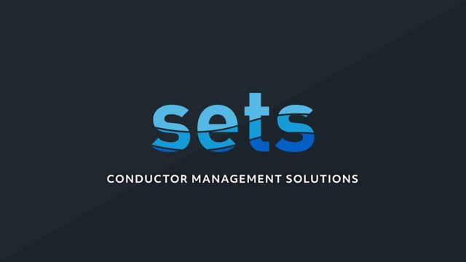
2
Animation

Slide 3
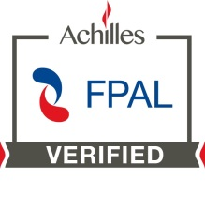
Early engagement. Disruptive thinking.
www.setsltd.com

