Slide 1

ICorr YEP Case Study:
Onshore Titanium Pipe Corrosion Failure
Team 6
Ross Houston (McDermott), Joshua Owen (University of Leeds), Sam Shea (KBR) and Josie Watson (Metec)
Mentor: Rob Doggett
Notes:
Introduce team members briefly

Slide 2
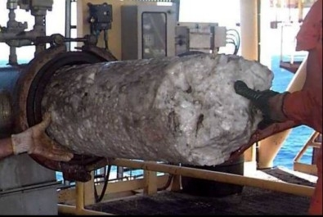
Case Study Introduction
Leaks experienced in titanium piping in an onshore Mono-ethylene Glycol (MEG) desalination plant during a routine shutdown.
Plant has been in operation for 15 years
Operator of the facility has a “no leak” policy
MEG is used for hydrate and corrosion control in gas pipelines from three offshore fields.
Plant is fabricated out of Titanium Grade 12
Gas Hydrates
Notes:
Ross

Slide 3
Key Process Information
Monovalent salts removed in a vacuum distillation column (Evaporator)
Designed to handle 2.5 wt% salt in the Evaporator
Sampling salt content > 6.7 wt%
Operating temperature ~120°C (maximum 135°C)
Possible for acetic acid and glycolic acid to form in the fluid

Slide 4
Why Did It Fail? Key Information
Four critical key factors contributed to corrosion of the piping:
  Oxygen – for approx. 1 year, O₂ ingress has been a problem
  Temperature – typically 120 – 130 °C in the pipe
  Chloride content – > 6.7 wt.% NaCl (Solid salt deposits)
  Organic acids – acidic pH observed in fluid from MEG degradation
Resulted in severe pitting corrosion and a crack in the titanium grade 12 pipelines

Slide 5
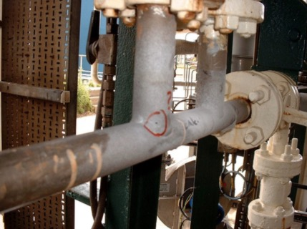
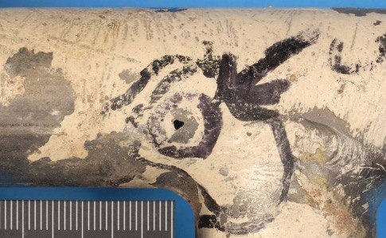
Titanium Failure
Two pinholes and a crack observed in the region of welds as a result of corrosion
Piping is small bore 1” and 1.5”
Leaking pipes were subject to further investigation
Notes:
Finish Ross

Slide 6
Titanium Grade 12
Growth of a passive oxide layer critical to corrosion resistance of titanium
Corrosive electrolyte
Passive layer forms:
Generally composed of titanium dioxide (TiO₂)
< 10 nm thick
Protects underlying metal
Titanium alloy
Durability of passive film critical, break down leads to aggressive degradation, often in the form of pitting and crevice corrosion
Resistance to film breakdown significantly higher for titanium alloys, with particular resistance in higher chloride concentrations

Slide 7
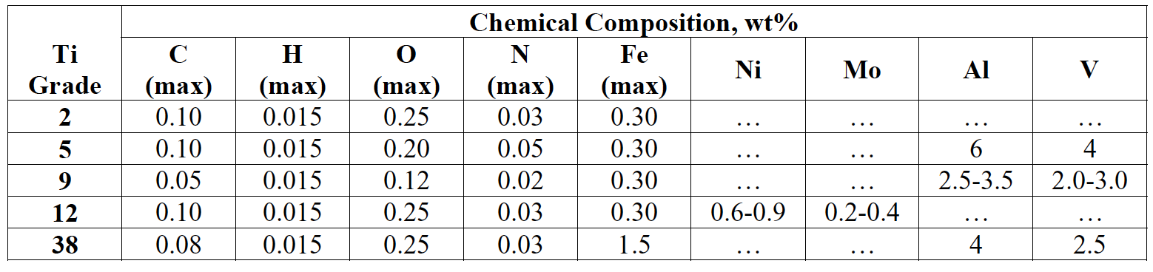
Titanium Grade 12
Several grades of titanium available
Grade 12 was used for superior corrosion resistance, containing nickel (Ni) and molybdenum (Mo) alloying elements
Addition of Ni and Mo enhances the durability of the passive film (compared to Grade 1 and Grade 2)
Has a hexagonal close packed/body centre cubic (α/β) microstructure

Slide 8
Case Study Exercise 1: Initial Queries for Further Information
Three keys areas were identified requiring further information to investigate the failure:
Pipe Condition
What other degradation was observed internally?
Was corrosive attack just in the region of the weld?
What surface analysis was completed on the pipe?
1
Conditions
What was the the process fluid composed of?
Had conditions changed?
2
Welding
What standards were followed for the weld?
Was the weld inspected after completion?
3
Notes:
1 - Enabled us to determine how localised the corrosion was and the extent of degradation
2 – We wanted a detailed description of the conditions to be sure of the conditions in the pipeline
3 – As the corrosive attack was in the region of the welds, we wanted to investigate the weld further

Slide 9
Case Study Exercise 2: Possible Causes of Corrosion (Pitting)
Formation and growth of a pit
Fluid containing corrosive species (oxygen and hydrogen ions)
MEG stream flow
O₂
R
O₂
Cl⁻
H⁺
Cl⁻
Passive film
H⁺
O₂
O
Ti²⁺
Cl⁻
Passive film breakdown
Cl⁻
Cl⁻
e⁻
Titanium
Reduction (R) – cathodic reaction: O₂ + 4H⁺ + 4e⁻ → 2H₂O
Oxidation (O) – anodic reaction: Ti → Ti²⁺ + 2e⁻

Slide 10
Case Study Exercise 2: Possible Causes of Corrosion (Pitting)
MEG stream flow
O₂
Temperature
Breakdown potentials of titanium can decrease by over 1 V from 125 °C to 150 °C
R
O₂
Cl⁻
H⁺
Cl⁻
H⁺
O₂
High chloride concentration
High concentrations increases probability of film break down. Increase in Cl⁻ in the pit can accelerate corrosion
O
Ti²⁺
Cl⁻
Cl⁻
Cl⁻
e⁻
Titanium
Oxygen ingress
Presence of O₂ provides an oxidative species for corrosion attack. Oxygen depletion in pit creates conditions favourable for localised corrosion
Organic acids/acidic pH
Critical pitting temperatures for Ti can be < 100 °C at pH 4. Further acidification in the pit likely. Higher concentration of H⁺ ions in acidic conditions provides source of hydrogen (from hydrogen evolution) which could have lead to hydrogen embrittlement and cracking

Slide 11
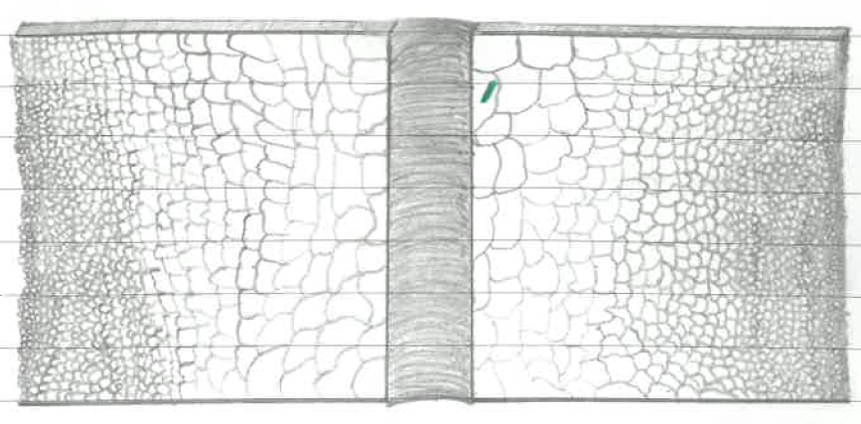
Case Study Exercise 2: Possible Causes of Corrosion (Welding)
One possible cause of film breakdown is microstructural change to/defects caused in the passive film caused by the weld, explaining high number of pits in the weld region.
Grain structures will be altered during welding.
The larger grain structure is harder with lower ductility and more susceptible to cracking.
Green area symbolises a crack.

Slide 12
Case Study Exercise 2: Possible Causes of Corrosion (Welding)
Cleanliness is key when welding titanium as it only has a tolerance of 0.3% oxygen, 0.15% Nitrogen and 150 parts/million of hydrogen.
A sufficient gas shield should be used.
The room should be atmospherically controlled.
Air velocity should be low enough to not cause any disturbances to the shielding gas.
All tools and workspaces should be cleaned.
Heat input should be low/high enough for the thickness of the material.

Slide 13
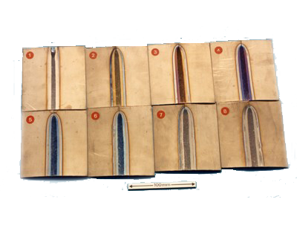
Case Study Exercise 2: Possible Causes of Corrosion (Welding)
Visual inspections of the weld are important as certain colours indicate signs of atmospheric Contamination.
Silver - Acceptable
Straw - Acceptable
Dark blue - Acceptable depending on service conditions.
Light blue/powdery white - Unacceptable.

Slide 14
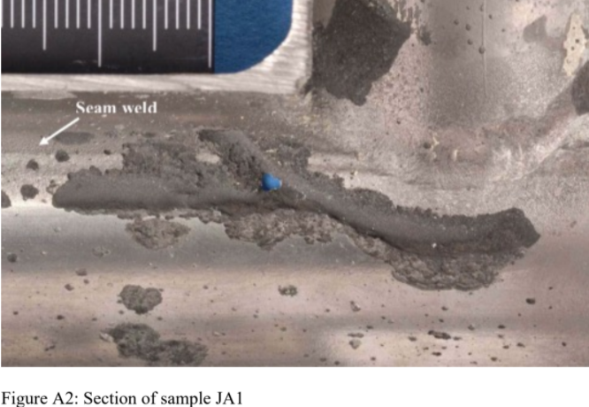
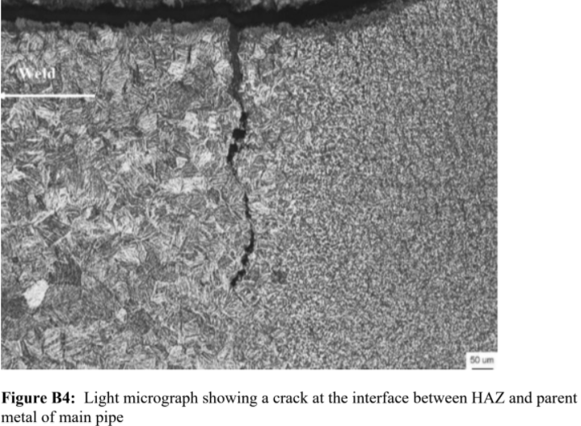
Case Study Exercise 2: Possible Causes of Corrosion (Welding)
Each failure occurred at a branch weld.
Both leaks were within the welds heat affected area.
Figure A2 shows the corrosion following the weld.
Figure B4 shows the micrograph of the crack.
The material was weakened during the welding process.
Notes:
Josie
For the mitigation processes we looked at if we are mentioning the cathodic protection can we add the below:
Cathodic Protection was considered as a long-term method however it is not possible to put a sacrificial anode in the pipe as the MEG line is operating in temperatures between 120 and 135 degrees Celsius. High temperature Zinc anodes only work in environments up to 90 degree Celsius. Magnesium and aluminium anodes are not often used in high temperatures.

Slide 15
Case Study Exercise 2: Possible Causes of Corrosion
Aggressive corrosive conditions
O₂ ingress
CORROSION
  Challenging corrosive environment for corrosion
  Close to operating limits of titanium 12
  Welded, thin pipes –susceptible areas to corrosion failure
  Changes the process conditions
  Oxidation of MEG can form organic acids
  Species for corrosion reactions to occur
  Combination of temperature, pH, salt and O₂ causes film breakdown
  Attack in HAZ region of weld
  Accelerated attack in pits and possible hydrogen cracking
  Cracking observed due to microstructural changes in HAZ

Slide 16
Case Study Exercise 3: Corrosion Risk Assessment
Risk = Probability × Consequences of Failure
Likelihood | Qualitative
1 | Never heard of in the industry
2 | Known possibility
3 | Has happened in the Organisation
4 | Has happened at the location
5 | Has happened more than once at the location
CoF | Safety | Production | Environment
A | No harm | No disruption | No residual impact
B | Minor Injury | Brief disruption to Production | Minor impact
C | Major Injury | Partial short-term shutdown | Localised but major impact
D | 1-2 Fatalities | Undefined shutdown | Severe impact
E | >2 Fatalities | Substantial plant loss | Extreme impact

Slide 17
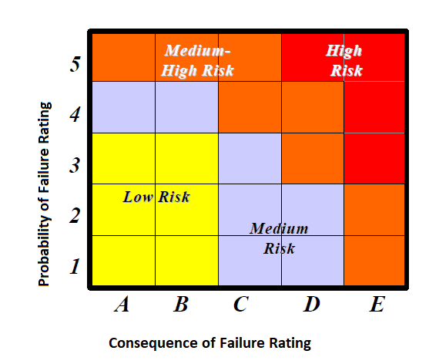
Case Study Exercise 3: Corrosion Risk Assessment
Consequence - B
Probability - 4
Extended down time could increase consequence.

Slide 18
Case Study Exercise 4: Short Term Mitigation Options
Short Term Mitigation Options
Patch/clamp
Replacement spool
Oxygen scavenging
Notes:
Include detail
Sam

Slide 19
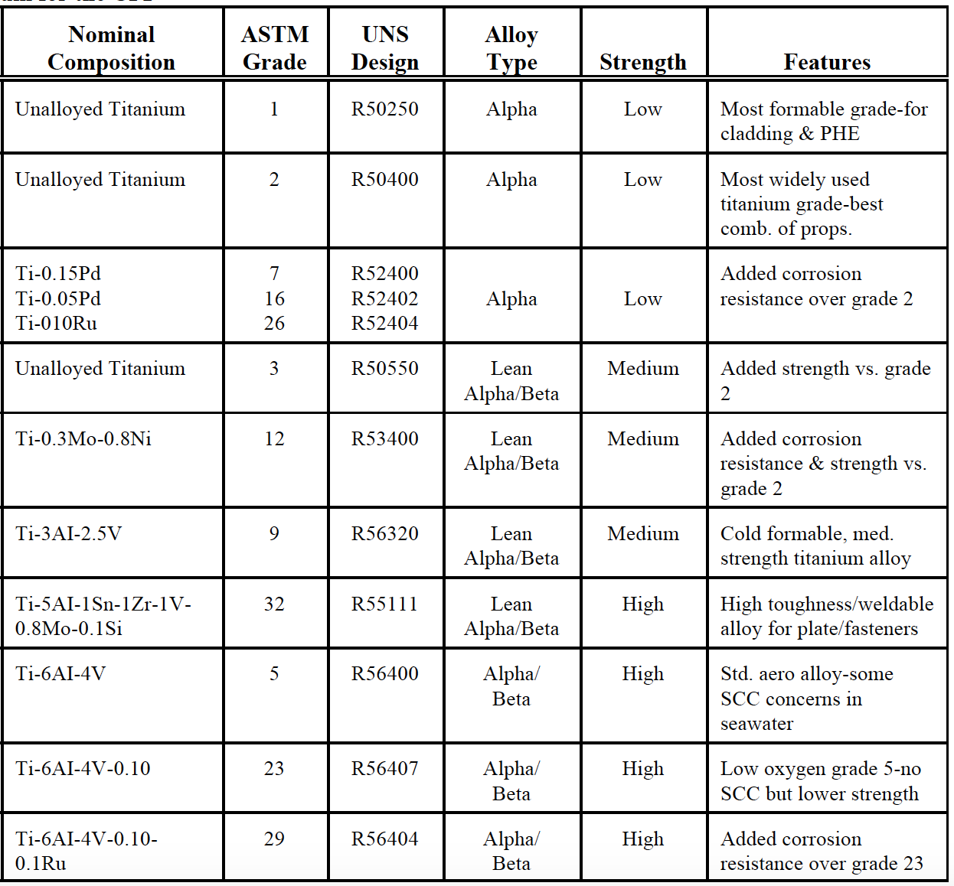
Case Study Exercise 5: Materials
Notes:
Thomas 2003: TITANIUM IN THE GEOTHERMAL INDUSTRY
Sam

Slide 20
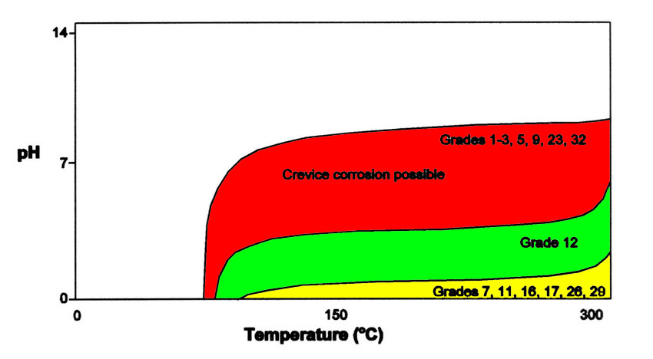
Case Study Exercise 5: Materials

Slide 21
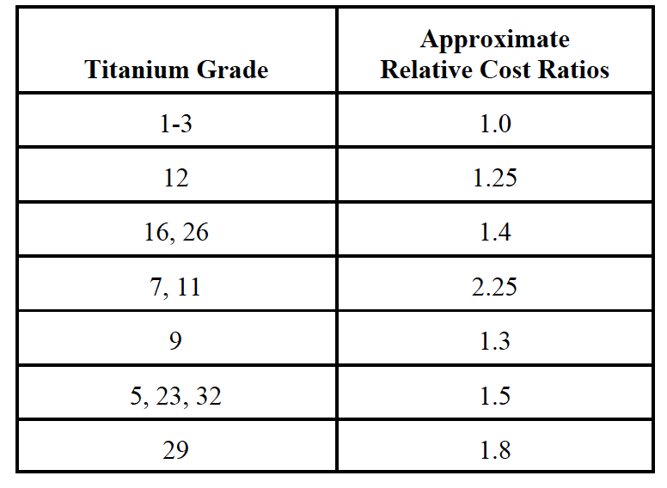
Case Study Exercise 5: Materials
Grade 7 or 11 titanium could be better alternatives – better resistance to crevice corrosion
Grade 7 also has good resistance to crevice corrosion in deaerated environments

Slide 22
Case Study Exercise 5: Materials
GRP (or GRP-lined) pipe possible alternatives
Removes galvanic corrosion chemistry
Cost ~1.9x carbon steel
Would be good option for new plant – offers reduced OPEX
Less financially beneficial for brownfield

Slide 23
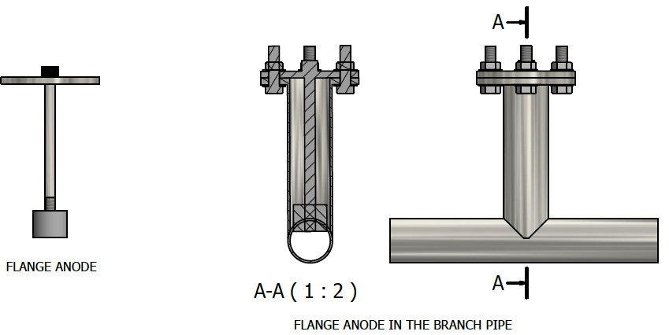
Case Study 6: Long Term Solutions
Oxygen scavenger injection into the Lean MEG Tank and high purity nitrogen blanketing to mitigate the risk of oxygen ingress
Improved Pump seals – API 53B
Spiral wound gaskets for vacuum service
Nitrogen purge on centrifuge
Desalinated water flush at stagnation points
Closed sampling points
Internal Resistor Controlled Cathodic Protection – however temperatures too high in this system (e.g. zinc anodes only work up to 90°C)

Slide 24
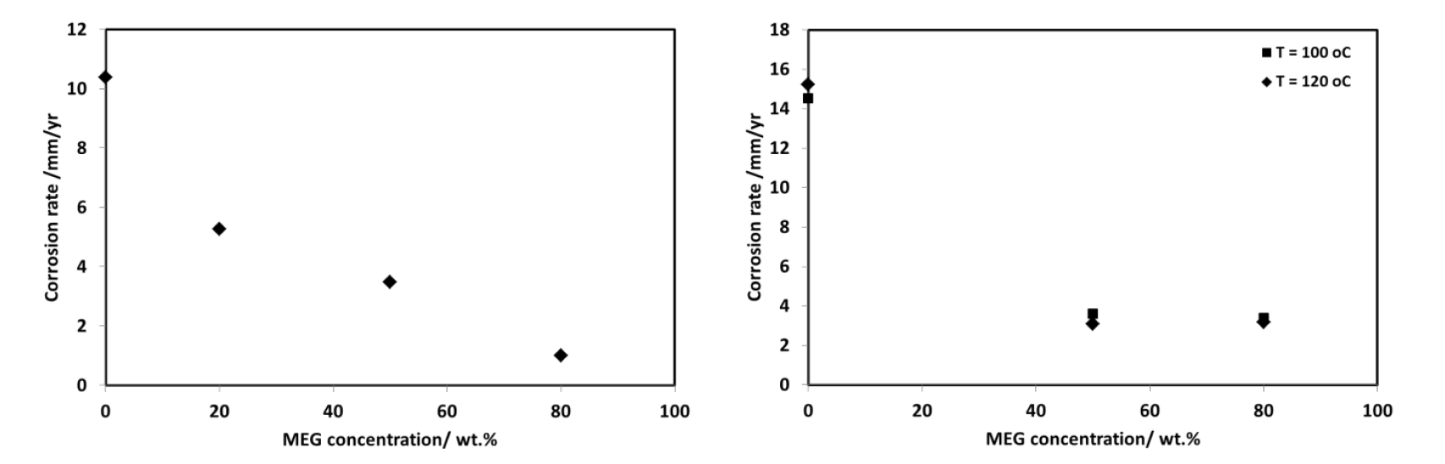
Case Study 6: Long Term Solutions
Carbon steel (ASTM A106 Gr.B) could be used as a significantly more cost effective and realistic solution for the pipe spools – easily replaceable and thicker pipes could be used
Isolation gaskets to prevent galvanic effects with Ti components
MEG stream contains up to 2,500 ppm of CORRTREAT corrosion inhibitor
MEG itself can also inhibit corrosion of carbon steel
80 °C

Slide 25
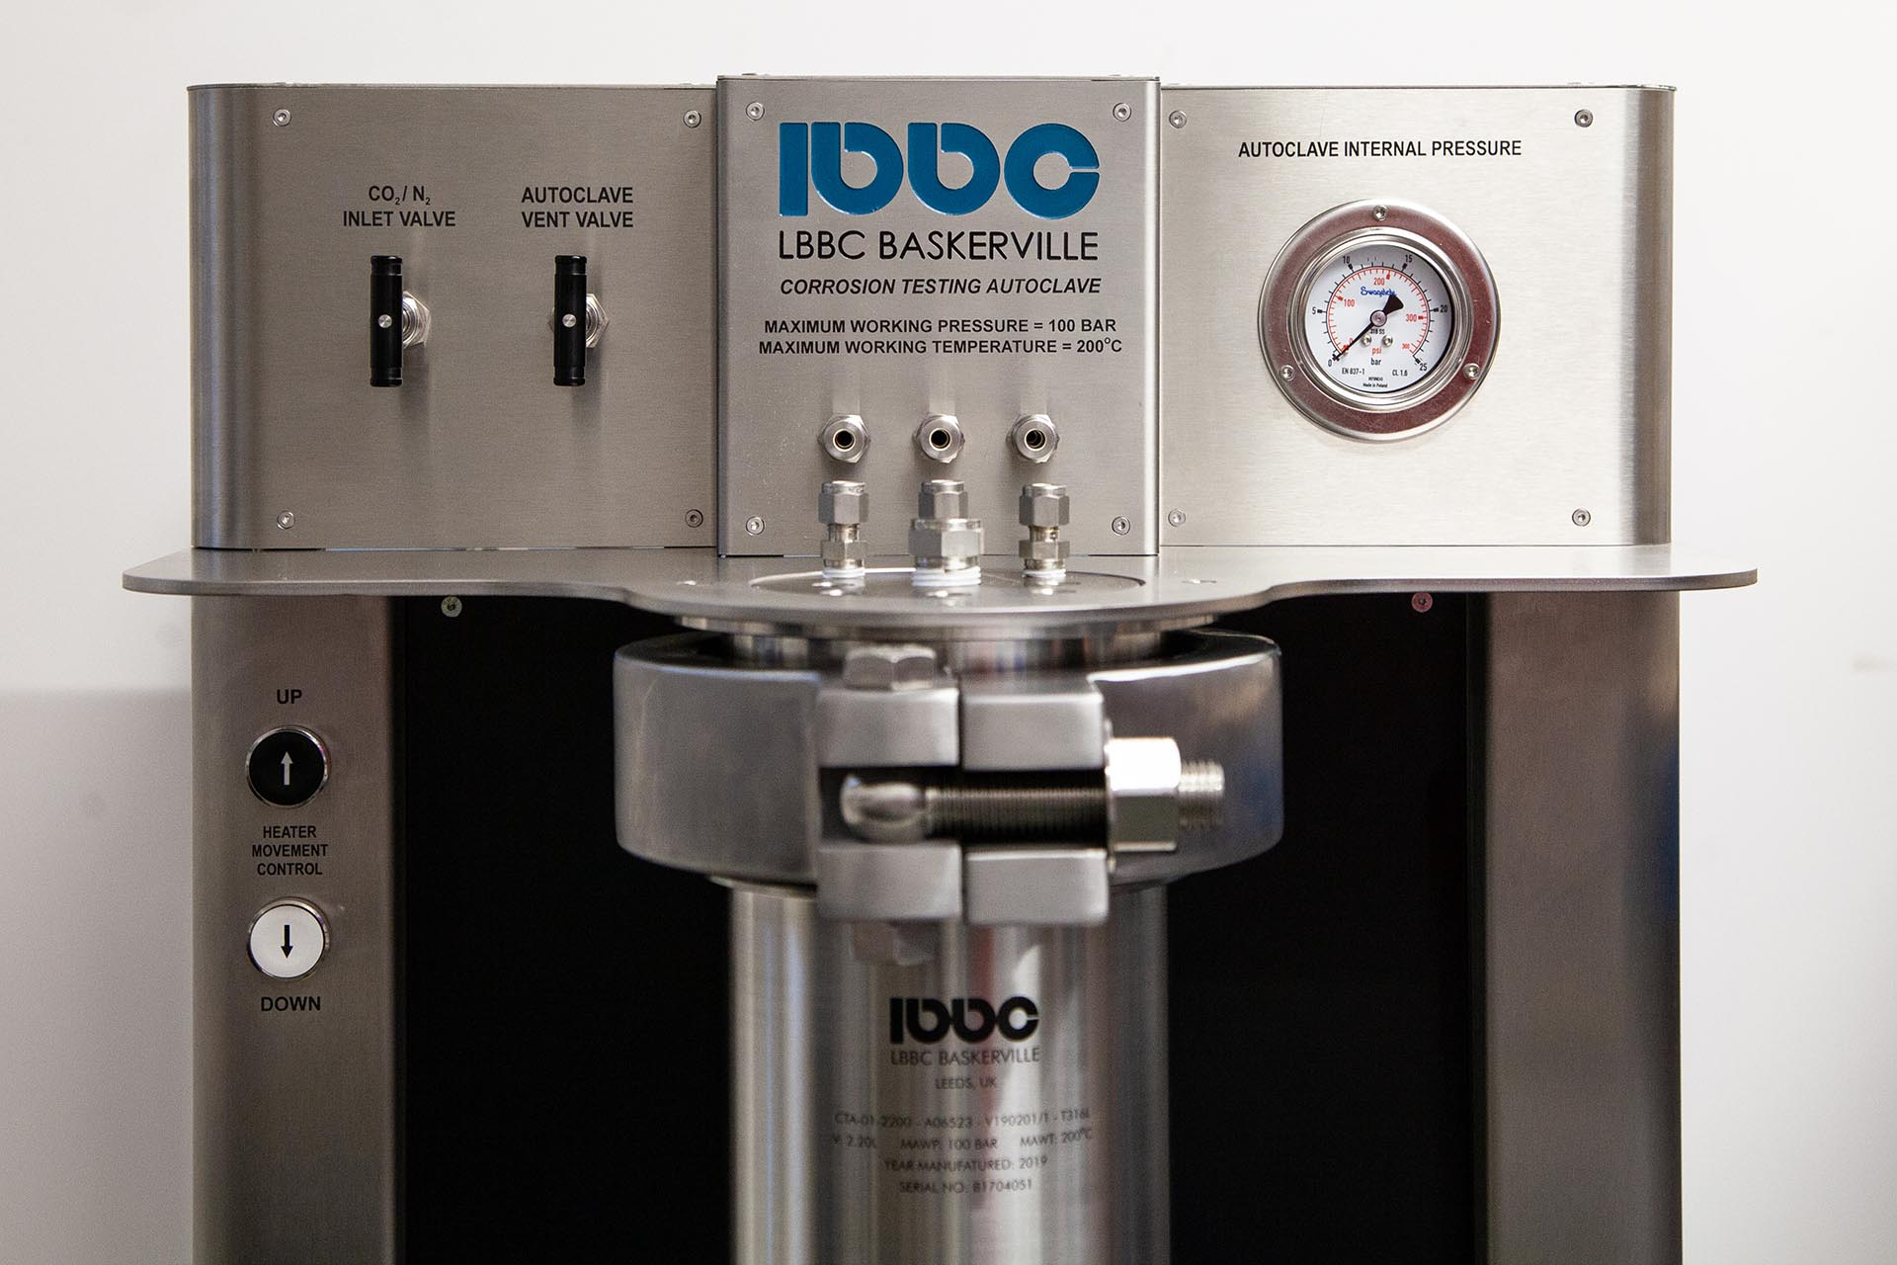
Case Study 6: Long Term Solutions
Corrosion would be expected in these conditions requiring replacement, however MEG and inhibitor may reduce corrosion rates
Experimental screening to determine corrosion rates in this system could be completed to evaluate life span of carbon steel components
Autoclave tests
Capable of 130 °C
Conditions easily replicated
Variable inhibitor and MEG concentrations
Measure corrosion rates of carbon steel
Possible to use a rotating cage setup to measure flow effects

