Slide 1
YEP Case Study
Team Barraclough
Thursday 12th November 2020

Slide 2
Team Barraclough
James McGladdery
Materials Engineer - KBR
Jake Taylor
Materials & Corrosion Technician - Intertek
Lewis Timmons
Offshore Materials Engineer – Worley Parsons
Shanzeh Khurshid
Mechanical Engineer – BP Chemicals

Slide 3
The Situation
Two leaks were identified in a section of Gr. 12 Ti piping in an onshore glycol desalination plant.
Our task:
  Causes of the failure
  Immediate repair solutions
  Long term repair solutions

Slide 4
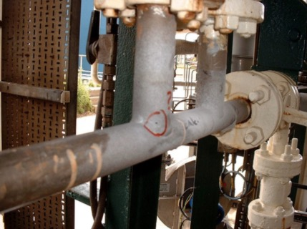
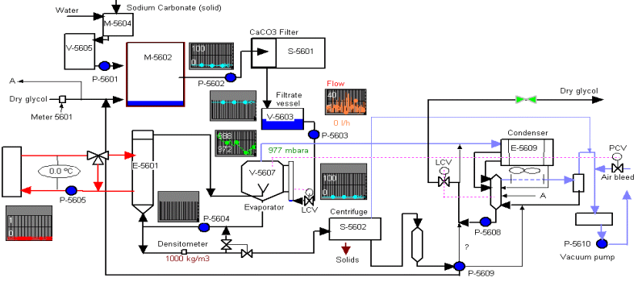
The Problem
Notes:
The leaking pipes were located in the Evaporator (V-5607) section of the desalination plant where salt (mainly sodium chloride) is separated from the lean glycol:
One leak occurred in a 28.5mm diameter pipe in the recycle line from V-5607 to the E-5601 Calandria (in the vicinity of a sampling point and pressure indicator).
Another leak occurred in a 33.4mm diameter 1.65mm thick pipe in the drain offtake from the Calandria to the S-5602 Centrifuge (Figure 3).

Slide 5
Key Info
Material
~ 1 inch ~ 1.6 mm
1 mm hole at the toe of a branch weld
Process Fluid
MEG slurry containing < 25wt% NaCl₂
Potential organic acids
“Minimal water”
Process conditions
120 – 135 °C
1.5 bar(a)
ASTM B861 Ti Grade 12
Acidic pH

Slide 6
The Solution…

Slide 7










1. Further Info
2. Root Cause
3. Risk Assessment
4. Mitigation
5. Materials

Slide 8
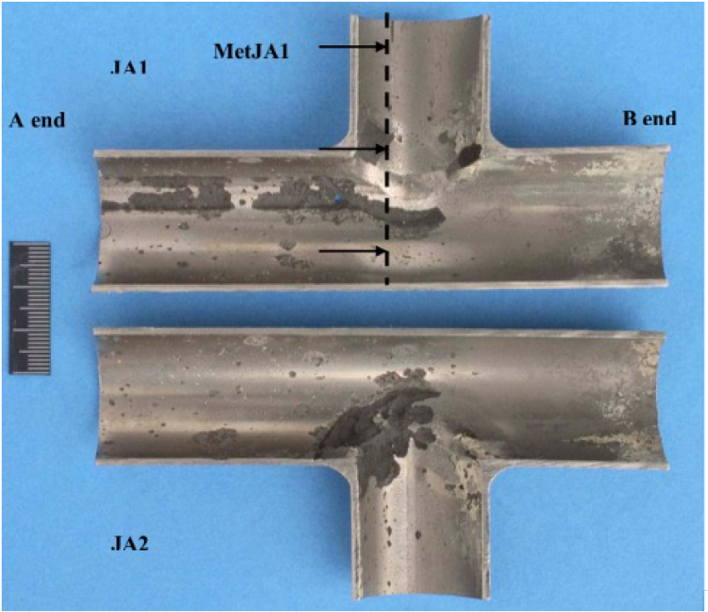
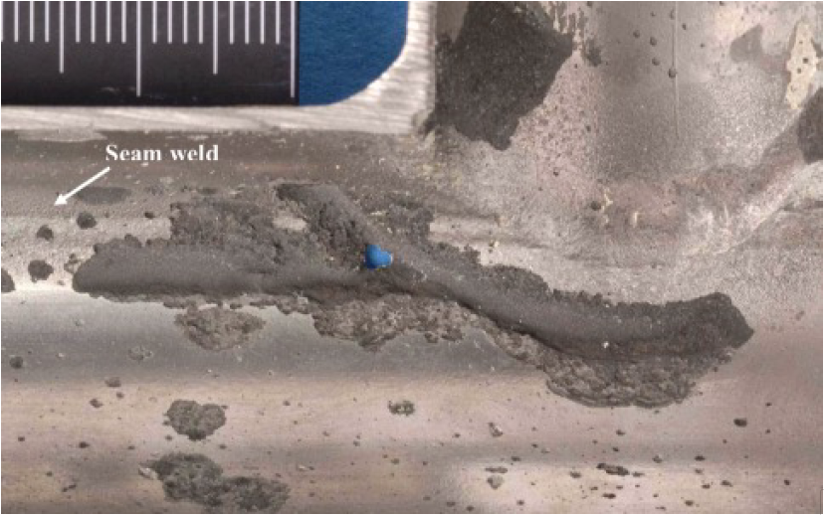
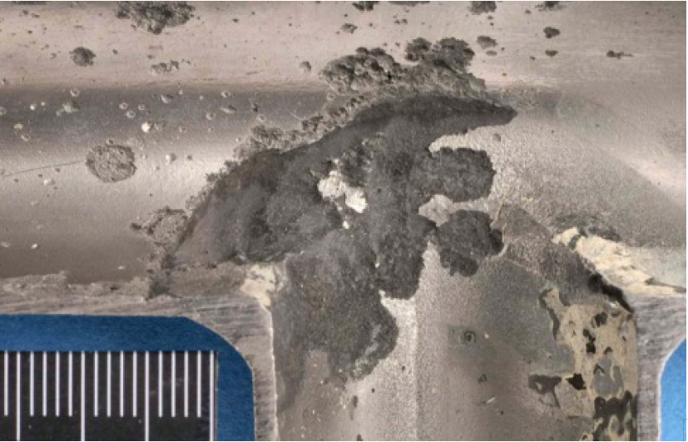
Material
Specification & Sample | Element (Wt. %)
 | C | Al | Fe | H | Mo | N | Ni | O | V | Ti
ASTM Gr. 12 | 0.08 | NS | 0.30 | 0.015 | 0.2 – 0.4 | 0.03 | 0.6 – 0.9 | 0.25 | NS | Remaining
Main Pipe | 0.012 | <0.01 | 0.08 | 0.0068 | 0.29 | 0.016 | 0.75 | 0.18 | <0.01 | Remaining
Weld | 0.021 | 0.02 | 0.11 | 0.0058 | 0.29 | 0.014 | 0.75 | 0.18 | <0.01 | Remaining
Branch | 0.009 | 0.02 | 0.13 | 0.0058 | 0.29 | 0.013 | 0.77 | 0.16 | <0.01 | Remaining
Notes:
Notice the discolouration and pitting distributed across the inside of the section, with a bias towards the left of the branch (assumed this is upstream of the branch in terms of the process flow)
This damage appears to be focussed around the welds and weld interfaces – along both the seam weld and the branch weld. Also there is particular damage and the hole located on the corner of the branch weld
Of note, we saw that the branch weld and the seam weld overlap, which by any normal weld procedure, should not have happened. Hence we asked for records of the WPS and fabrication records.
The fact that the material selection was changed from Gr 2 to Gr 12 also made us wonder if the incorrect weld consumable had been used.
However, the chemical analysis revealed that this was not the case and we were informed that the quality of the weld was not an underlying cause of the failure.

Slide 9
Salt Analysis
Production Data
Salt produced/day | 2000 kg
Percentage of salt | 25 wt%
Density | 1000 kg/m³
Velocity | 11 m/s
Flow (Q = A*V) | 0.00964 m³/s
Mass flow rate | 9.64 kg/s
Salt flow rate (by wt%) | 2.41 kg/s
Salt produced per hour | 867 kg/h
Time running to produce 2 tons | 2.31 h
Sample | 9500504 (ex plant) | 9500505 (filter cake)
Sodium Chloride | 92.7% | 5.7%
Sodium Carbonate | 0.9% | 4.4%
MEG | 4.2% | 37.9%
Water | 1.8% | 22.2%
Potassium Chloride | 0.1% | 0.2%
Calcium Carbonate | 0.2% | 16.3%
Magnesium Carbonate | 0.1% | 0.5%
Strontium Carbonate | -- | 0.5%
Iron Oxide | -- | 0.5%
Sodium Bromide | -- | 0.3%
Chemically Bonded Water | -- | 5.6%
Wt of Solids in Water Solubles (g) | 7.87% | 9.90%
Volume of Water Solubles (ml) | 250 | 250
pH of Water Solubles | 9.75 | 10.38
Water Insolubles | 0.27% | 21.6%
Production Data
Salt produced/day | 2000 kg
Percentage of salt | 25 wt%
Density | 1000 kg/m³
Velocity | 11 m/s
Flow (Q = A*V) | 0.00964 m³/s
Mass flow rate | 9.64 kg/s
Salt flow rate (by wt%) | 2.41 kg/s
Salt produced per hour | 867 kg/h
Time running to produce 2 tons | 2.31 h
Sample | 9500504 (ex plant) | 9500505 (filter cake)
Sodium Chloride | 92.7% | 5.7%
Sodium Carbonate | 0.9% | 4.4%
MEG | 4.2% | 37.9%
Water | 1.8% | 22.2%
Potassium Chloride | 0.1% | 0.2%
Calcium Carbonate | 0.2% | 16.3%
Magnesium Carbonate | 0.1% | 0.5%
Strontium Carbonate | -- | 0.5%
Iron Oxide | -- | 0.5%
Sodium Bromide | -- | 0.3%
Chemically Bonded Water | -- | 5.6%
Wt of Solids in Water Solubles (g) | 7.87% | 9.90%
Volume of Water Solubles (ml) | 250 | 250
pH of Water Solubles | 9.75 | 10.38
Water Insolubles | 0.27% | 21.6%
Sample | 9500504 (ex plant) | 9500505 (filter cake)
Sodium Chloride | 92.7% | 5.7%
Sodium Carbonate | 0.9% | 4.4%
MEG | 4.2% | 37.9%
Water | 1.8% | 22.2%
Potassium Chloride | 0.1% | 0.2%
Calcium Carbonate | 0.2% | 16.3%
Magnesium Carbonate | 0.1% | 0.5%
Strontium Carbonate | -- | 0.5%
Iron Oxide | -- | 0.5%
Sodium Bromide | -- | 0.3%
Chemically Bonded Water | -- | 5.6%
Wt of Solids in Water Solubles (g) | 7.87% | 9.90%
Volume of Water Solubles (ml) | 250 | 250
pH of Water Solubles | 9.75 | 10.38
Water Insolubles | 0.27% | 21.6%
Production Data
Salt produced/day | 2000 kg
Percentage of salt | 25 wt%
Density | 1000 kg/m³
Velocity | 11 m/s
Flow (Q = A*V) | 0.00964 m³/s
Mass flow rate | 9.64 kg/s
Salt flow rate (by wt%) | 2.41 kg/s
Salt produced per hour | 867 kg/h
Time running to produce 2 tons | 2.31 h
Notes:
Plant is designed to handle 2.5 wt% solids

Slide 10
Process Fluid
1 year of vacuum leak
=
Increased O₂ at > 4000 ppm
Thermal degradation of MEG
=
Organic acid formation ~ 600 ppm
Bicarbonate content ~ 290 ppm
22.2 % water
Notes:
The examination revealed that the spool had suffered internal corrosion which was most severe in the outer parts of the HAZ of welds joining tubes and the main seam welds

Slide 11
Erosion
Ti oxide (230 Gpa) is brittle compared to the Ti substrate (115 GPa) [1]
Dynamic slurry solutions accelerate erosion-corrosion [2] (tested at 12.8 m/s, 100 g/l conc. NaCl)
The short operation times limit repassivation window
Production Data
Salt flow rate (by wt%) | 2.41 kg/s
Salt produced per hour | 867 kg/h
Time running to produce 2 tons | 2.31 h
Notes:
Considering the high temperature, high salinity and acidic process conditions, Grade 12 Ti was chosen – typically used when there is a risk of pitting and crevice formation in which lower grades if Ti would not suffice.
Gr 12 Ti works so well in these conditions because it forms an oxide layer with logarithmic growth (passivating layer). This is where a lot of Ti’s resilience comes from.
The addition of Mo and Ni increase the protection given by the oxide layer and the passivity of the Ti alloy.
Some recent research shows that Ti used in desalination plants DO NOT suffer erosion and cavitation up to 36 m/s. However, in more recent studies [as referenced above] slurries similar to that in this instance have caused accelerated rates of oxide layer breakdown. This paper also found that the way in which erosion is tested has a significant impact on the erosion velocity limit.
Ultimately, we are suggesting that the flow rate of the salt suspended in solution is likely to have caused such erosion, particularly around areas of high turbulence, such as that found around the branch weld – as demonstrated in both right-hand figures. This has relinquished the Ti of its protective layer.
Re-passivation of the Ti substrate is limited due to the short window of operation in which the Ti would be exposed to the 22% water content and the oxygen from the ingress, leaving the Ti exposed to corrosion.
Furthermore, the same study found that areas of oxide crystallisation growth reduced the corrosion resistance of the base material, as the creation of new grain boundaries have shown lower resistance pathways for ion transportation.
Additionally, at the operating temperatures in which any oxide would reform, it would reform in the crystal form of anatase, which is known to have reduced corrosion resistance compared to Rutile
Essentially, the titanium becomes more susceptible to pitting and crevice corrosion once it has been erode and is trying to repair itself.
What may ordinarily be conditions in which Gr 12 is suitable may become at risk during the erosion-corrosion process.

Slide 12
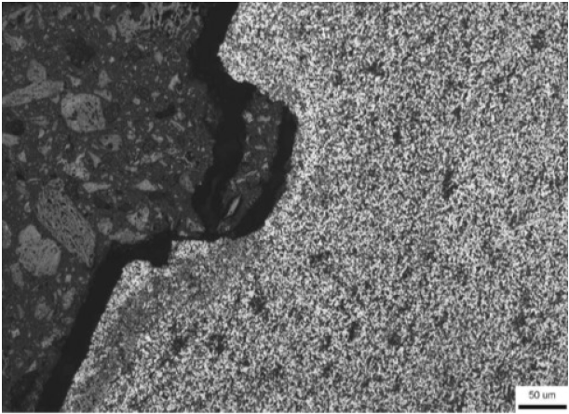

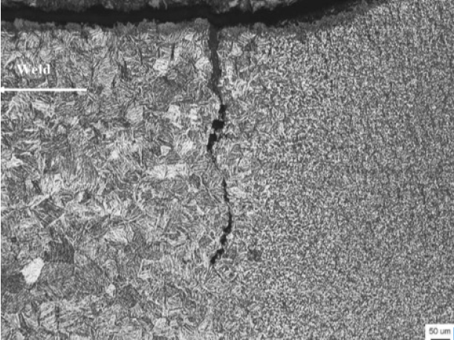
Crevice Corrosion
Gr 12 is typically resistant to crevice & pitting corrosion
In the presence of organic acids > 100°C, pitting CAN occur. Particularly in the presence of Cl⁻ ions [3]
Risk of crevice corrosion is increased above 70°C in gaps ≤ 50 µm [4,5]
Salt Deposit
O₂
O₂
O₂
Cathode
Cl⁻
Cl⁻
Cl⁻
e⁻
Cl⁻
e⁻
Anode
Notes:
So, what we know so far is that the inside of the pipe is eroding exposing raw Ti, there is higher than expected levels of water, and there is an oxygen leak causing the residual MEG to thermally degrade into a cocktail of organic acids … and of course lots of salts.
Higher magnification images show that there is corrosion damage in the form of pits at the boundary between the HAZ and the base metal. Such a zone is likely to have higher levels of residual stress and is more anodic. However, pits have been observed across the cross-section provided.
This is supported by the literature which has found pitting corrosion to occur in the presence of high concentrations of organic acids, at temperature above 100 C. Furthermore, there is research to suggest that the risk of crevice corrosion is increased in operating conditions such as these.
We believe the root cause is the oxygen ingress which has led to the formation of these organic acids, which due to the depleted oxide layer from the erosion, has caused a crevice to form at the interface of the branch-seam weld HAZ region., as seen in the lower right hand image.

Slide 13


Differential Aeration Cell
${Ti}^{4+}+{2H}_{2}O→{{[Ti(OH)}_{2}]}^{2+}+{2H}^{+}$
[3]
${Ti}^{4+}+{4H}_{2}O→{Ti(OH)}_{2}+{4H}^{+}$
Ti⁺
O₂
O₂
O₂
Salt Deposit
Cathode
Cl⁻
Cl⁻
Cl⁻
e⁻
Cl⁻
e⁻
Anode
Notes:
This crevice corrosion has formed what is known as a differential aeration cell, in which oxygen is depleted from inside the crevice and active at the surface. Chlorides also get trapped in the stagnant flow of the crevice, driving down the pH further. This causes the crevice and oxide to form a galvanic cell, further depleting Ti ions from the crevice which is unable to form an oxide and recover, leading to an accelerated corrosion.
At the same time, the Ti+ ions react with the water to form Titanium hydroxide and hydrogen ions

Slide 14
Root Cause
O₂ Ingress = Acid Formation
Erosion Assisted Oxide Breakdown
Crevice Corrosion
Salt Deposits

Slide 15
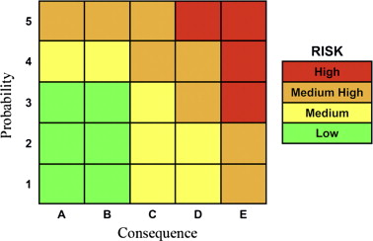
Risk Based Inspection (RBI)
Increased risk
RBI combines the qualitatively assessed likelihood of risk/failure against the consequences with-in a ‘Likelihood Consequence Matrix’.
Increased probability/likelihood
Increase in severity of consequence
[10]
Notes:
Risk can be defined as a mathematical expression designed to combine probability/likelihood and consequence.
Results can often be displayed on a simplistic “3-by-3 X-Y” risk matrix.
A more optimal tool when looking to examine equipment in an industrial setting.
The process of developing inspection-based knowledge of the risk of failure by ways of a ‘Risk analysis’ with use of tools such as an ‘RBI Matrix’..

Slide 16
RBI: Step by Step
Step 1
Hazard identification through detailed plant/site inspection.
Step 2
Decide implications of hazard, risks and failures: (who or what might be harmed)
Step 3
Evaluate risk and decide on precautions with use of an RBI Matrix
Step 4
Step 5
Record findings and implement them (integrity plans/scope)
Review and update RBI when/if necessary

Slide 17
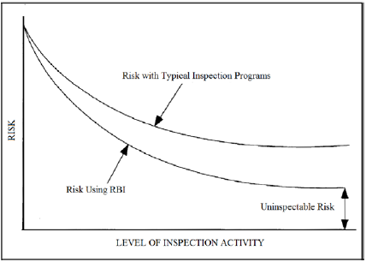
RBI Benefits
Risk Based inspections are more thorough and therefore leave fewer stones unturned when designating what constitutes as a ‘Risk’.
[11]

Slide 18
Potential Causes for Risk & Failure
Inadequate design/material
Integrity & Scope
NDT on material preservice or during service (proficiency testing?)
Incorrect/defective manufacture
System/computer-based errors
Unanticipated material deterioration (Corrosion or fatigue cracking)
Basic malfunction of equipment
Human error/sabotage
External events (fires/storms/water damage)
More frequent machine maintenance
Cleaning of work areas during system down time
Flushing the system with adequate cleaning solution
Staff training more readily available

Slide 19
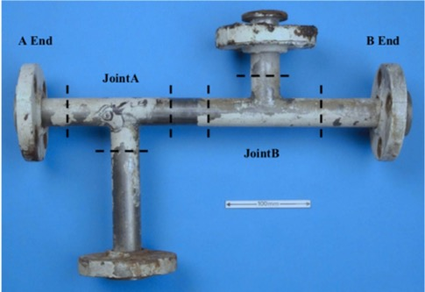
Short Term Mitigation - Patch
Metal patch with fastened bands
Compatible with pipe material and process conditions
Can be applied on the run whilst process is running
Applied by leak repair specialists
Can be designed to last days - weeks
RT of the pipe will have to be done prior to ensure patch is fastened on sufficiently thick pipe section
Notes:
But we don’t recommend it to be applied OTR as plant only needs to be operational 2 hours a day and the company has a strong safety policy, so unnecessary risk to place someone on a leak
Leak repair specialists such as TEAM Furmenite, etc.
Good short term solution as it:
immediately seals the leak
Is quick to do, esp as low pressure leak
Relatively inexpensive

Slide 20
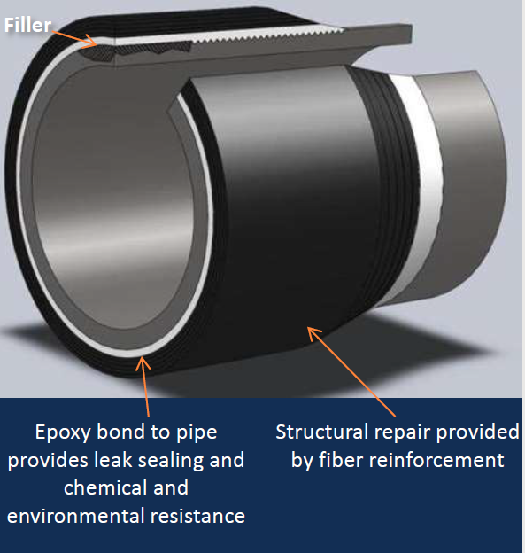
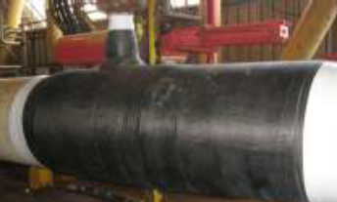
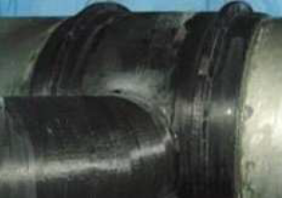
Medium Term Mitigation – Composite Wrap
Advantages
Carbon fibre composite wrapped around awkward T pipe shape
No prefabrication required
Simple and fast to apply and set – within a day
Not hot work required
Strengthens structure of pipe as well as plugs leak
Can last up to 5 years in current process conditions
Limitations
Leak must be stopped for this application
Surface based inspection techniques not possible to gauge state of original pipe once wrapped
Notes:
As composite wraps are most suitable as a preventative measure (but can be used as a reactive measure over the patch as well), although it would work in this case, we recommend the focus on the leaking area be to replace the pipework as soon as possible, especially as the plant can have a significant amount of downtime in the day.
Therefore extending its life by a few years shouldn’t be the priority as the patch will hold the leak in by a few weeks anyway.
However as there may be other areas where corrosion has caused thinning titanium pipework at risk of leaking shortly, this would be a very suitable preventative measure to extend the lifetime of those other pipes.

Slide 21
Material Selection in Desalination Plants
1st Generation
Carbon Steel
2nd Generation
Stainless Steels
2nd Gen +
Titanium
Notes:
Thanks Shanzeh, now we are going to take a look a material selection in desalination plants.
If we look at the first generation of desalination plants, carbon steel was initially used for equipment, structures and piping due to its availability and being relatively inexpensive.
The corrosion behaviour of CS was largely understood and so it was fitted with heavy allowances as a solution with the view of replacing it regularly.
In second Generation plants, a greater understanding of the operating conditions had been gained and the consequences they had on materials. Improved manufacturing technology led to reduced costs and so material selection moved to stainless steel.
The development in materials meant that the design life of plants increased and with this came the use of titanium.
An increase in titanium was observed particularly for tubing due to its known erosion and corrosion properties. Its application saw significant reduction in tube weights and installation cost.

Slide 22
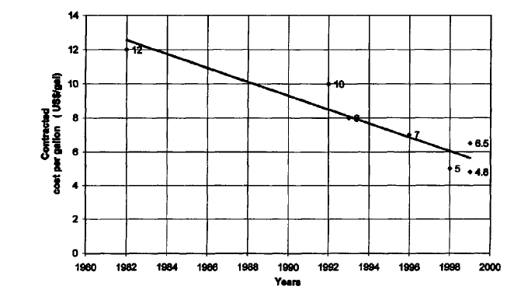
Material Selection in Desalination Plants
[12]
Notes:
A quick look at the installation cost trend in desalination plants from the 1960s to 2000’s shows that the price of installed material has decreased significantly.
Although largely this is a result of economy of scale, material selection upgrading has also taken place.
Although the cost of titanium is around 30 times that of CS for the same weight, the strength properties of titanium allows it to be thinner- which actually results in the installation cost being 10 times more expensive than that of CS.
In any case the second generation of desalination plants were expected to achieve a design life of 40 years with minimum maintenance and overhauling.
The utilisation of stainless steels and titanium allowed this to happen.
Forty-year design life: the next target
Material selection and operating conditions in thermal
desalination plantsCorrado Sommariva*, H. Hogg, K. CaUister

Slide 23
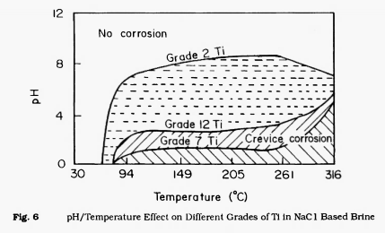
Titanium Gr 12
[13]
Notes:
Moving forward we have decided to replaced the failed spool with the same material- titanium grade 12.
We had considered carbon steel and copper nickel alloys, however from industry research there have been a significant number of failures in desalination plants where these materials have been used.
We know that titanium grade 12 is the most suitable material to withstand the acidic MEG, high salinity and high temperature.
The graph on the slide depicts the effects of pH and temperature for grade 2 ti, grade 12 and grade 7.
We can see that titanium grade 2 shows a larger susceptibility to corrosion and crevice corrosion over a wider pH range than grade 12
Gr7 could also be an option, however to continue a reduced capex approach we believe grade 12 is more suitable and widely available compared to speciality titanium grades. Due to The higher strength than Grade 2 or Grade 7 at room and elevated temperatures gr 12 allows material and cost saving through use of thinner sections.
Whilst gr 7 is shown to be more resistant to crevice and pitting corrosion in saline process conditions we believe that this just follows the complacent trend that led to the failure in the first place. A fit and forget with no further monitoring of the process.
As I mentioned earlier with 1st generation plants moving away from CS, the graph on the right hand side shows the decrease in installed material weights, showing that more and more stainless steel and titanium is being utilised in these plants to withstand harsh process conditions.
This incorporation displays lighter equipment weights and costs whilst at the same time ensuring a better performance against corrosion and erosion.

Slide 24
Inspection and Testing of New Fit
pH & O₂ Probes
Acoustic Monitor
Radiographic Testing
Forged Spool & Seamless Pipe
Notes:
Utilising titanium grade 12 again due to its enhanced corrosion properties and strength is all fair and well however we must ensure that protocols are in place to mitigate a failure from happening again.
Implementing a comprehensive inspection and monitoring plan allows us to resolve the KEY issues and the actual root cause of the problem that lead to the corrosion in the first place. The selection of grade 7 titanium would effectively just be adding a titanium corrosion allowance by specifying a more expensive solution.
So how can we monitor/inspect the process fluid to check if this oxygen ingress and MEG breakdown is happening again?
The utilisation of pH and oxygen probes can monitor the process fluid for acidity and oxygen, which if either is present will suggest there is an issue upstream.
In addition acoustic monitoring at opposite ends of the pipe and ultrasound will be used to check for erosion and wall thinning.
To reduce turbulence, corrosion and erosion in the process, we can improve the pipe geometry by using a forged spool and flanges instead of welded connections. Also ensuring the procured pipe is seamless providing uniform material characteristics throughout the system.
The inspection and testing plans of plants can be an expensive operation and we believe that by inspecting the pipes where there were no failures we could possible salvage part of the spool and have a phased capex.

Slide 25
Summary
O₂ ingress
↓
Acid formation
↓
Crevice corrosion
Risk probability x criticality matrix
↓
Risk based inspection program
Short term: Patch
↓
Long term: Ti Gr. 12 replacement & inspection plan

Slide 26
References
J Zhou, S. Bahadur. Erosion-corrosion of Ti-6Al-4V in elevated temperature air environment. Wear; 186; 1995.
Y Liu, et al. Localized instability of titanium during its erosion-corrosion in simulated acidic hydrometallurgical slurries. Corrosion Science; 174; 2020.
D Prando, et al. Corrosion of titanium part 1: aggressive environments and main forms of degradation. Journal of Applied Biomaterial Functional Materials; 15(4); 2017.
X He, et al. Electrochemically induced pitting corrosion of Ti anode: Application to the indirect reduction of bromate. Journal of Chemical Engineering; 289; 2016.
MI Abdulsalam, et al. Crevice corrosion of titanium in high temperature concentrated chloride environments. Journal of Materials Engineering and Performance; 16; 2007.
HJ Christ, et al. Effect of hydrogen on mechanical properties of β-titanium alloys. Sadhana; 28; 2003.
D Eliezer, TH Böllinghaus. Hydrogen effects in titanium alloys. Gaseous Hydrogen Embrittlement of Materials in Energy Technologies; 2; 2012.
E Tal-Gutelmacher, D Eliezer. The hydrogen embrittlement of titanium-based alloys. The Journal of The Minerals, Metals & Materials Society; 57; 2005.
RW Schutz. Utilizing titanium to successfully handle chloride process environments. CM Bulletin; 2002.
J Shui. Risk based inspection for large crude oil tanks. Journal of Loss Prevention in the Process Industry; 25; 2012.
W Sorares, et al. Risk-based inspection in the context of nuclear power plants. International Nuclear Atlantic Conference; 13; 2015.
C Sommariva, C Hogg, K Callister. Forty-year design life: the next target material selection and operating conditions in thermal desalination plants. Desalination; 136; 2001.
C De. Use of titanium and its alloys in sea-water service. High Temperature Materials and Processes; 11(1-4); 1993.

Slide 28
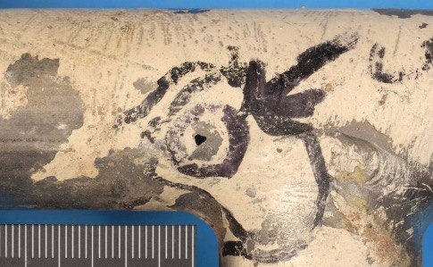
Further Info

Slide 29
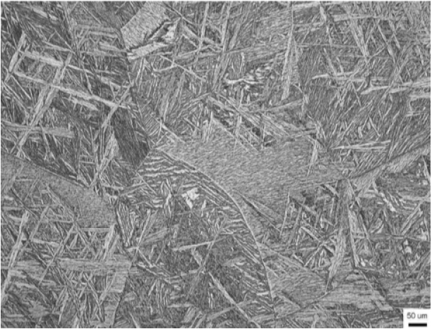
Hydriding
Ti hydriding needs:
  Low pH, typically < 3
  Temperature > 80°C
  Source of hydrogen
Higher susceptibility in Gr 12 Ti, due to beta phase [3,6-8]
Matt silver-grey appearance [9]
Notes:
Beyond crevice corrosion, it is possible that the formation of brittle titanium hydrides has occurred within the crevice to cause a potential cracking mechnanism
We know we are at low pH, the temperature is above the hydriding threshold, and we have identified a potential source of hydrogen due to the differential aeration cell.
We also know that Gr 12 is a mix of both alpha (equiax grains) and beta (lamella needles inside the alpha grains) phases in the microstructure due to the Mo in Gr 12 acting as a beta former (particularly in the regions around the weld and HAZ – hence why the failure has occurred at the intersection between the branch and the seam.
Critically, the beta phase has a much higher diffusivity of hydrogen, and therefore, Gr 12 is at a higher risk of hydriding – perhaps the upgrade to Gr 12 was actually a bad idea in this instance.
There is evidence of hydriding in the micrographs as there is the matt silvery-grey colouration of the affected zones do suggest that hyrdiding has taken place according to the literature, and therefore, it cannot be ruled out as a damage mechanism
However, we do not see the signature intergranular cracking and there was a low level of hydrogen detected by the optical emission spectroscopy, so without further analysis such a gas chromatography (for hydrogen) or XRD (for titanium hydrides), we cannot decisively conclude this as the ultimate cause of failure.

