Slide 1
Young Engineer Programme Group 2
Onshore Titanium Pipe Corrosion Failure
November 2020
1
Notes:
Good evening welcome to Group 2 cases study presentation

Slide 2
Introduction
George
Group approach
Identification of the problem
Assessment of the Original Material Selection
Katie
Interpretation of the Failure Analysis
Development of Corrosion Risk Assessment
Ben
Short-Term Client Considerations
Recommended measures
Consideration of Long-Term Replacement
Future Mitigation and Integrity Investigations
2
Notes:
This is a brief structure of our presentation
I will be kicking off, setting out the problem
Katie will go through the research and analyse we carried out
Ben will take the client facing role and present to solution

Slide 3
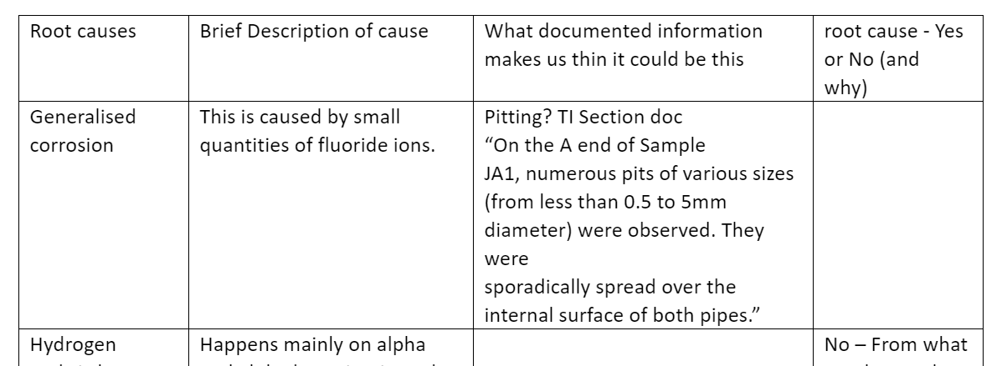
Group 2's Approach
Absorbed the information provided
Discussed the information
Research and fed back to the team
Root cause table
Answered the questions
3
Notes:
Read through the information provided individually
Discuss and the problem, identify gaps in out knowledge
Personal research calibration and shared information using a Microsoft teams page we set up.
Approached Chris and had an informed discussion
Put together a root cause analyses chart which left us with a couple of option took a deep dive in to these
Circled back to the questions to make sure we had answered them
Presentation

Slide 4
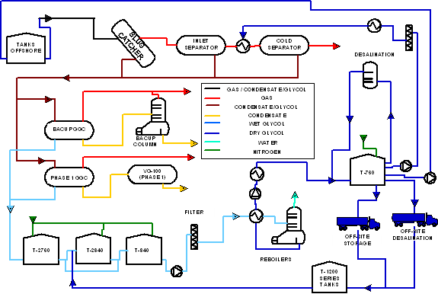
Background
Onshore Gas Processing Facility
Contains a Glycol Desalination Unit
When the Desalination Unit is offline 70 trucks a week are required to treat Glycol offsite
Source: Process schematic of onshore gas processing facility
4
Notes:
Plant design to remover Salt from mono-ethylene glycol (MEG) allowing the MEG to recycle
Batch production leads to periods of time where the product is stagnate
if the lines if not blown down correctly could lead to areas of high pitting.
When the plant is down 70 trucks a week that is 10 trucks a day are required to ship the MEG off else where for it to be recycled
Trucking 70 tucks a week not very green

Slide 5
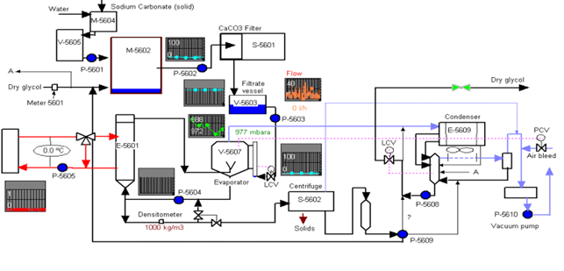
The Problem
Leak 1 location: Recycle Line (sampling point)
Leak 2 location: Drain Offtake Line
Figure 2: Process schematic of desalination unit
5
Notes:
At this point indicated by the red arrows leaks were idenfified
2 points to note:
all leaks occurred down stream of the Evaporator Very saline environment –
Leaks occurred at Sampling point, Drain off point. Fluid could site if not blown down correctly
Design condition in these areas:
1) Saline, 160 deg very corrosive

Slide 6
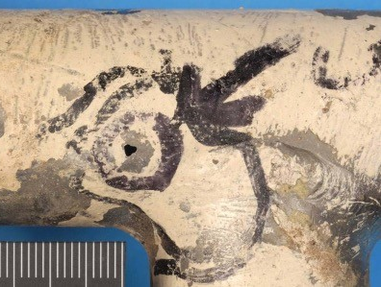
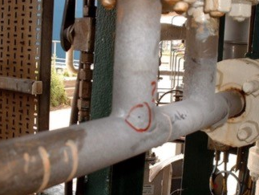
Photographs of Leaks
Leak 1 location: Recycle Line (sampling point)
Leak 2 location: Drain Offtake Line
6
Notes:
At this point indicated by the red arrows leaks were idenfified
2 points to note:
all leaks occurred down stream of the Evaporator Very saline environment –
Leaks occurred at Sampling point, Drain off point. Fluid could site if not blown down correctly
Design condition in these areas:
1) Saline, 160 deg very corrosive

Slide 7
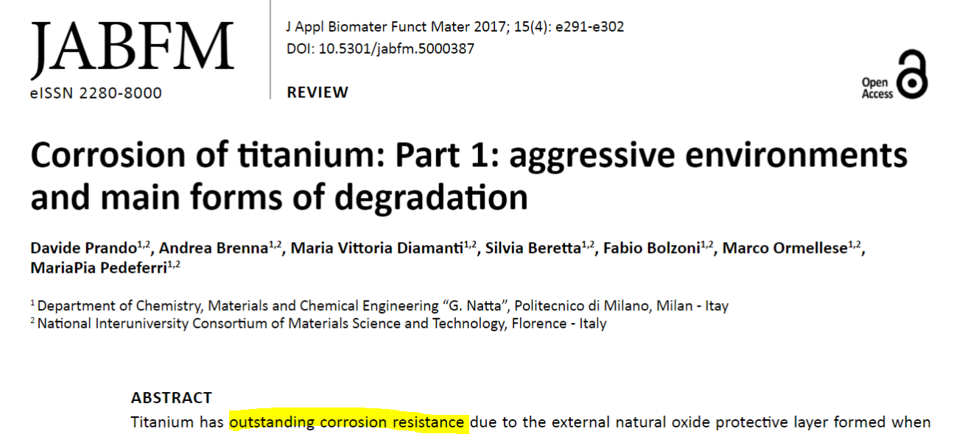
Original Material Selection
Titanium Grade 1 or 2 is good
Titanium Grade 12 is even better… offers better corrosion resistance in high temperature environments than other titanium grades
High weldability
7
Notes:
Ti is good
Better corrosion resistant
Better welding credentials

Slide 8
The Problem Source
Evaporator Vacuum not maintained, therefore oxygen ingress.
Salt, Acid and high temperature
Figure 3: Process schematic of desalination unit
8
Notes:
Following information presented by the operations team it was discovered the evaporator was not maintaining the vacuum resulting in oxygen ingress.
This had been going on for a year
As a result oxygen was now able to get in to the process an acid was formed making out to be an extremely corrosive environment.
acidic MEG, high salinity, >100C – strayed from the design conditions

Slide 9
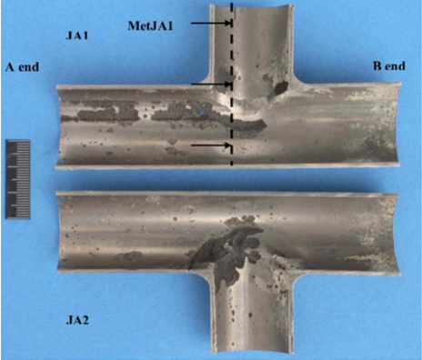
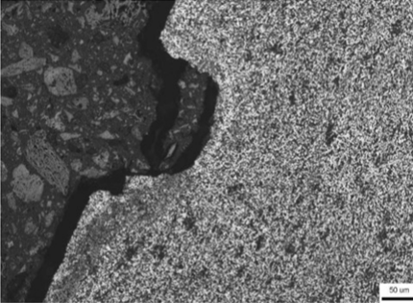
Localised Corrosion
• Pitting Corrosion located on inside of pipe
• Aggressive working environment
• Breakdown of TiO₂ layer
• Perforation of titanium surface
9

Slide 10
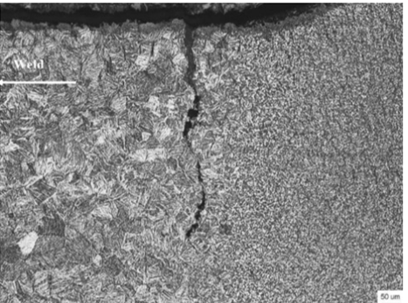
Weld Crack
• Crack located between HAZ and Parent Material
• Weld material Titanium 12
• Shield welding
• Highly skilled welder required
• Bad weld practice
- Atmospheric contamination
- Debris contamination
10

Slide 11
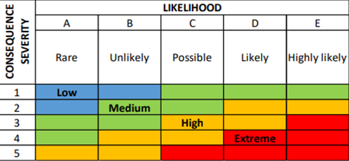
Corrosion Risk Assessment
Initial Steps
Failure Mode and Effects Analysis (FMEA)
• Localized Corrosion (pitting)
• Sub-surface crack (weld crack)
Corrosion Assessment
• Estimate the overall risk associated in the corrosion loop
• Likelihood of Occurrence 1,2,3..
• Consequence Severity A,B,C..
Risk = Likelihood (Probability) x Consequence (Severity)
11

Slide 12
Consideration of Likelihood and Consequence
Likelihood
How likely is it that the failure will happen again?
Run material tests to identify if pitting corrosion was caused by solution
Find out more information about the weld process/weld assessment
Consequence
Safety
Assess the COSHH assessment of solution
Investigate if any personnel will come into contact with solution
Production
Calculate the time from the initial failure to when the site is running normal again
Total cost of failure = deferment cost + repair/replacement cost + clean-up cost
Environment
Bunded area
Put results into a matrix to confirm overall risk/see if the site is safe to operate
12

Slide 13
Short-Term Considerations
Short-Term Consideration |  | Economic (Production) | Safety | Environmental
1 | Do nothing | Plant continues to operate, cost of repairing failure may increase with time | Pipe continues to leak – exclusion zone required, larger burst event possible | Medium continues to leak and requires control measures
2 | Regular inspections | Plant continues to operate subject to inspections | Pipe continues to leak but risk of larger burst event reduced | Medium continues to leak and requires control measures
3 | Apply temporary repair bandage | Short shutdown before operations resume | Leak halted, however, monitoring of repair integrity required | Leak temporarily halted
4 | Shutdown and tanker MEG offsite | Tankering offsite is expensive | No residual safety hazard when in shutdown | Leak halted but environmental impact of tankering offsite
13

Slide 14
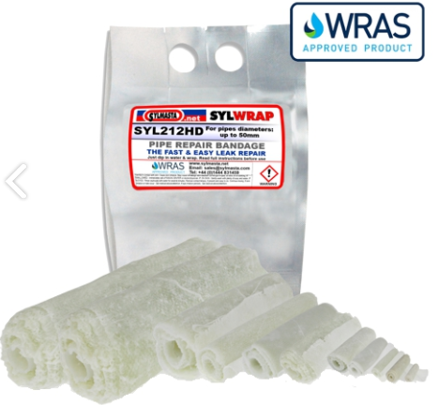
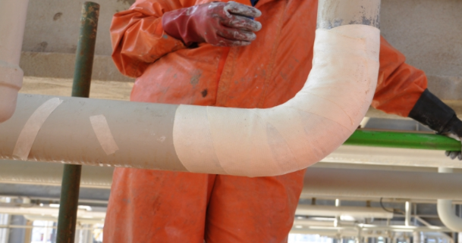
Recommended Short-Term Measure
Apply temporary “SylWrap” Pipe Repair Bandage
Temporary shutdown preferred – Functional Cure possible in 30 – 45 minutes
Capable of resisting 30 bar pressure and temperatures of over 200ºC
Source: SylWrap Datasheet
14

Slide 15
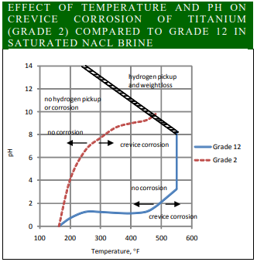
Long-Term Replacement Materials
Considered materials included:
Carbon Steel
300 Grade Stainless Steel
Inconel
Nickel Chromium Alloy 825
Titanium Grade 7
Titanium Grade 11
Chosen Material:
Titanium Grade 12
Source: Timetal 12 Datasheet
15

Slide 16
Future Mitigation
We would recommend the following improvements are implemented:
Improve welding/construction record keeping and quality control
Implement a dedicated reporting system for operational staff to highlight potential problems
Undertake regular review of operational staff highlighted problems and risk assess accordingly
Monitor solution flows throughout the plant pipework
Retain a stock of Pipe Repair Bandages or Titanium Clamps if similar situations should arise in the future.
16

Slide 17
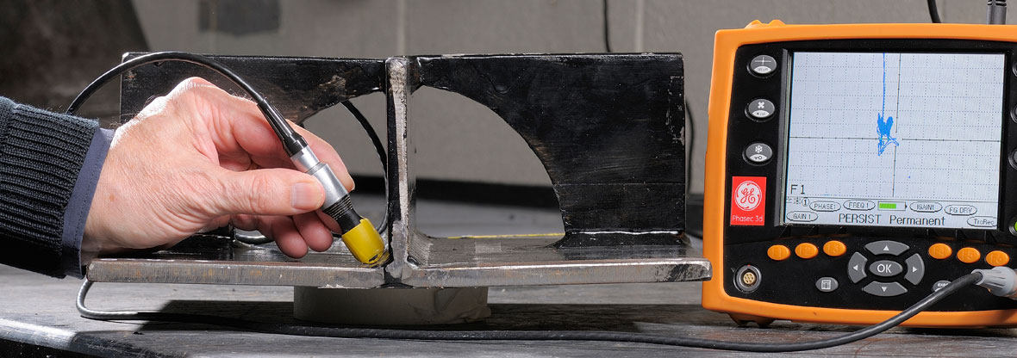
Integrity Investigations
To investigate the ongoing Integrity of the plant, propose:
Titanium Grade 12 Pipe Inspection
Ultrasonic inspection
Eddy current inspection
Weld Inspection
Visual Inspection
Dye penetrant inspection
Ultrasonic inspection
Source: TWI Training and Examination Services
17

Slide 18
Questions?
18

