Slide 1

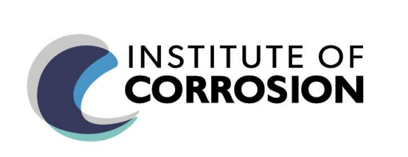
Onshore Titanium Pipe Corrosion Failure
2020 Case Study
TEAM 1

Slide 2

Index
TEAM 1
Aim
Information obtained
Process description
Root cause: location, two streams, HAZ area, environment.
Potential failure scenario: failure conditions and main corrosion process.
Risk assessment: safe to operate?
Risk assessment: ongoing integrity surveillance plan.
Possible mitigation options: operation conditions, pipe, slurry erosion, organic acids, oxygen, others.
Alternative materials
Longer term solutions
Other Considerations
Summary
References

Slide 3
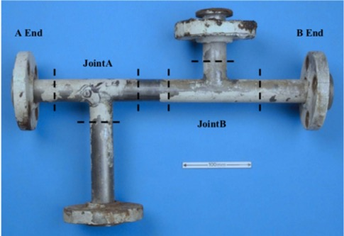
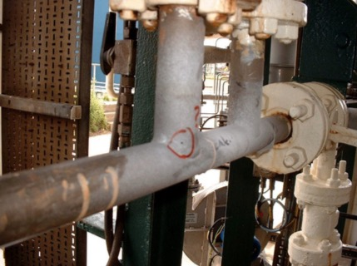
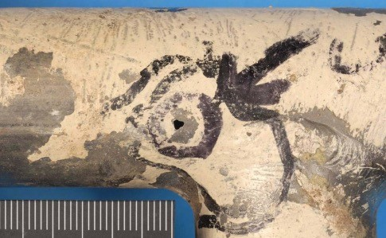
Aim
CASE STUDY: Onshore Titanium Pipe Corrosion Failure
SERVICE | Onshore desalination plant in service for 15 years; Remove the salts from MEG; Based around a vacuum distillation column (Evaporator);
PROBLEM | Several leaks located in the Evaporator (V-5607) section.
MATERIAL | ASTM Grade 12 Titanium [0.3% Mo, 0.8% Ni]
OBSERVATIONS | Exercise Question 1
DIAGNOSIS | Exercise Question 2
REMEDY | Exercise Question 3-6
TEAM 1

Slide 4
Aim
CASE STUDY: Onshore Titanium Pipe Corrosion Failure
SERVICE | Onshore desalination plant in service for 15 years; Remove the salts from MEG; Based around a vacuum distillation column (Evaporator);
PROBLEM | Several leaks located in the Evaporator (V-5607) section.
MATERIAL | ASTM Grade 12 Titanium [0.3% Mo, 0.8% Ni]
OBSERVATIONS | Exercise Question 1
DIAGNOSIS | Exercise Question 2
REMEDY | Exercise Question 3-6
TEAM 1

Slide 5
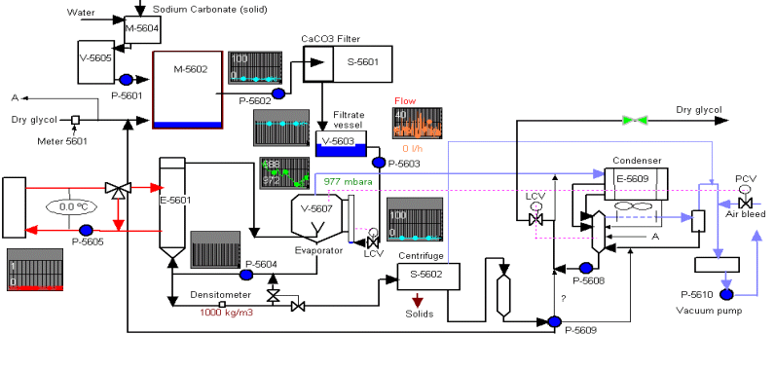
Process Description
TEAM 1
Salt (mainly NaCl) is separated from the lean glycol.
Operate at a partial vacuum of approximately 200 mbar(a)
Glycol and water to flash off from the liquid,
Slurry of concentrated salt, undergoes crystallisation.
Calandria
Evaporator and Calandria

Slide 6

Root cause
Two leaks location
TEAM 1
Flow
Leak 1
slurry
Problematic area
Leak 2
Leak 2 in offtake line from E-5601
Leak 1 Spool from recycle line from V-5607
Flow
Leak 1 was subject to failure investigation

Slide 7
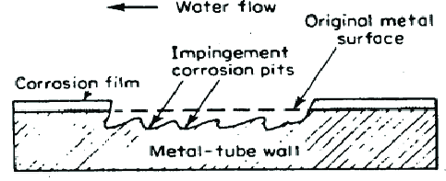
Root cause
Two streams joining
TEAM 1
2 streams joining going joint A
Leak 1 Spool from recycle line from V-5607
After the evaporator → slurry of concentrated salt, which subsequently undergoes crystallization.
Slurry erosion in titanium → material degradation [10]
Damage of protective layer of Ti caused by erosion.
Flow
Flow
No visible damage
Flow
Notes:
Flow
When an increased solids concentration is detected, the slurry that forms in the bottom of the Evaporator is treated and send to the evaporator. When the densitometer detects an increase in solids, this ones are sent to the centrifuge, if not they come back to the loop of evaporator-calandria etc.

Slide 8
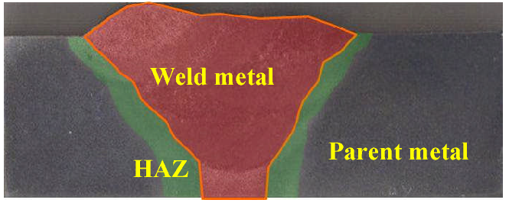
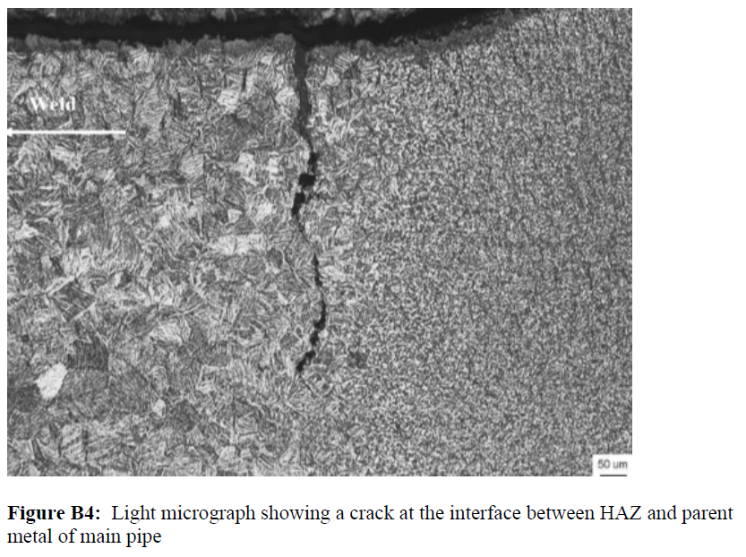
Root cause
Weld: HAZ area
TEAM 1
Bigger damage in the Weld/Heat Affected Zone (HAZ). Causes:
The welding process is considered to be harmful to the corrosion behavior of welded titanium alloys. [1]
The metal could have become brittle due to absorption of gases during the welding process. [2]
The corrosion performance of Ti ASTM Grade 12, in an acidic environment, is dependent on its heat treatment condition. [3]
It is likely to have secondary phases (e.g. beta phase) in the weld areas which will have poorer corrosion behavior compared to the desired alpha phase.
HAZ areas
Crack in the interface HAZ/pipe
The fusion zone particularly sensitive to stress corrosion cracking because of the entirely different structure in comparison to the base metal [1].
HAZ
Parent metal

Slide 9

Root cause
Environment: O₂
TEAM 1
Aggressive service environment
Acidic MEG
High Salinity (NaCl)
High Temperature > 100°C
+ O₂
Organic acids are formed
Glycolic
acetic
formic
For 1 year the required vacuum in the evaporator was not maintained.
Only a few organic acids are known to attack titanium. Among these are hot non-aerated formic acid. [4]
Accumulation of organic acids inside the MEG loop.

Slide 10
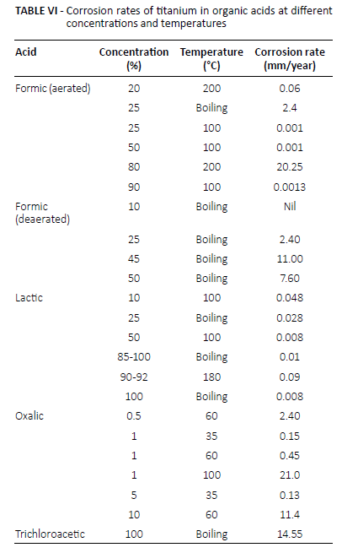
Root cause
Environment: O₂
TEAM 1
[4]
“During the original materials selection Titanium Grade 1 and 2 were considered, but because of the acidic MEG, high salinity and high temperature (>100°C) in the Evaporator unit, Titanium Grade 12 was selected based on its enhanced corrosion resistance”
To choose the material, oxygen was not taken into account.
The more formic acid concentration and temperature, the bigger corrosion rate in titanium. [4]

Slide 11
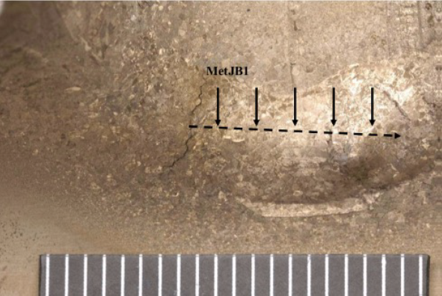
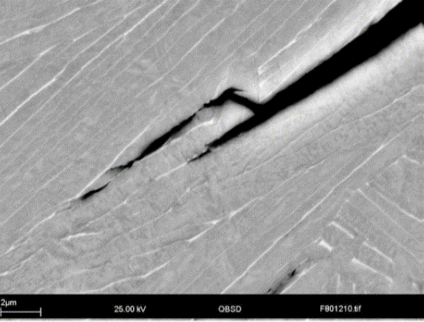


Root cause
Environment: H⁺
TEAM 1
Absorption of hydrogen with consequent hydrogen embrittlement, which promote the cleavage cracking.
“Hydrogen embrittlement is much more pronounced in alloys with high amounts of beta phase, such as grade 12” [4]
Sources:
Welding process, absorption of gasses.
Pitting corrosion, once initiated, is supported by reduction of protons inside the pit:
For passive titanium, corrosion is promoted by reaction with neutral water and proceeds at an extremely slow rate, in the range of the passive current density (vacuum unable → water).
Cleavage Crack
HIC
Cleavage cracking
$$Ti+4H^{+}→Ti^{4+}+2 H_{2}$$
1.56 mm deep
$$Ti+4H_{2}O→TiO_{2}+2 H_{2}$$

Slide 12
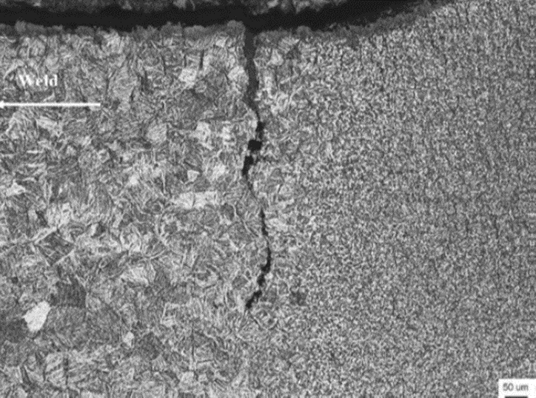

Potential failure scenario
Failure conditions summary
TEAM 1
Erosion
Weaker weld/HAZ area
Presence of hydrogen
Presence of oxygen → formic acid

Slide 13
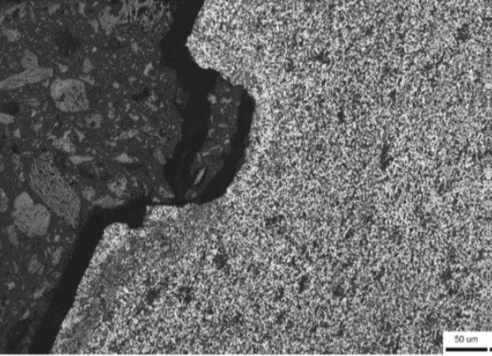
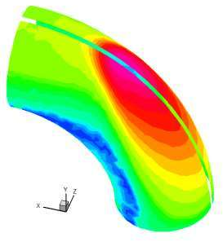
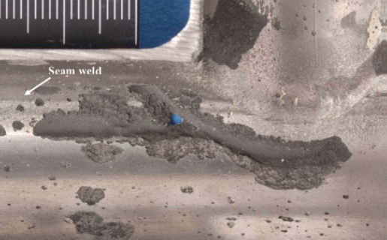
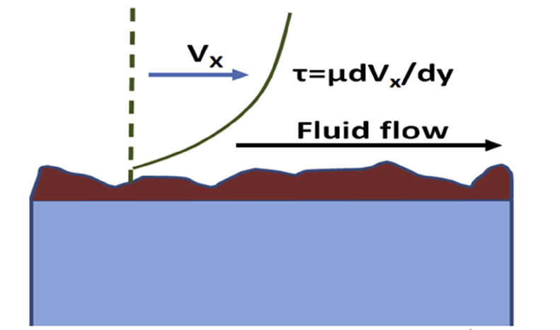
Potential failure scenario
Main corrosion process
TEAM 1
Slurry erosion corrosion
Pitting corrosion
Galvanic corrosion between HAZ area and parent metal
SCC
Formic acid
HIC
O₂
Formation of an electrolytic cell between HAZ area of active metal (anode) and passive surface of TiO₂ film (cathode).
NaCl
The environment helped the progression of the pits.
High T
Damage of protective layer of Ti.
Pit on pipe surface
TiO₂

Slide 14
Risk assessment
Safe to Operate?
TEAM 1
Methodology
- ISO 23222 - Corrosion control engineering life cycle — Risk assessment
- YEP Case Study Guide
- FMEA, Likelihood, Consequence
Input and Uncertainty
- Likelihood – Incident Data
- Consequence (S,E, P) – Fluid, Temp, Press, Leak Hole size,
Location, Investigation, Repair, Replacement Cost, Shutdown Time
Risk Contributors
- Material
- Process Conditions – T, pH, O₂
- Hotspots – Weld, T Joint

Slide 15
Risk assessment
Ongoing Integrity Surveillance Plan
TEAM 1
Process Monitoring
- Temp, Press, pH
- O₂, Organic acids
Equipment Monitoring
- Installed Ultrasonic Sensors
- At Critical Points – Weld, T Joint
Inspection & Maintenance
- Integrate with Plant RBI
- Corrosion Factor x Consequence Factor
Source - Ultracorr®

Slide 16
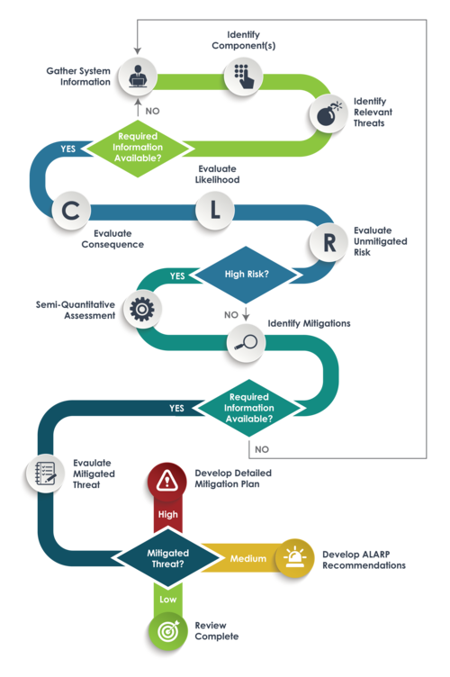
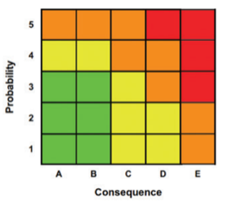
Risk assessment
Ongoing Integrity Surveillance Plan
TEAM 1
Process Monitoring
- Temp, Press, pH
- O₂, Organic acids
Equipment Monitoring
- Installed Ultrasonic Sensors
- At Critical Points – Weld, T Joint
Inspection & Maintenance
- Integrate with Plant RBI
- Corrosion Factor x Consequence Factor
Source – gate.energy

Slide 17
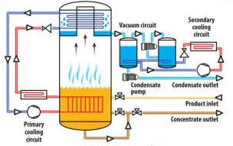




Possible mitigation options
Operation conditions
TEAM 1
Adjust some op. conditions
Fix the vacuum in the evaporator.
Reduce the treated content in solids → When an increase in solids is detected, send outside for treatment. 70 trucks/ week available.
“When the desalination plant is offline, or the salt concentrations are very high in the glycol stream (>10%wt), the product is sent offsite for desalination”
“Up to 70 trucks of glycol per week can be sent offsite from the plant when required”

Slide 18
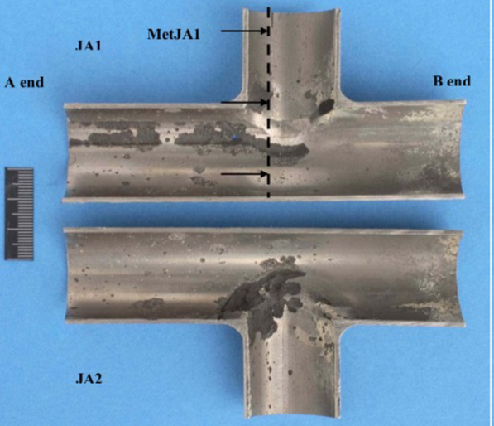
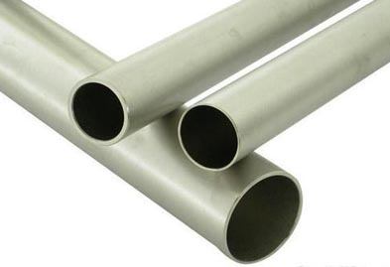
Possible mitigation options
Pipe
TEAM 1
Seamless pipes
Corrosion most severe in the outer parts of the HAZ of Weld joining tubes
Replace the pipe with a seamless pipe or weld in an inert environment and apply heat treatment to it.

Slide 19
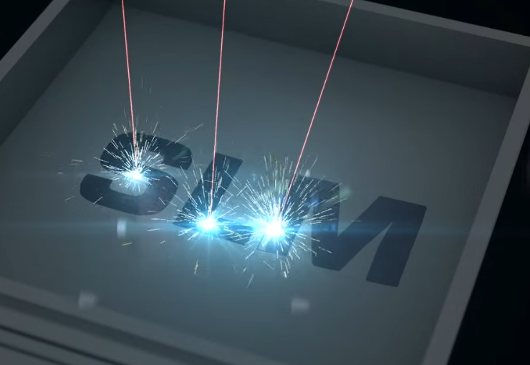
Possible mitigation options
Slurry erosion
TEAM 1
Hardness and yield strength of the material should be enhanced to increase the erosion resistance on Ti components [5]:
Surface coatings and heat treatments have been observed to be common practices to improve both surface hardening and strength.
Treat Titanium via Selective laser melting (SLM) is one of the metal powder bed fusion AM (additive manufacturing) processes. In SLM, objects are manufactured directly from specific metal powders in a layer-by-layer manner. [5]

Slide 20
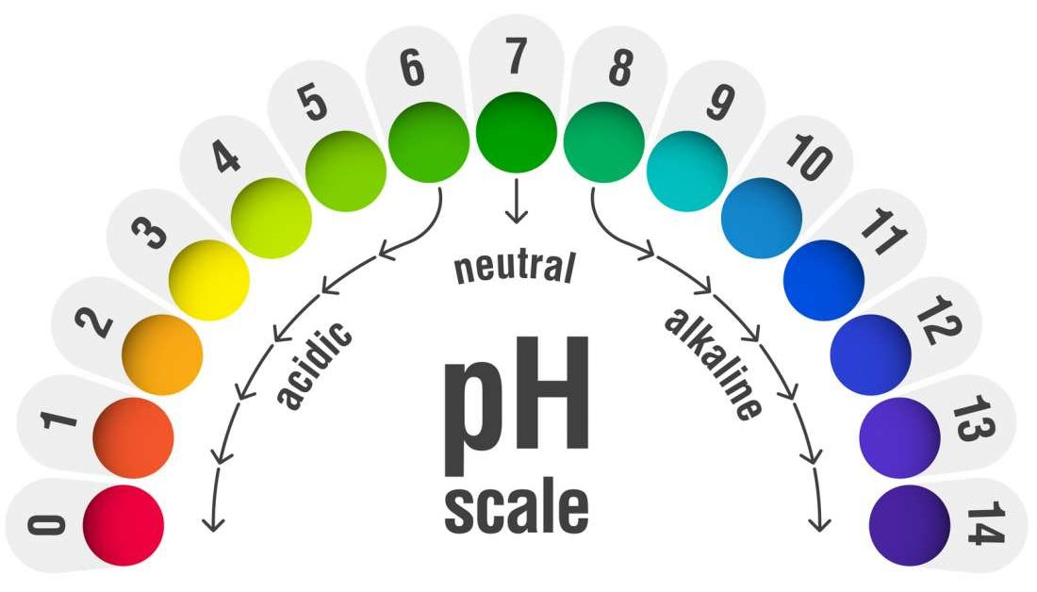
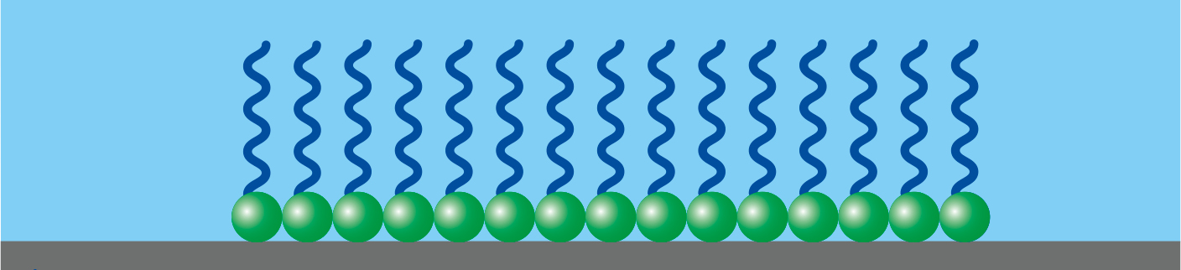
Possible mitigation options
Organic acids
TEAM 1
To avoid accumulation of organic acids in MEG regeneration plants it is typical, to choose between one of these options [7],[9]:
pH stabilization:
Injection of film forming corrosion inhibitors (FFCI) in the evaporator. To avoid scaling, this option is the best.
The pH within pipelines is typically increased through addition of hydroxides, carbonates, or amine-based compounds including methyldiethanolamine (MDEA).

Slide 21

Possible mitigation options
Oxygen
TEAM 1
Oxygen removal. Inject an oxygen scavenger, for example:
Sodium bisulphite (NaHSO₃)
Ammonium bisulphite (NH₄HSO₃)

Slide 22
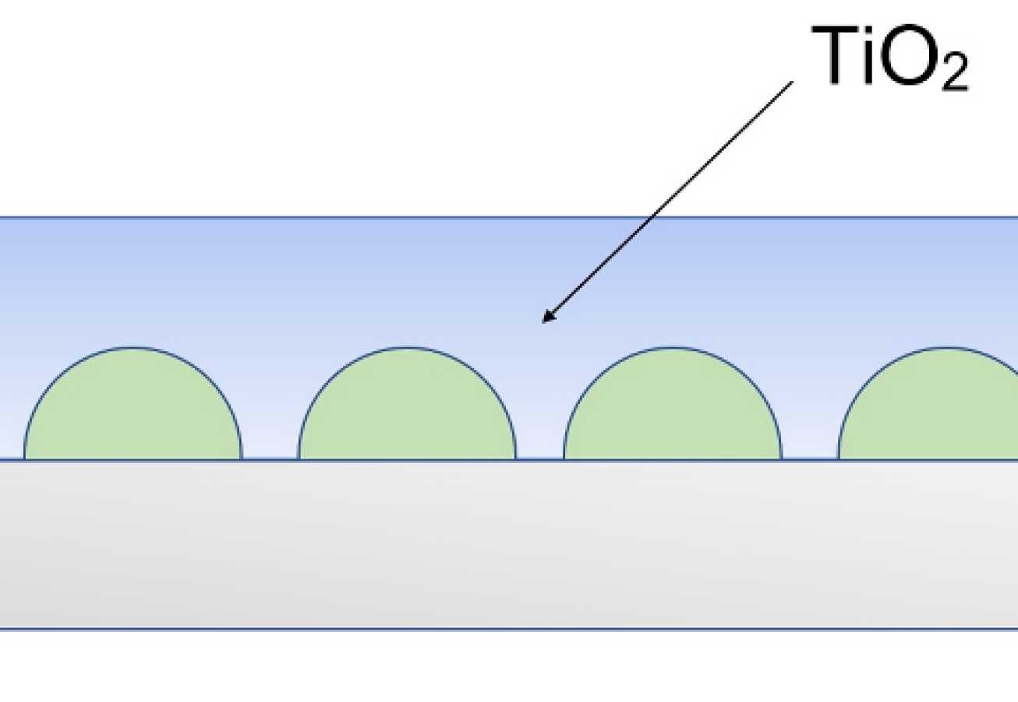
Possible mitigation options
Other options
TEAM 1
Increase TiO₂ thickness: Another possible way is to increase the natural thickness of TiO₂ by surface treatments. [6]
Anodization
Thermal oxidation
Chemical oxidation and
Ion implantation are other possible techniques

Slide 23
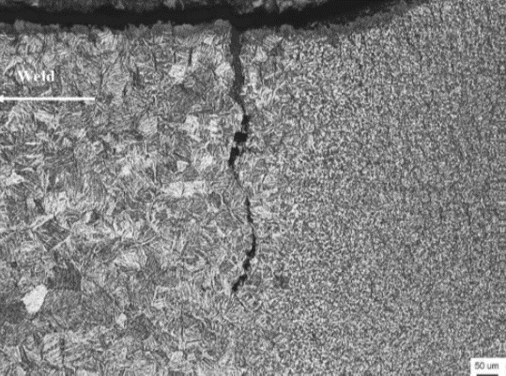
Alternative Materials
Weld
TEAM 1
Improvement of corrosion resistance of weld metal
Guarantee that requirements from recognised standards are correctly applied.
Crack at the interface between HAZ and parent metal
NOTE: Several researches have indicated that the microstructure of welded titanium alloys could be adjusted by post weld heat treatment, such as bulk heat treatment in furnace [1].
Crack in the weld in section Met JB1

Slide 24
Alternative Materials
TEAM 1
Ti-Pd/Ti-Ru Alloys Grades
Ti Grade 7 (Ti – 0.15Pd)
Improved corrosion resistance mildly reducing solutions and high-temperature chloride solutions (addition of Pd)
Excellent weldability and fabricability
The most corrosion resistance of all Ti alloys.
Ti Gr. 16 (Ti-0.05Pd)
Cheapest leaner palladium version of Gr. 7
Mechanical/phisycal properties similar to Gr.7
Ti Gr. 26 (Ti-0.1Ru)
Outstanding resistance to general and localised crevice corrosion
Mechanical properties similar to Grade 2, but with improved corrosion resistance
Competitive alternative to Gr. 7
(Critical Crevice Temperature for Ti Grades 2, 12 & for Pd- and Ru-containing Alloys in Acidic Chloride Environments)
Notes:
24

Slide 25
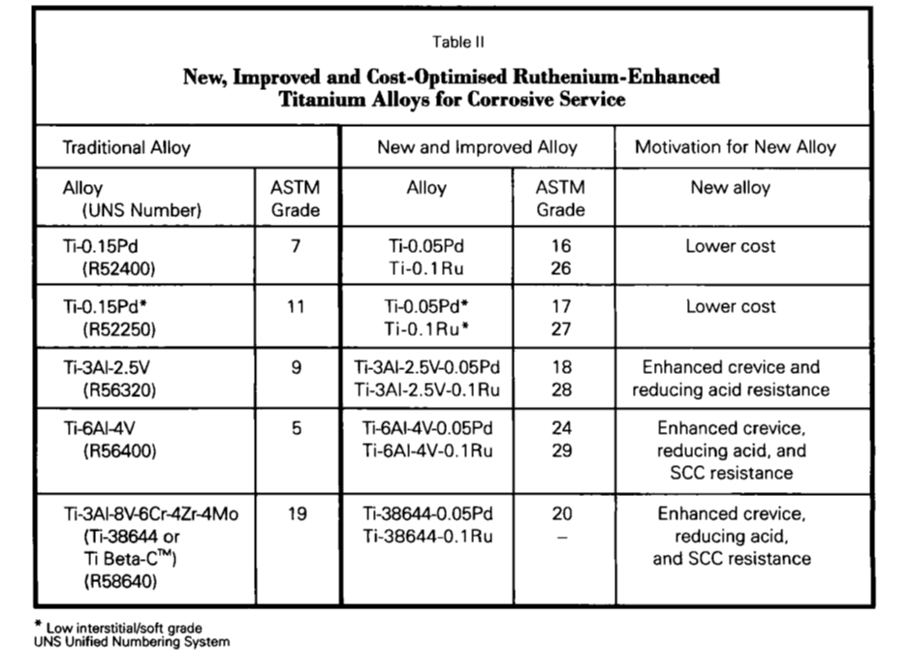
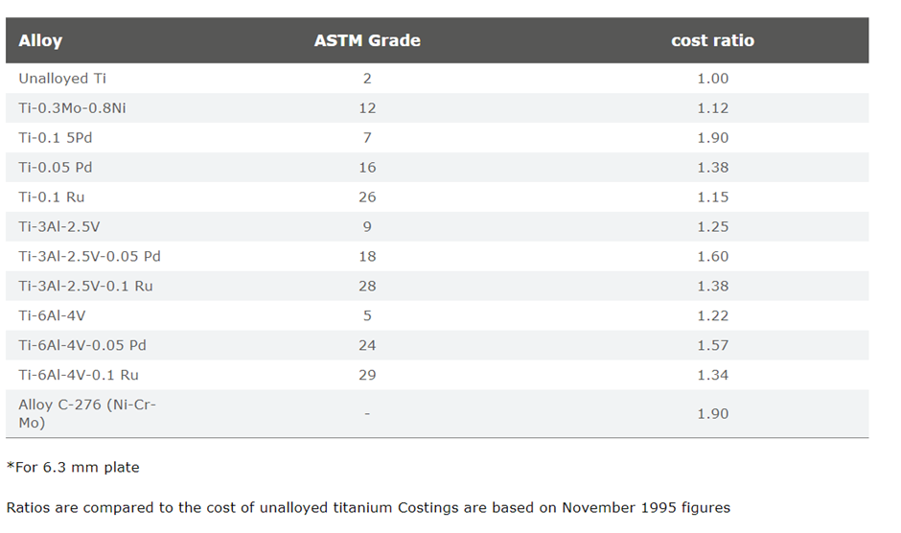
Alternative Materials
TEAM 1
Ti-Pd/Ti-Ru Alloys Grades
Table II
Table I
Notes:
25

Slide 26

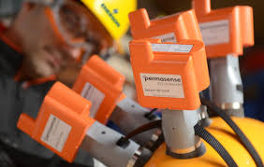
Longer Term Solutions
TEAM 1
Increase in maintenance schedule
More through maintenance on all areas of plant
Increased monitoring of area of high turbulence and aggressive environments
Improvements made to the fault reporting process.
Accountability for maintenance, reporting and repair of plant
Corrosion monitoring equipment
Coupons and permanent UT equipment in Known vulnerable areas.
Better training for Technicians in use of corrosion monitoring equipment
Source – Icorr.org

Slide 27
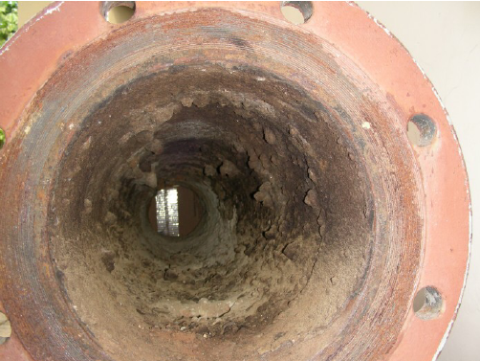
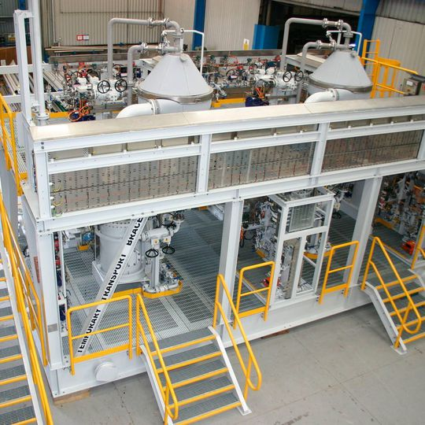
Longer Term Solutions
TEAM 1
Fouling control
Dispersants injected at critical points
Maintain high flow Rate +2m/s to stop fouling
Deposit analysis.
Two stream system
Allows complete strip down without loss of production
Fail safe in place in case of major failure

Slide 28

Other Considerations
TEAM 1
Why weren’t they able to maintain vacuum.
Weld process and treatment.
Why are the 2 HAZ in contact, longitudinal seam weld in the main pipe and branch weld. Is that standard practice
Calcium carbonate dosage calculated based on assumption?
Source - nonprofitlawblog.com

Slide 29
Summary
CASE STUDY: Onshore Titanium Pipe Corrosion Failure
SERVICE | Onshore desalination plant in service for 15 years; Remove the salts from MEG; Based around a vacuum distillation column (Evaporator);
PROBLEM | Several leaks located in the Evaporator (V-5607) section.
MATERIAL | ASTM Grade 12 Titanium [0.3% Mo, 0.8% Ni]
OBSERVATIONS | Operation beyond design Parameters Non-monitoring of corrosion processes Non-conformance to quality of equipment
DIAGNOSIS | Erosion and pitting corrosion at Weld/HAZs
REMEDY | Replace material with seamless Titanium Grade 16/26 Better maintenance schedule and procedure’s in place Ensure all Manufacturing/welding standards are met
TEAM 1

Slide 30
References
TEAM 1
[1] Effect of Heat Treatment on Stress Corrosion Cracking Behavior and Electrochemical Characteristic of Welded Ti-6Al-4V Alloy during Slow Strain Rate Test. Yan Liu1, Shawei Tang1, Guangyi Liu, Yue Sun, Jin Hu, School of Materials Science and Engineering, Harbin Institute of Technology, Harbin 150001, China State Key Laboratory for Marine Corrosion and Protection, Luoyang Ship Material Research Institute (LSMRI), Qingdao 266101, China September 2016.
[2] Titanium corrosion. Corrosion doctors. https://www.corrosion-doctors.org/MatSelect/corrtitanium.htm
[3] Froes, F. H., Malone, R. F., Petersen, V. C., Rhodes, C. G., Chesnutt, J. C., Williams, J. C., & Hall, J. A. (1982). METALLURGICAL SYNTHESIS OF A NEW GENERATION OF DEEP HARDENABLE TITANIUM ALLOYS. THE METASTABLE BETA Ti-Mo-V-Cr-Al SYSTEM - DESIGN AND PROPERTIES. (Vol. 3, pp. 2161–2171). Plenum Press. https://doi.org/10.1007/978-1-4757-1758-7_51
[4] Appl Biomater Funct Mater 2017; Corrosion of titanium: Part 1: aggressive environments and main forms of degradation, Davide Prando, Andrea Brenna, Maria Vittoria Diamanti, Silvia Beretta, Fabio Bolzoni, Marco Ormellese, MariaPia Pedeferri, Department of Chemistry, Materials and Chemical Engineering “G. Natta”, Politecnico di Milano, Milan - ItayNational Interuniversity Consortium of Materials Science and Technology, Florence – Italy.
[5] Slurry Erosion–Corrosion Characteristics of As-Built Ti-6Al-4V Manufactured by Selective Laser Melting Saleh Ahmed Aldahash, Osama Abdelaal , Yasser Abdelrhman September 2020.
[6] Corrosion of titanium: Part 2: Effects of surface treatments. Davide Prando, Andrea Brenna, Maria Vittoria Diamanti, Silvia Beretta,Fabio Bolzoni, Marco Ormellese, MariaPia Pedeferri. Journal of Applied Biomaterials & Functional Materials 2018, Vol. 16(1) 3–13.
[7] Removal of Organic Acids during Monoethylene Glycol Distillation and Reclamation To Minimize Long-Term Accumulation Adam Soames, Ahmed Barifcani, and Rolf Gubner WA School of Mines: Minerals, Energy and Chemical Engineering, Curtin University, Australia. Ind. Eng. Chem. Res. 2019, 58, 6730−6739.
[8] Corrosion behavior of titanium alloys in acidic and saline media: role of alloy design, passivation integrity, and electrolyte modification Michael O. Bodunrin*, Lesley H. Chown, Josias W. van der Merwe, Kenneth K. Alaneme,Christian Oganbule, Desmond E.P. Klenam and Nthape P. Mphasha. September 2019.
[9] Operation of a MEG pilot regeneration system for organic acid and alkalinity removal during MDEA to FFCI switchover Adam Soamesa, Edith Odeigaha, Ammar Al Helala, Sami Zaboona, Stefan Iglauerb, Ahmed Barifcania, Rolf Gubnera. 2018.
[10] A comprehensive review on internal corrosion and cracking of oil and gas pipelines. M. Askaria, M. Aliofkhazraeia, S. Afroukhtehb. Journal of Natural Gas Science and Engineering 71 (2019) 102971.
[11] Technical challenges and solutions in a closed loop MEG regeneration system for gas field offshore, UK S. Baraka-Lokmane1, Ch. Hurtevent1, M. Seiersten2, E. Flaten2, M. Farrell3, O. Bradshaw3, S. Hare3, M.
[12] Corrosion of Titanium Alloys. QRS-1384J-1 v.2.1 Appendix D.
[13] Effect of Heat Treatment on Stress Corrosion Cracking Behavior and Electrochemical Characteristic of Welded Ti-6Al-4V Alloy during Slow Strain Rate Test Yan Liu1, Shawei Tang1, Guangyi Liu, Yue Sun, Jin Hu, China. 13 September 2016.
[14] Titanium alloy guide. An RTI International Metals, Inc. Company.
[15] Effect of monoethylene glycol on sweet top of the line corrosion. Shaoqiang Guo, Fernando Farelas, Marc Singer. Paper No.7891. corrosion expo 2016.
[16] Welding titanium a designers and users handbook. TWI. 1999. Paper No. 7891.

Slide 31
Thanks for your attention!

