Slide 1
YEP Team 5
Antoine Reed, Celine Dischamps, Freda Akwah, Sophie Zhang

Slide 2
Overview
Process overview
Operation conditions (deviations from intended design)
Failure Observations (Recycle line and Drain line)
Root Cause Analysis
Corrosion Risk Assessment
Risk mitigation and solutions
  Short-term
  Medium-term
  Long-term

Slide 3
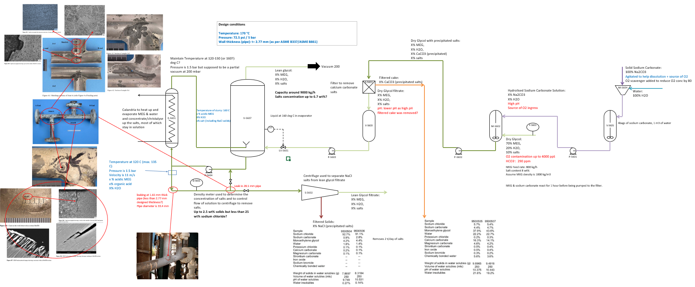
Process overview
Initial investigation PFD mapping out all the information we gathered and identifying areas of uncertainty
Notes:
Our first step in approaching this case study was to draw out a simplified PFD of the system and to map out all the available information to identify areas of uncertainty or gaps in data.

Slide 4
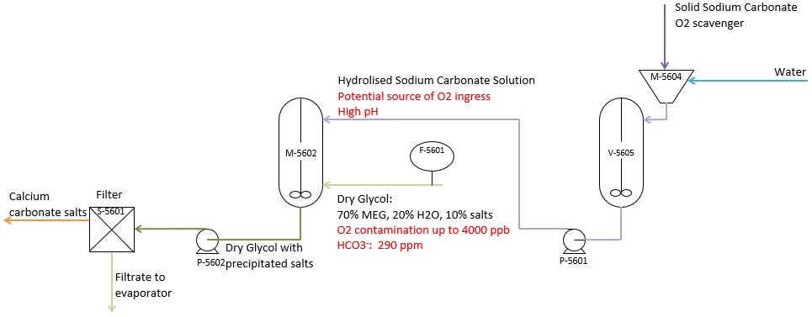
Process overview: front end
Notes:
We looked at understanding the front end of the process:
Sodium carbonate and water are mixed in a vessel, which is a source of O2 ingress, but this is removed by an oxygen scavenger. It is also a source of high pH as it is alkaline.
The sodacarb solution is mixed with dry MEG from storage, which is another source of O2 ingress for which it is not believed that scavenger is used.
The MEG and sodacarb are mixed and left to react for an hour to precipitate carbonates.
These are then removed by a filter which seems to remove any undissolved salts which mainly includes some sodium chloride, sodium, calcium and magnesium carbonate.
The filtrate is then ready to be pumped to the evaporator.

Slide 5
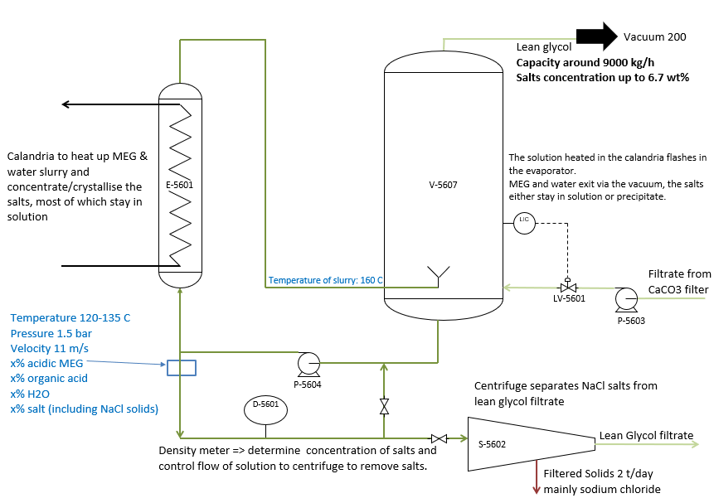
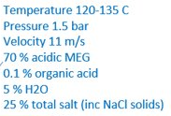
Process overview: evaporator
Observed leaks in similar conditions
Assume same failure mechanisms
Notes:
Fresh dry MEG filtrate is pumped to the evaporator which already contains an inventory of salt-concentrated MEG.
This is in turn pumped:
1) to the calandria where it is heated up to 160 deg C. It then flashes in the evaporator which is at a lower pressure, 200 mbara. The flash vapour which is lean MEG is recovered in the vacuum system by condensing the MEG.
2) to the spillback line which contains a density meter to monitor the salt concentration and control how much of the solution is sent forward to the centrifuge separator. The spillback continuously sends rich MEG around back to the pump suction.
The rich MEG take-off is processed in the centrifuge where lean MEG is separated from salts, mainly sodium chloride (over 90%).

Slide 6
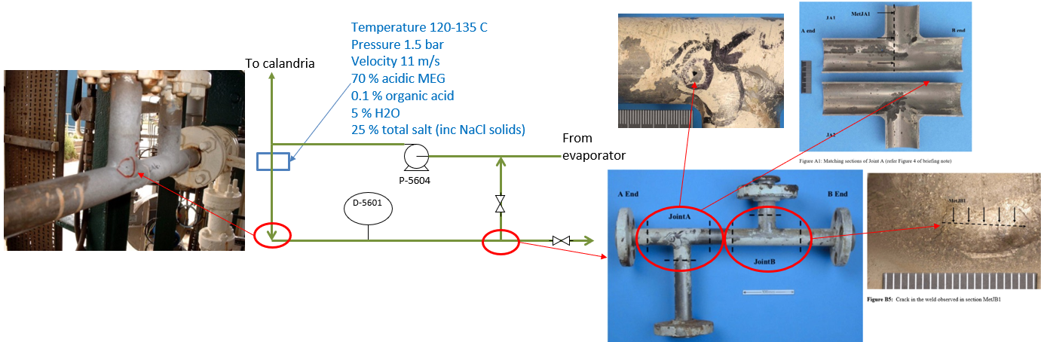
Investigation:
To Density Meter
To Pump Suction
To Centrifuge
FLOW DIRECTION
FLOW DIRECTION
DEAD LEG
To Sample Point
B
A
DEAD LEG
To Flush Line
Notes:
Part of the investigation was to pin-point the exact location of the leaks and to make sense of which pictures belonged to which leak.
Two leaks were observed in the pump spillback at similar locations (near bends and dead legs) and similar conditions (same temp, P, velocity, composition). We have assumed they leaked for the same reasons so will concentrate only on one location: the leak at the takeoff to the centrifuge.

Slide 7
Investigation:
Observed process conditions which are cause for concern:
High velocity of slurry in pipe => risk of errosion
Vacuum not maintained for the past year => O2 ingress
Formation of organic acids => acidic environment
Corrosive chloride ions present in the solution
Operating at high temperatures (160 deg C reported)
Notes:
We found several inconsistencies and areas of concern:
- high velocities in the pipe 11 m/s for a slurry line is very high and is likely to lead to errosion.
- the required vacuum of 200 mbar was not maintained for the past year. It is unclear what caused the vacuum to fail but it resulted in O2 ingress into the system. This in turn caused the formation of acids mainly glycolic acid and formic acid in the calandria.
- corrosive chloride ions are present in the solution. However this is what the system would have been designed for but the presence of acids may have changed the material suitability for this service.
- there was some conflicting information about the operating temperature of the calandria, with some sources stating up to 160 dgeC and others stating an operating temperature of 120-130 deg C. This high temperature is also, in the presence of O2 a catalyst for the formation of acids.

Slide 8
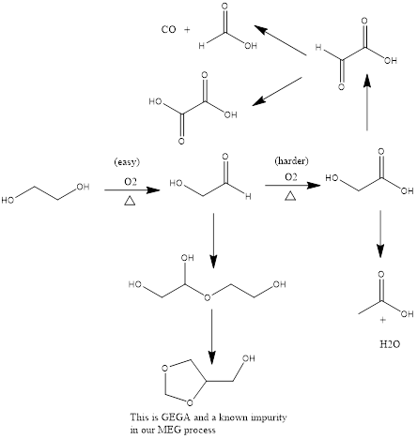
Acid formation:
Formic Acid
MEG oxidises in presence of air and heat to aldehyde
Aldehyde oxidises further to all three acids.
TiO2 is a catalyst to the reactions
MEG
Glycolic Acid
2-hydroxyacetaldehyde
Acetic Acid
Notes:
We investigated what could be the cause of formation of acids and how these could be made:
MEG easily oxidises to an aldehyde under the presence of air
The aldehyde then oxidises to glycolic acid with heat and the presence of a catalyst.
We would expect this catalyst to be either an enzyme or a base metal.
The paper this is extracted from suggested Titanium dioxide could catalyze the conversions
The main dominant acid we would see is glycolic acid as it is most stable but formic and acetic are also be formed.

Slide 9
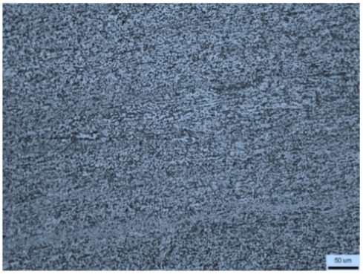
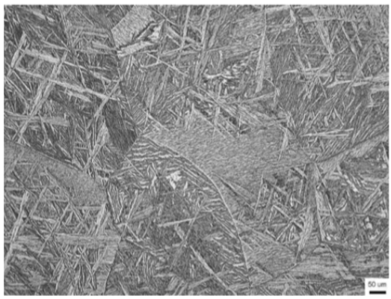
Titanium Grade 12
A high strength, high corrosion resistance and weldable alloy used for various industrial and aerospace applications.
Titanium12 has two phases (α-alpha) and (β-beta).
  α-alpha phase is generally associated with a low modulus, but good corrosion resistance and weldability
  Β-beta phase is generally associated with a higher modulus, it serves to make the material more workable for industrial applications.
HAZ has more Β-beta phase because of the precipitation of beta due to the welding.

Slide 10
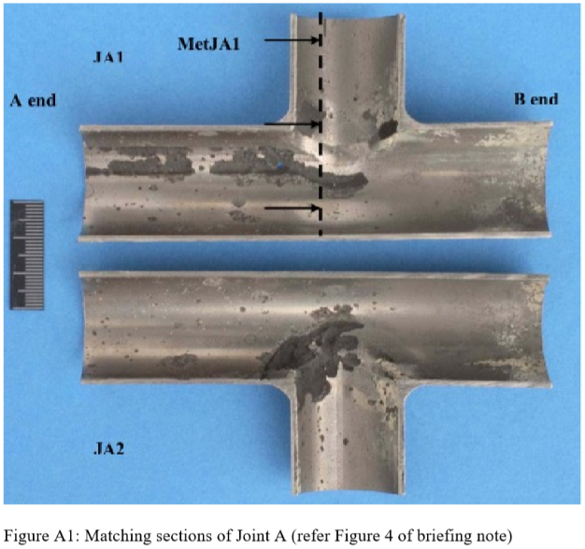
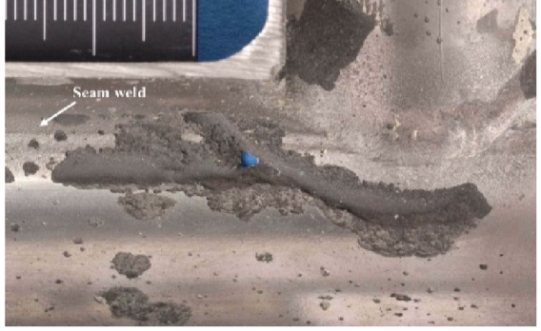
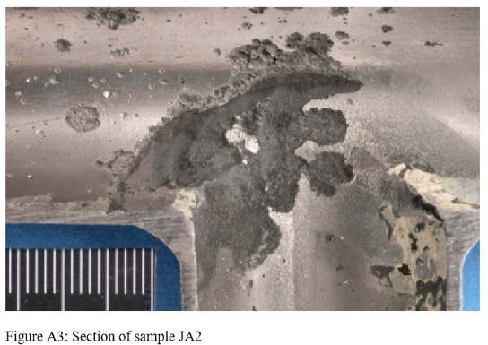
Failure Observations (Leak 1 recycle line Joint A)
Gross pitting downstream from B end
Failure from inside to outside
Gross pitting predominately in the HAZ of the branch weld and the seam weld of the pipe
Additional pitting in the pipe parent material downstream from TEE junction
Majority of internally surface not associated with pitting and seems unaffected
No deposits on the internal surface of the pipe (maybe due to the process)
Flow direction
flow away from the main pipe
HAZ of branch weld
HAZ of branch weld
JA2
HAZ of seam weld
Surface crack transverse to the weld
JA1

Slide 11
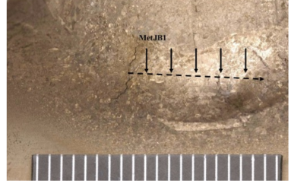
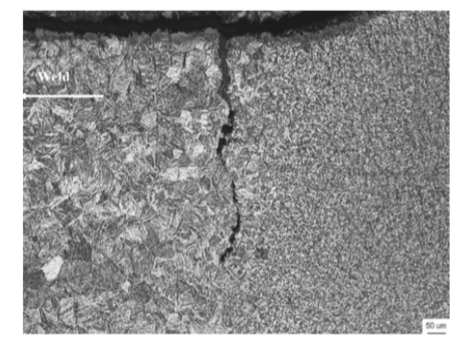
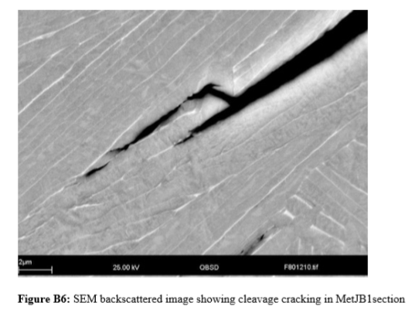
Failure Observations (recycle line Joint B)
Fine branchlike cracking initiating from the internal surface
Cracking transverse to the welding direction
Cracking but no leaking
HAZ
Parent material
β phase: ‘bright platelets’
‘Cleavage’ like fracture surfaces
intergranular cracking and along the alpha/beta interface

Slide 12
Root Cause Analysis – leak 1 joint A
2. HCl corrosion
Destabilise passive film
+
Reducing potential
NaCl solids (2.5 wt%) high Cl⁻
pH 5 – 5.5, acidification
Formation of HCl
Flow velocity
11 m/s
Formation of organic acids
O₂ ingress
Gross pitting in HAZs of seam weld, branch weld; internal crack to the weld
Residual stress from weldment
4. Stress corrosion cracking / Hydrogen induced cracking
Piping geometry, right angle bend , additional turbulence
HAZ
3. Preferential attack in β phase
Change in microstructure: from fully α to α+β
1. Erosion+ Corrosion
Notes:
Erosion-Corrosion – Erosion-corrosion is a description for the damage that occurs when corrosion contributes to erosion by removing protective films or scales, or by exposing the metal surface to further corrosion under the combined action of erosion and corrosion;
Geometry of the pipe in the failed areas (Joint A + other failed area) would be associated with additional turbulence and therefore implies an erosion type failure.
Flowing salt slurry of which we have approximately 2.5% wt% NaCL solids can mechanical removed protective oxide films and break down passivity.
Although for titanium, a minimum velocity of 30 m/s is required usually for erosion, the presence of corrosion/pitting removes this minimum velocity limit and a speed of 11 m/s would certainly be sufficient to break down the passive protective coating.
Inability to reform oxide (re-passivation) in reducing environment (low potential)
HCl corrosion – HCl corrosion causes both general and localized corrosion
HCl corrosion will de-stabilise the passive film formed on the surface of titanium which usually makes the material immune to pitting and corrosion.
Selective Attack – Selective attack of a certain phase in a material in this case, we have a duel phase titanium, with increased beta phase around the

Slide 13
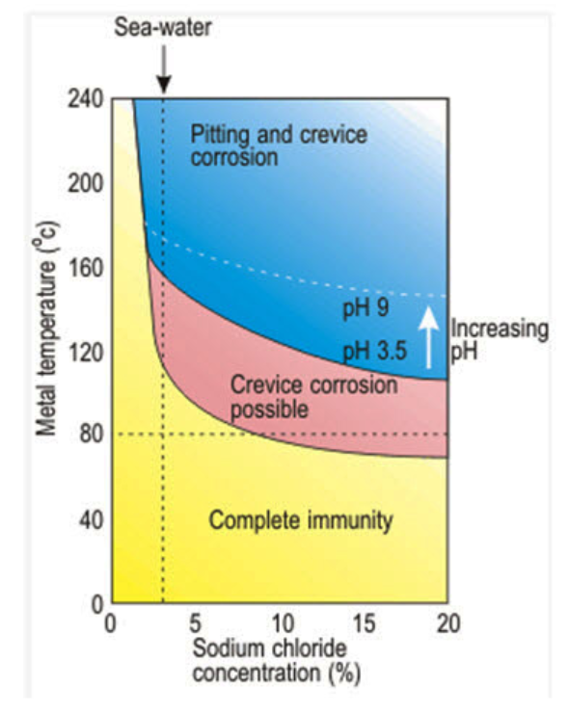
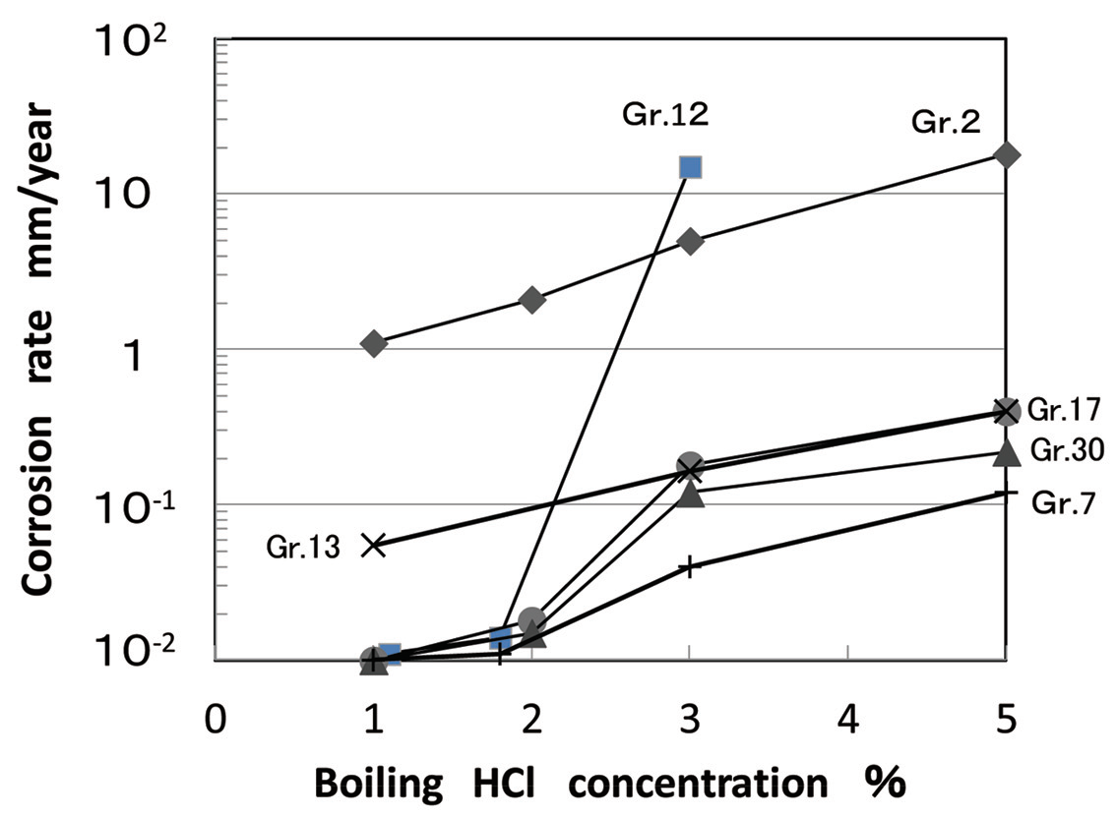
Corrosion of Ti in HCl
At pH =5, active dissolution of Ti occurs
Rapid deterioration of corrosion resistance of Gr12. when HCl% > 2% [1]
Grade 2 Ti [2]
[1] Kaminaka et al. 2014; [2] Total Materia database

Slide 14
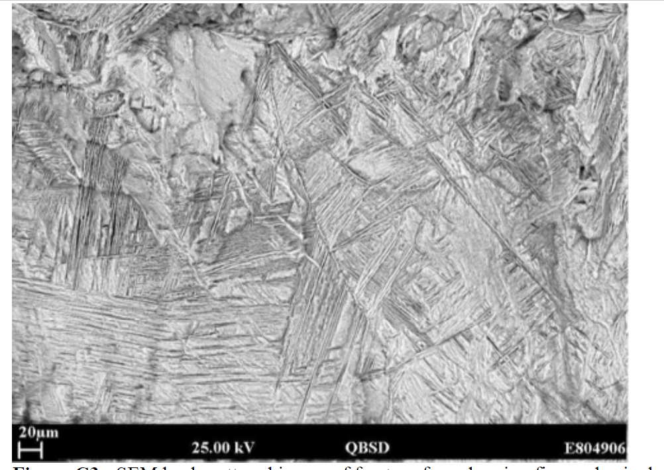
Root Cause Analysis - Leak 1 joint B
Hydrogen induced cracking (HIC)
β phase: ‘bright platelets’
Atomic Hydrogen is produced by corrosion
H adsorption and diffusion
  Differentiation of H diffusion in alpha and beta phases
  Intermetallics Ti₂Ni preferential sites for H adsorption
  High temperature (>80 °C) significantly promotes H diffusion [3]
Hydride formation – maybe preferentially in beta phase (low H solubility)
  Brittle – loss in ductility
[3] Hua et al. 2005
Notes:
Fix hydride formation – no need to be detailed -

Slide 15
Corrosion Risk Assessment
What is a Corrosion Risk Assessment
Methodology
Inputs:
  intended service
  selected material
  operating conditions
  What controls are in place
  Upset conditions
Uncertainties in the data provided (pH levels, solids content, temperature)

Slide 16
The identifiable Risk (predictable?)
What is the Risk against the identified damage mechanisms
Should the possibility of upset conditions have been considered at design stage
What is the likelihood of failure
Was Titanium Grade 12 material suitable for this service

Slide 17
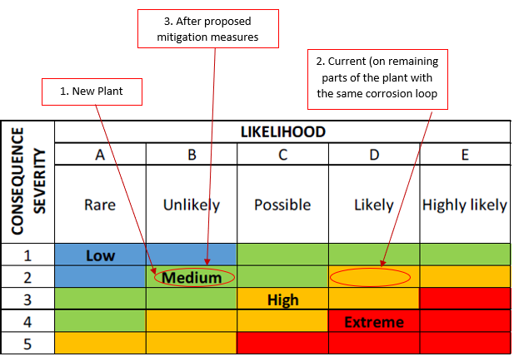
Consequences of Failure
People (risk of death or serious injury) - determined that there was no risk of death
Environment (pollution) - minimal
Economic (plant shutdown, fines & cost of moving production to a different facility) - some disruption

Slide 18
Mitigation Measures
Introduce measures that will prevent a reducing environment being formed (organic acids)
Introduce extra controls in place to allow early capture of any issues e.g. loss of vacuum, pH , O2 content
Establish a targeted inspection programme (Risk-based inspection)
Replace with a better grade titanium

Slide 19
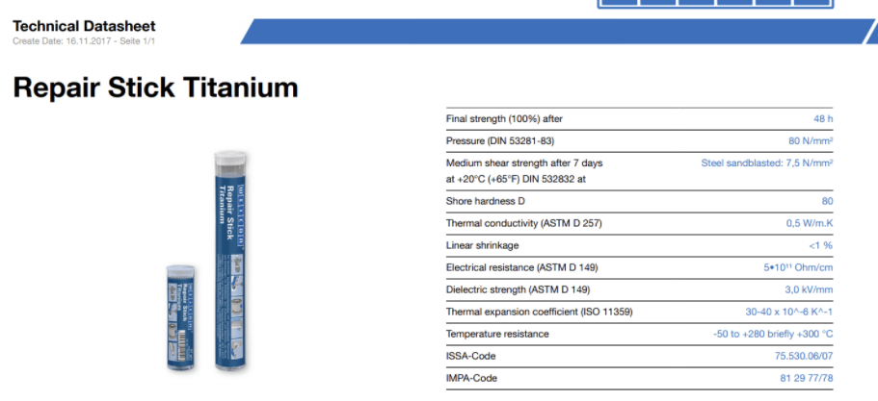
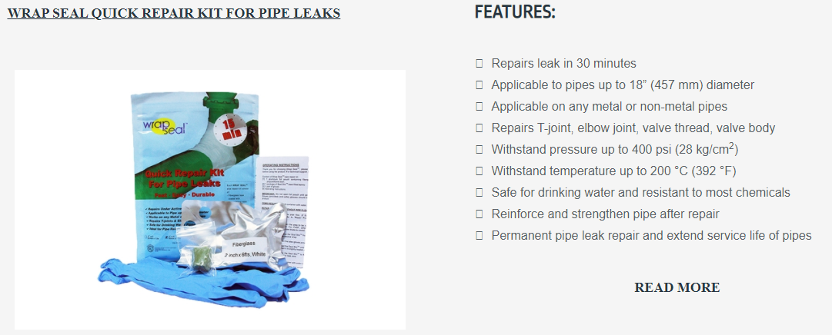
Short term (< 4 weeks)
‘Apply wraps’ or ‘repair sticks’ to the areas of the assembly which have failed.
Pros:
  Cheap, Fast and Easy
Downside:
  Short term
Begin to plan for future activities (NDT + RCA analysis which will require cut out and shut down of the batch process)

Slide 20
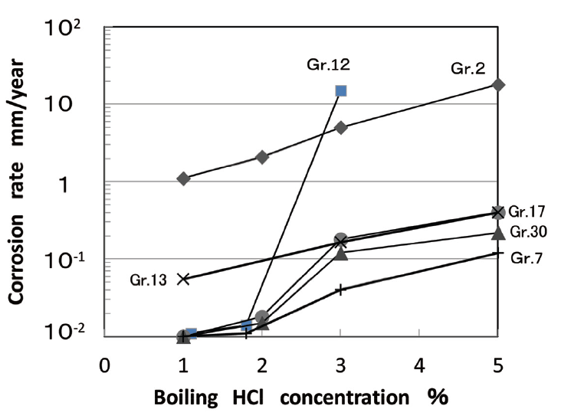
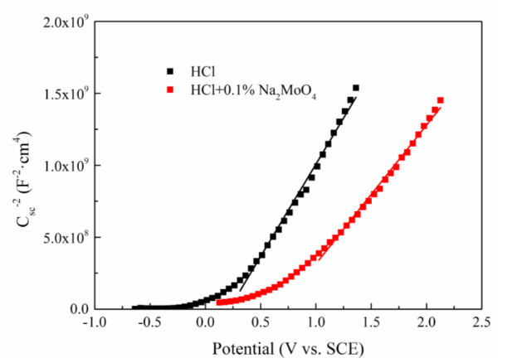
Medium + Long term (till end of life)
With the results from the RCA and NDT. Appropriate action should be implemented:
Replace piping. Ensure appropriate welding procedure.
Corrosion inhibitors/deration of process. (Na2MoO4 possible inhibitor)
Pros + Cons:
  Longer Lasting Solution that should last until end of service
  May be expensive.
  Will only work if process issues are resolved.
Notes:
Na2MoO4 changes titanium from active-passivation state to a passive state at 40C and therefore may be appropriate as an inhibitor for this system.

Slide 21
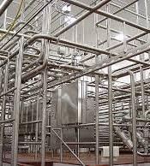
Monitoring (Until End of life)
Monitoring the PH/Oxygen of the spillback line
PH levels should be constant for each batch.
Oxygen levels should be monitored.
If issues with oxygen continue
  new oxygen scavenger in the MEG tank.
Pro + Cons
  Requires some management
  Relatively cheap

Slide 22
Summary
Process: Planned process operating parameters and fluid chemistries were upset over time.
Grade 12: may have been acceptable should the process not have been upset
Causes of Failure: salt slurry, low pH, HCl, O₂, reducing potential; right angle bend TEE joint; susceptible microstructure
Mitigations: short, medium and long term

