Slide 1



Ben Hudson - ICorr YEP Winner 2024
Case Study: Investigation of Dump Condenser Failures
Manchester University, 19th February 2025

Slide 2
Agenda
Introduction
Case Study and Initial Findings
Investigation and Research
Mitigation Strategies
Risk Management
Summary
Q&A

Slide 3
Introduction
1
2
3
4
5
6
7
About me, the team and how we investigated a real-world problem
Notes:
Perspective and self awareness that this project is very complex

Slide 4
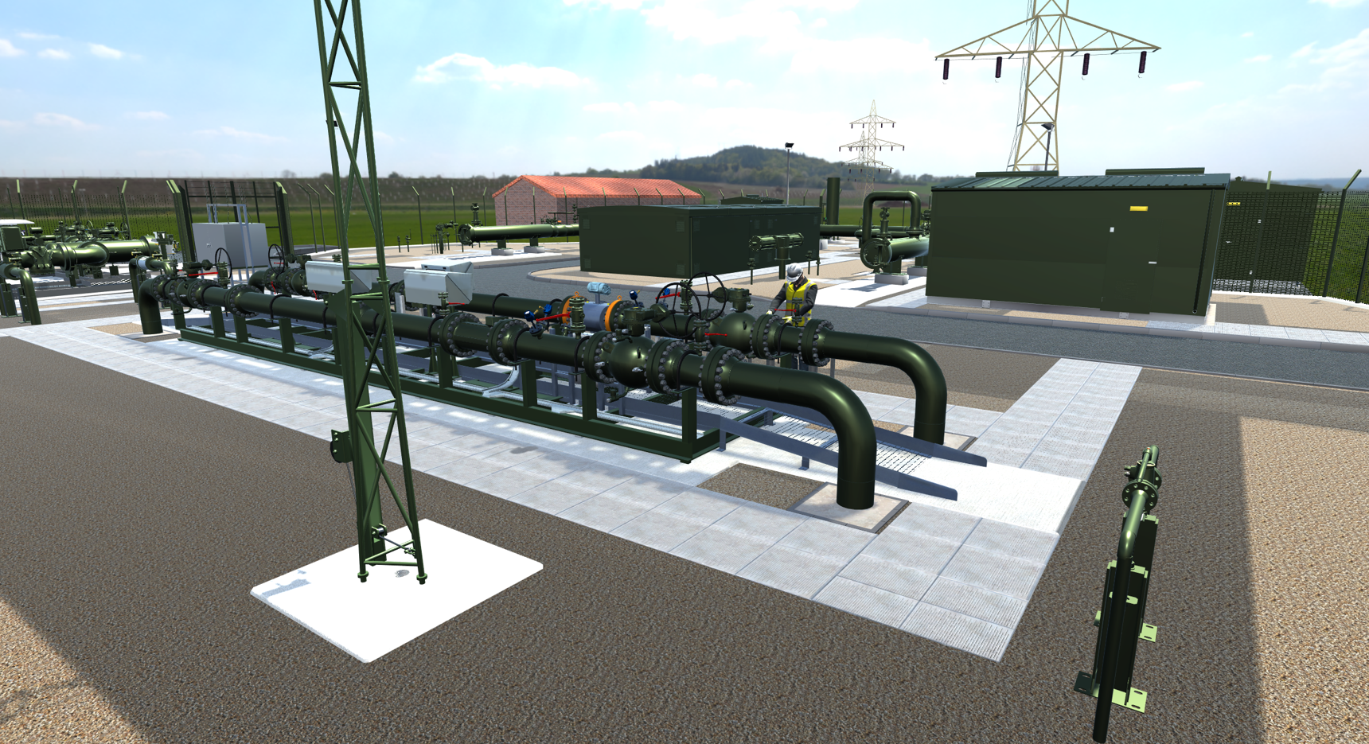
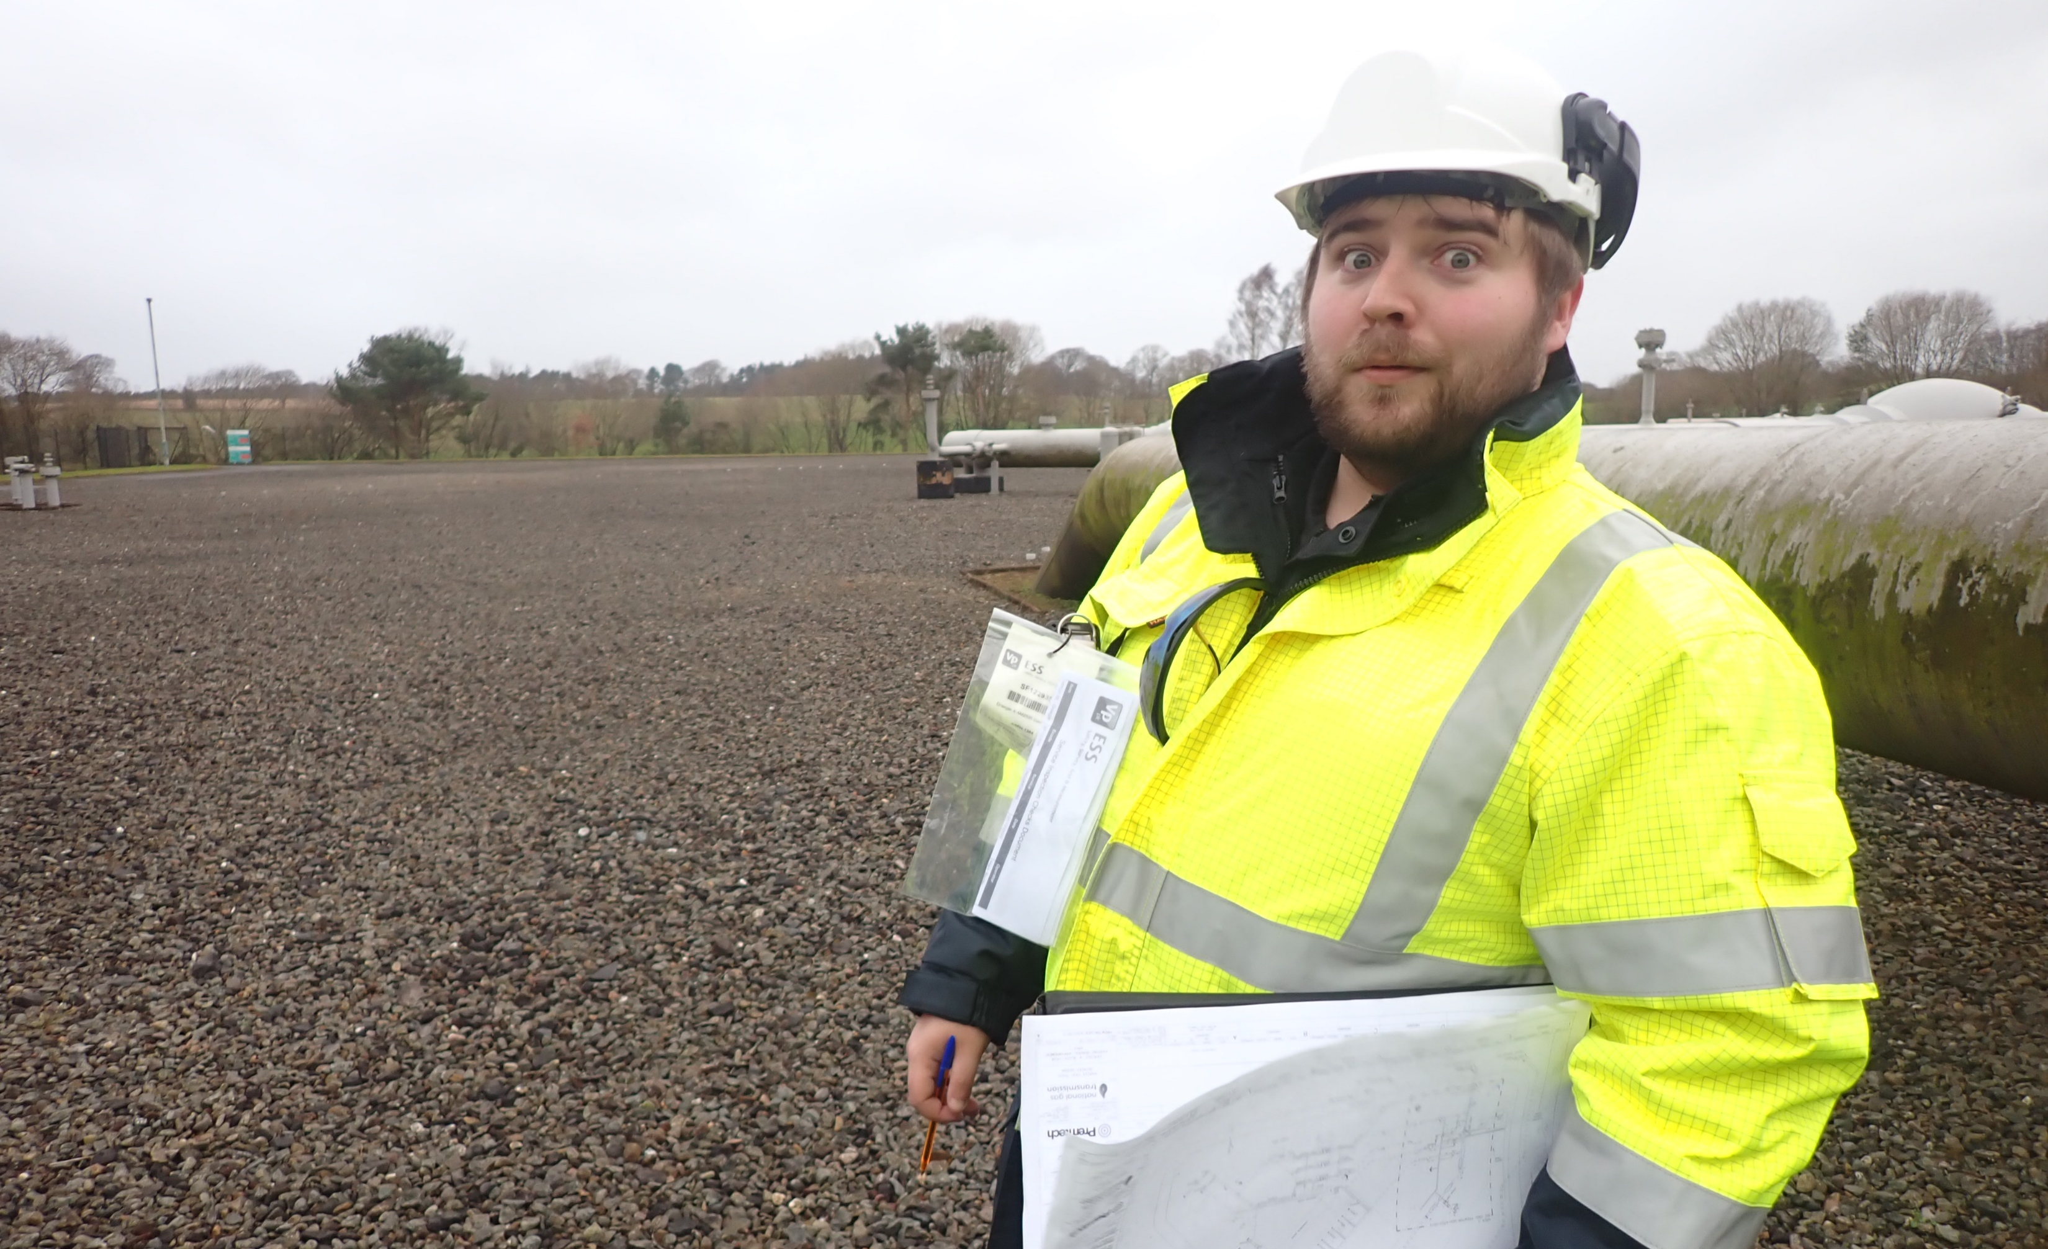
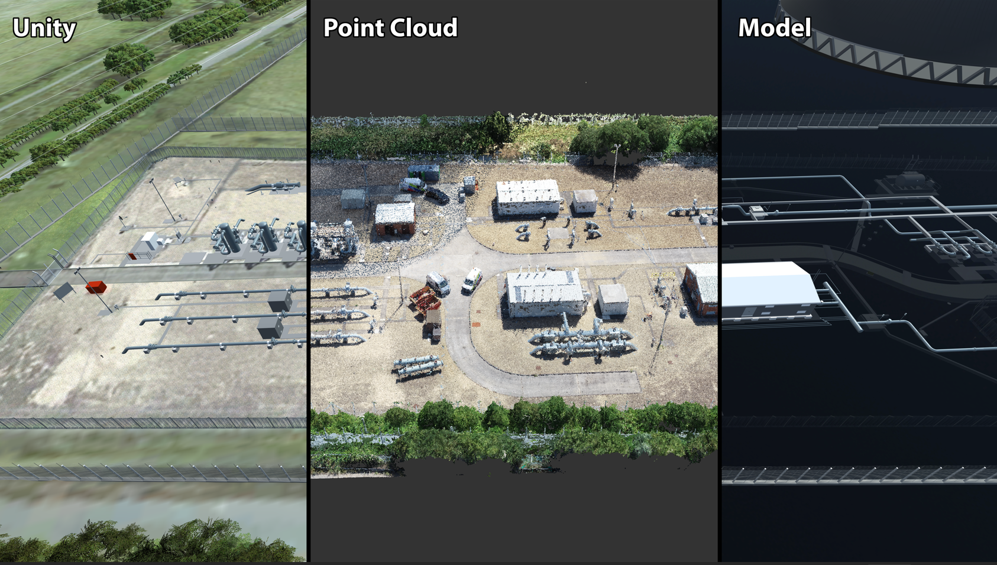
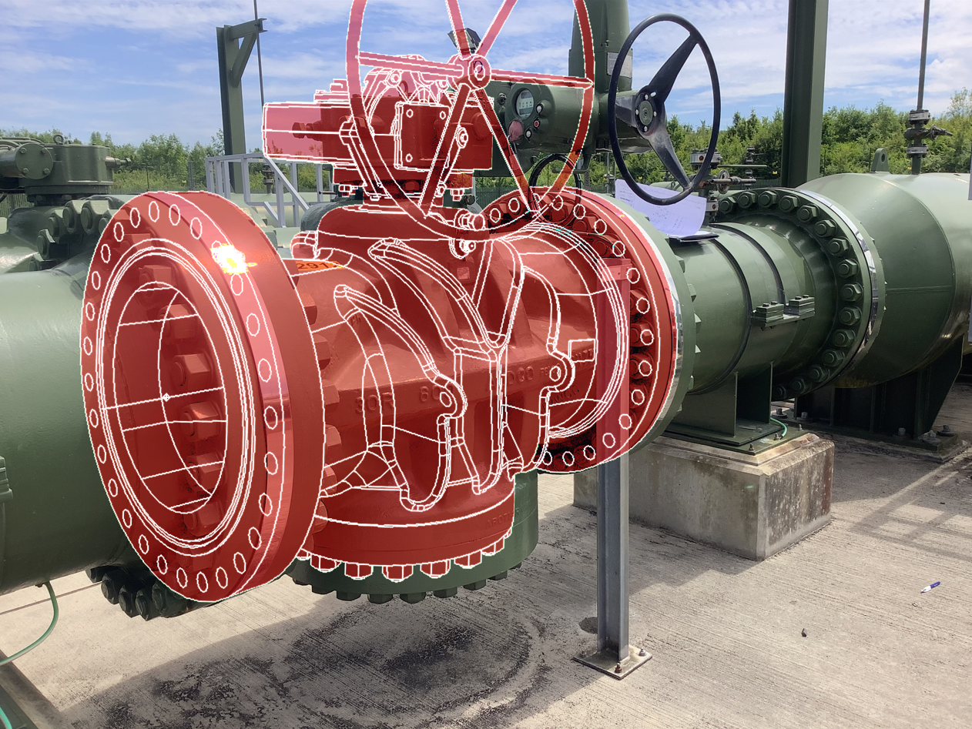
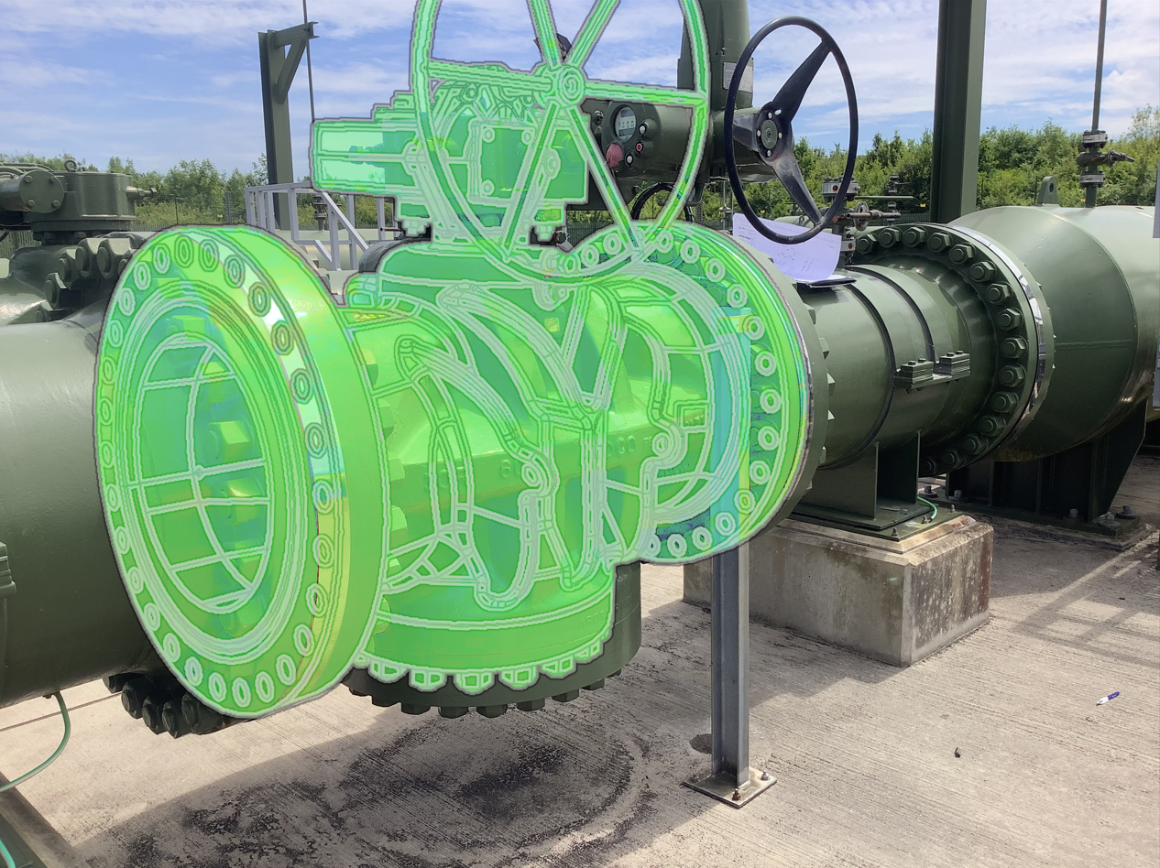

Introduction – About Me
Graduated in Mechanical Engineering from University of Leicester 2022 (MEng Hons)
“Mechanical & CP Engineer” at Premtech Ltd for 2+ years.
Premtech Ltd is a primary designer in the Gas Industry, undertaking a range at projects across the National Transmission System (NTS)
CP Technician Lvl 2 BS EN ISO 15257:2017
Notes:
Perspective and self awareness that this project is very complex

Slide 5
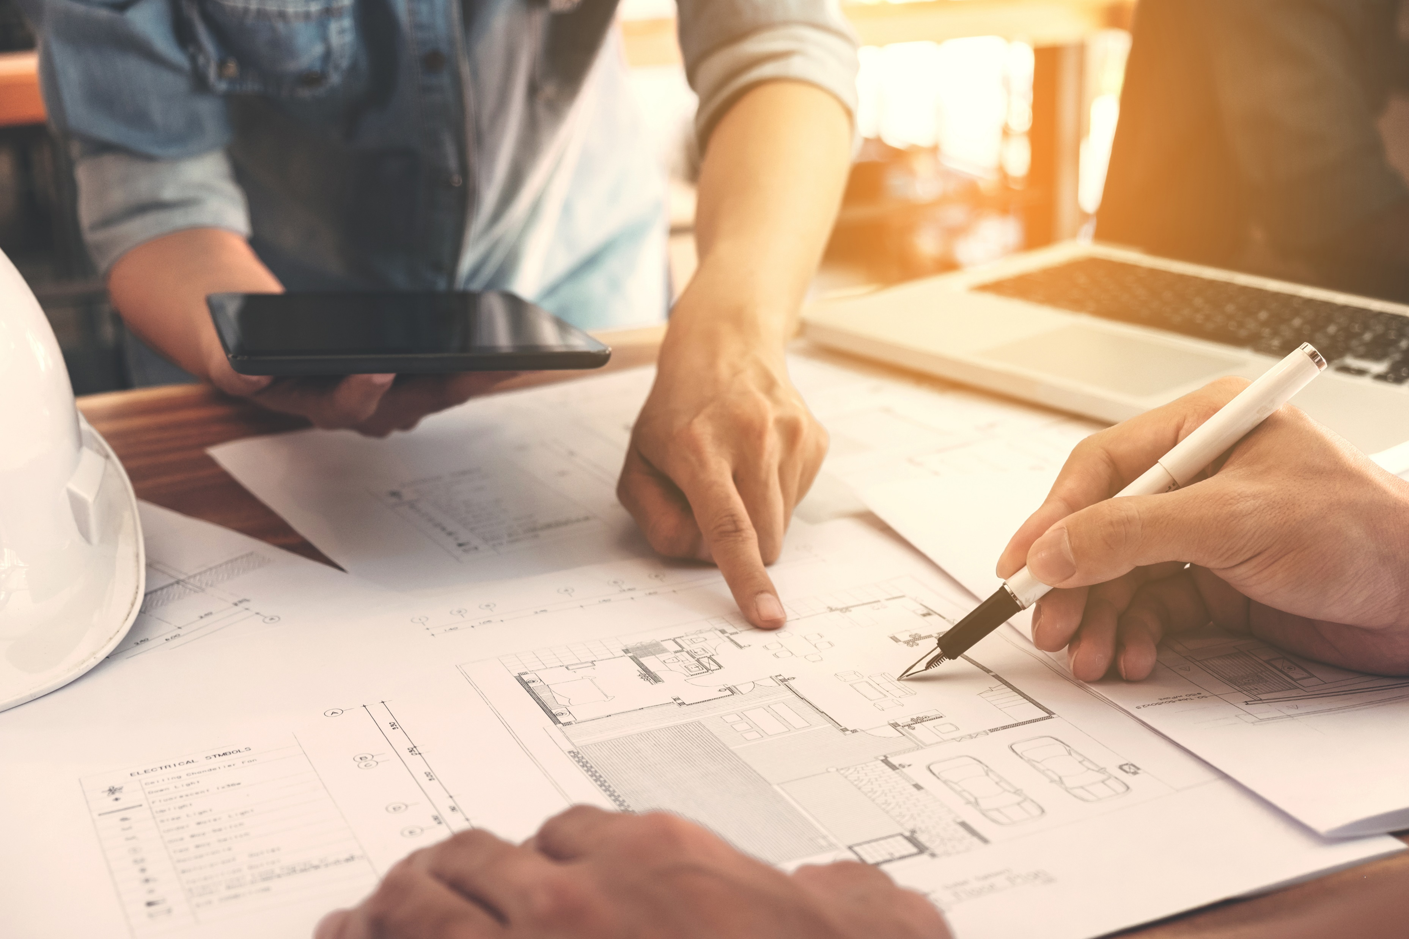
Introduction – Team 1
Team 1 – Ali Morshed (Mentor)
Álvaro González Fuentes Corrosion
Amy Johnstone Structural
Ben Hudson Mechanical
Kishan Nittur Ramesh Integrity
Notes:
Perspective and self awareness that this project is very complex

Slide 6
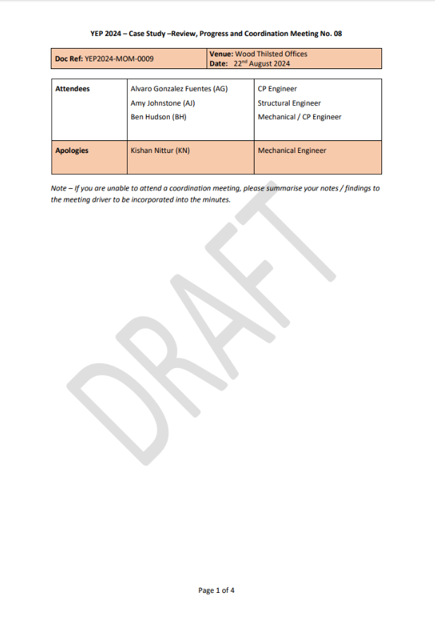
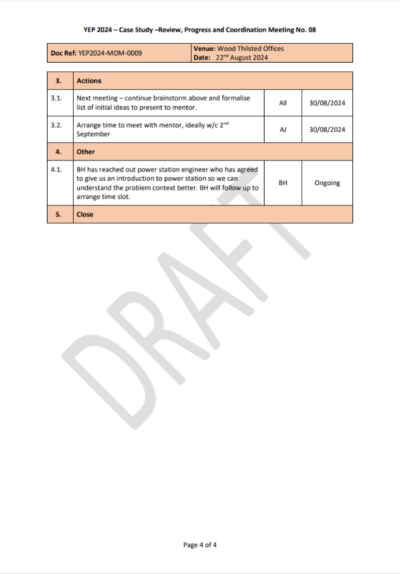
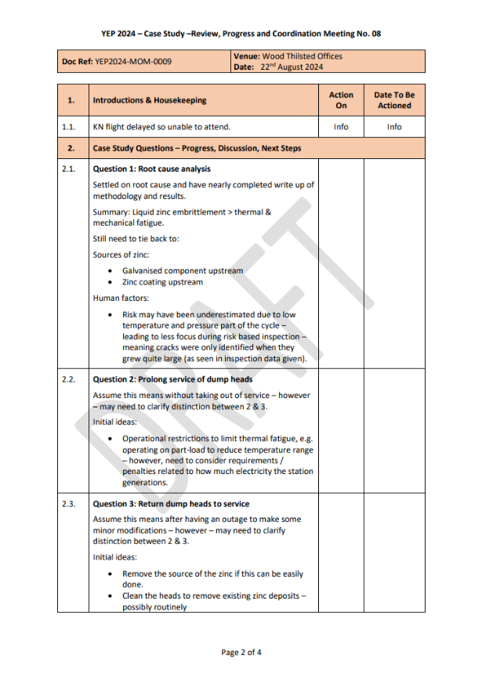
Introduction – Project Management
Weekly meetings on MS Teams
Monthly mentor catchups
Meeting of Minutes
Request for Information (RFI)
Gannt Charts
SharePoint
Honesty
Notes:
Perspective and self awareness that this project is very complex

Slide 7
Case Study and Initial Findings
1
2
3
4
5
6
7
How do you find out why something breaks?
Notes:
Perspective and self awareness that this project is very complex

Slide 8
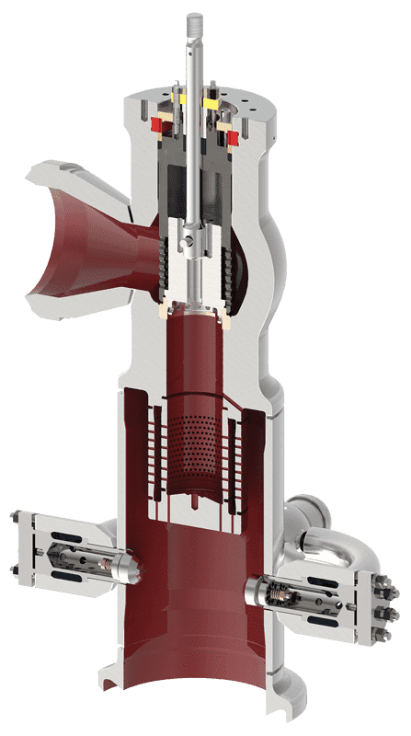
What is a Dump Condenser?
Specialized heat exchanger used in power plants and industrial processes
Rapidly condenses large volumes of steam during sudden pressure fluctuations
Primarily used during start up and shut down procedures
Notes:
Perspective and self awareness that this project is very complex

Slide 9
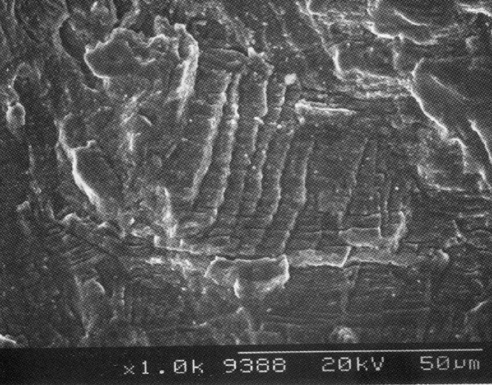
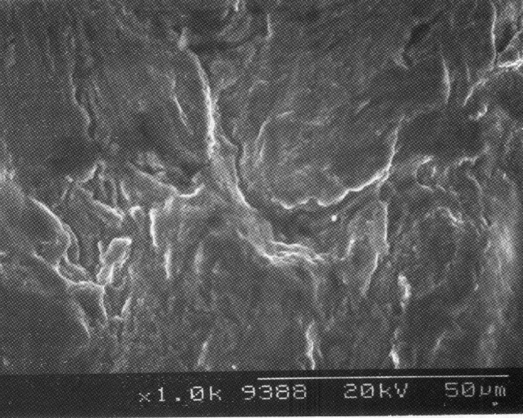
Dump Condenser Failure Scenarios
Operational Information:
Two-shifting operation, shutdown every 16 hours.
Large thermal cycling (~530°C - ~150°C)
Vibration upon quenching by ~20°C feed water.
Alloy composition: C, Mn, Si, Cr, Ni, Mo, N, Ti
Intergranular cracking at Surface ^{[2]}
SEM Analysis
Reported Failure Information:
EDX Analysis – Material Composition
Fracture Surface: Zn, Al, S, Mo, Cl, Ti, Cr, Fe, Ni
Additional Elements at Fracture Surface: Zn, Al, S, Cl, Fe
Transgranular Cracking at 3mm from Surface ^{[2]}
Notes:
Perspective and self awareness that this project is very complex

Slide 10
Failure Outcomes
Dump Condensers Failure Outcomes
Safety
Efficiency
Capacity
Heat Recovery
Environmental Impacts
Cost Savings
Plant Cycling
Resource Conservation
Recognise this small crack can lead to devastating impacts
Identify how this happened and how to prevent this going forward as a Corrosion Engineer
Notes:
Perspective and self awareness that this project is very complex

Slide 11
Investigation and Research
1
2
3
4
5
6
7
How we determined the root cause of the dump condenser failures
Notes:
Perspective and self awareness that this project is very complex

Slide 12
Crack Initiation & Propagation
Damage Mechanism | Operating Conditions (Temperature / Process) | Affected Materials / Alloy Composition | Damage Morphology
Temper Embrittlement | ✗ | ✗ | ✓
Chloride Stress Corrosion Cracking | ✗ | ✓ | ✗
Thermal Shock | ✓ | ✓ | ✓
Liquid Metal Embrittlement | ✓ | ✓ | ✓
Vibration-Induced Fatigue | ✓ | ✓ | ✓
Notes:
Perspective and self awareness that this project is very complex

Slide 13
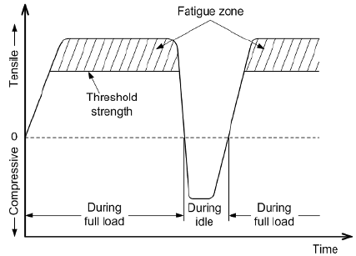
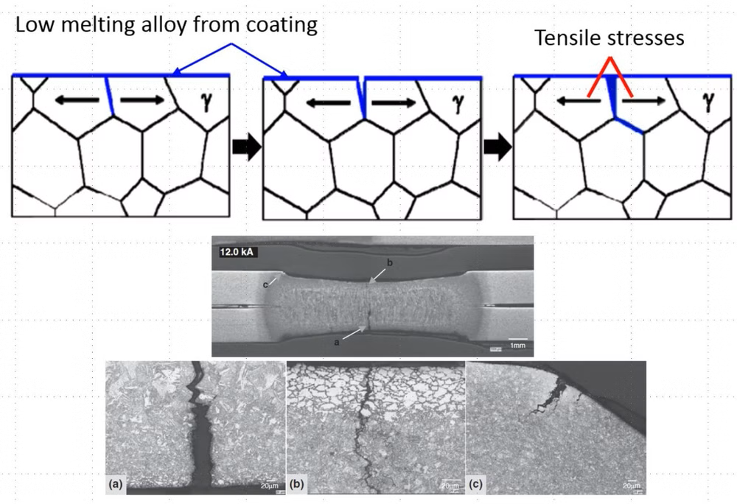
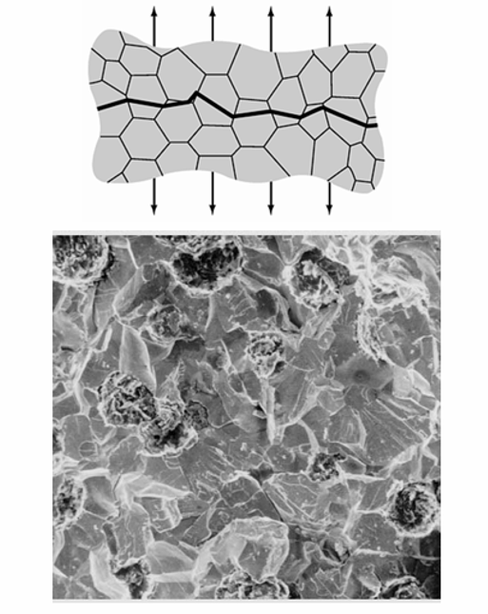
Damage Failure Analysis
Thermal Shock / Fatigue
Thermal Cycling
High & non uniform stress development
Intergranular crack at surface & transgranular crack propagation
Liquid Metal Embrittlement
Low melting point metal contacts specific alloys
Intergranular cracks filled with low melting metals.
Tensile stress – crack propagation
Vibration-Induced Fatigue
Dynamic loading – vibration
Cracking at stress points, discontinuity
Lack of supports / stiffening
Notes:
Perspective and self awareness that this project is very complex

Slide 14
Root Causes
Corrosion Engineering – Process, Foreign materials
Material Selection & Design
Manufacturing, Maintenance & Handling
Risk-Based Inspection
Root Causes
Notes:
Perspective and self awareness that this project is very complex

Slide 15
Mitigation Strategies
1
2
3
4
5
6
7
How can we collectively determine the underlying factors contributing to crack initiation and propagation? What are the short-term and long-term considerations
Notes:
Perspective and self awareness that this project is very complex

Slide 16
Crack Initiation
Mitigation | Short-term | Long-term | Feasibility
Removal of zinc source | ✓ | ✗ | ✓
Coating or sleeve for the condenser surface | ✓ | ✗ | ✗
Cleaning of the steel surface | ✓ | ✓ | ✓
Upgrade steel alloy in condensers | ✗ | ✓ | ✓
Modify temperature of steam water (Corrosion Control Matrices) | ✓ | ✓ | ✓
New condenser design to reduce thermal shock | ✗ | ✓ | ✓
Reduce turbine load | ✓ | ✓ | ✗
Notes:
Perspective and self awareness that this project is very complex

Slide 17
Crack Propagation
Mitigation | Short-term | Long-term | Feasibility
Increased surveillance using risk approach | ✓ | ✓ | ✓
Grinding and weld repair cracks | ✓ | ✗ | ✗
Change in operation conditions (Corrosion Control Matrices) | ✓ | ✓ | ✓
Reduce vibrations in the condenser | ✓ | ✓ | ✓
New condenser design | ✗ | ✓ | ✓
Replace valve like-for-like | ✓ | ✗ | ✗
Notes:
Perspective and self awareness that this project is very complex

Slide 18
Short-Term Mitigations
Liquid Metal Embrittlement
Reduced temperature gradient
General Maintenance
Reduce vibrations in condenser
Eliminate source of zinc
Thermal Shock
Increased surveillance
Vibration-Induced Fatigue
Clean to remove contamination
Failure risk assessment
Add temporary supports
Adjust operating parameters
LOW
TIME AND COST
HIGH
Notes:
Perspective and self awareness that this project is very complex

Slide 19
Long-Term Mitigations
Original design
New Design
Alternative Materials
Control System Upgrades
Double Walled Head
Increased Damping at Supports
Notes:
Perspective and self awareness that this project is very complex

Slide 20
Risk Management
1
2
3
4
5
6
7
Assess and mitigate the potential consequences of dump condenser failures
Notes:
Perspective and self awareness that this project is very complex

Slide 21
Risk Matrix
Severity | F | Catastrophic | Medium | High | Very High | Very High | Very High | Very High
 | E | Major | Medium | Medium | High | Very High | Very High | Very High
 | D | Severe | Low | Medium | Medium | High | Very High | Very High
 | C | Significant | Low | Low | Low | Medium | High | High
 | B | Minor | Low | Low | Low | Low | Medium | Medium
 | A | Insignificant | Low | Low | Low | Low | Low | Low
 |  |  | Remote | Rare | Unlikely | Possible | Probable | Frequent
 |  |  | 1 | 2 | 3 | 4 | 5 | 6
 |  |  | Likelihood
Notes:
Perspective and self awareness that this project is very complex

Slide 22
Failure Modes & Effects Analysis
Cracking of dump condenser heads
Overheating and overpressure
Fragmentation
Blockage of pipework with debris
Impact to inside of pipework
HP steam enters LP pipework
Inefficient operation
Overheating and overpressure
Trip
Failure of pipework
HP steam release
Fire or explosion
Burns and damaged pipework
Trip
Notes:
Perspective and self awareness that this project is very complex

Slide 23
Risk Assessment
Component | Failure Mode | Effect | Likelihood | Severity | Risk | Component Failure Mode Risk
Cracks identified / not inspected | LME and subsequent fatigue cracking | Inefficient operation | 5 | B | M | Very High
 |  | Trip | 4 | B | L
 |  | Burns & Pipework Damage | 3 | D | M
 |  | Fire / Explosion | 3 | F | VH
Inspected, no cracks identified / Short-term mitigations in place | LME and subsequent fatigue cracking | Inefficient operation | 4 | B | L | High
 |  | Trip | 3 | B | L
 |  | Burns & Pipework Damage | 2 | D | M
 |  | Fire / Explosion | 2 | F | H
Long-term mitigations in place | LME and subsequent fatigue cracking | Not Credible |  |  |  | N/A
Notes:
Perspective and self awareness that this project is very complex

Slide 24
Summary
1
2
3
4
5
6
7
Key findings, recommendations and takeaways from the YEP
Notes:
Perspective and self awareness that this project is very complex

Slide 25
Key Findings
Failure of Dump Condenser Heads
Liquid Zinc Embrittlement and Thermal Shock
Thermal & Vibration-Induced Fatigue
Failure Investigation
Fitness For Service Assessments
Alternative Materials
Short-Term Mitigations
Risk-Based Strategy
Long-Term Upgrades
LEARNING AND UNDERSTANDING
Notes:
Perspective and self awareness that this project is very complex

Slide 26
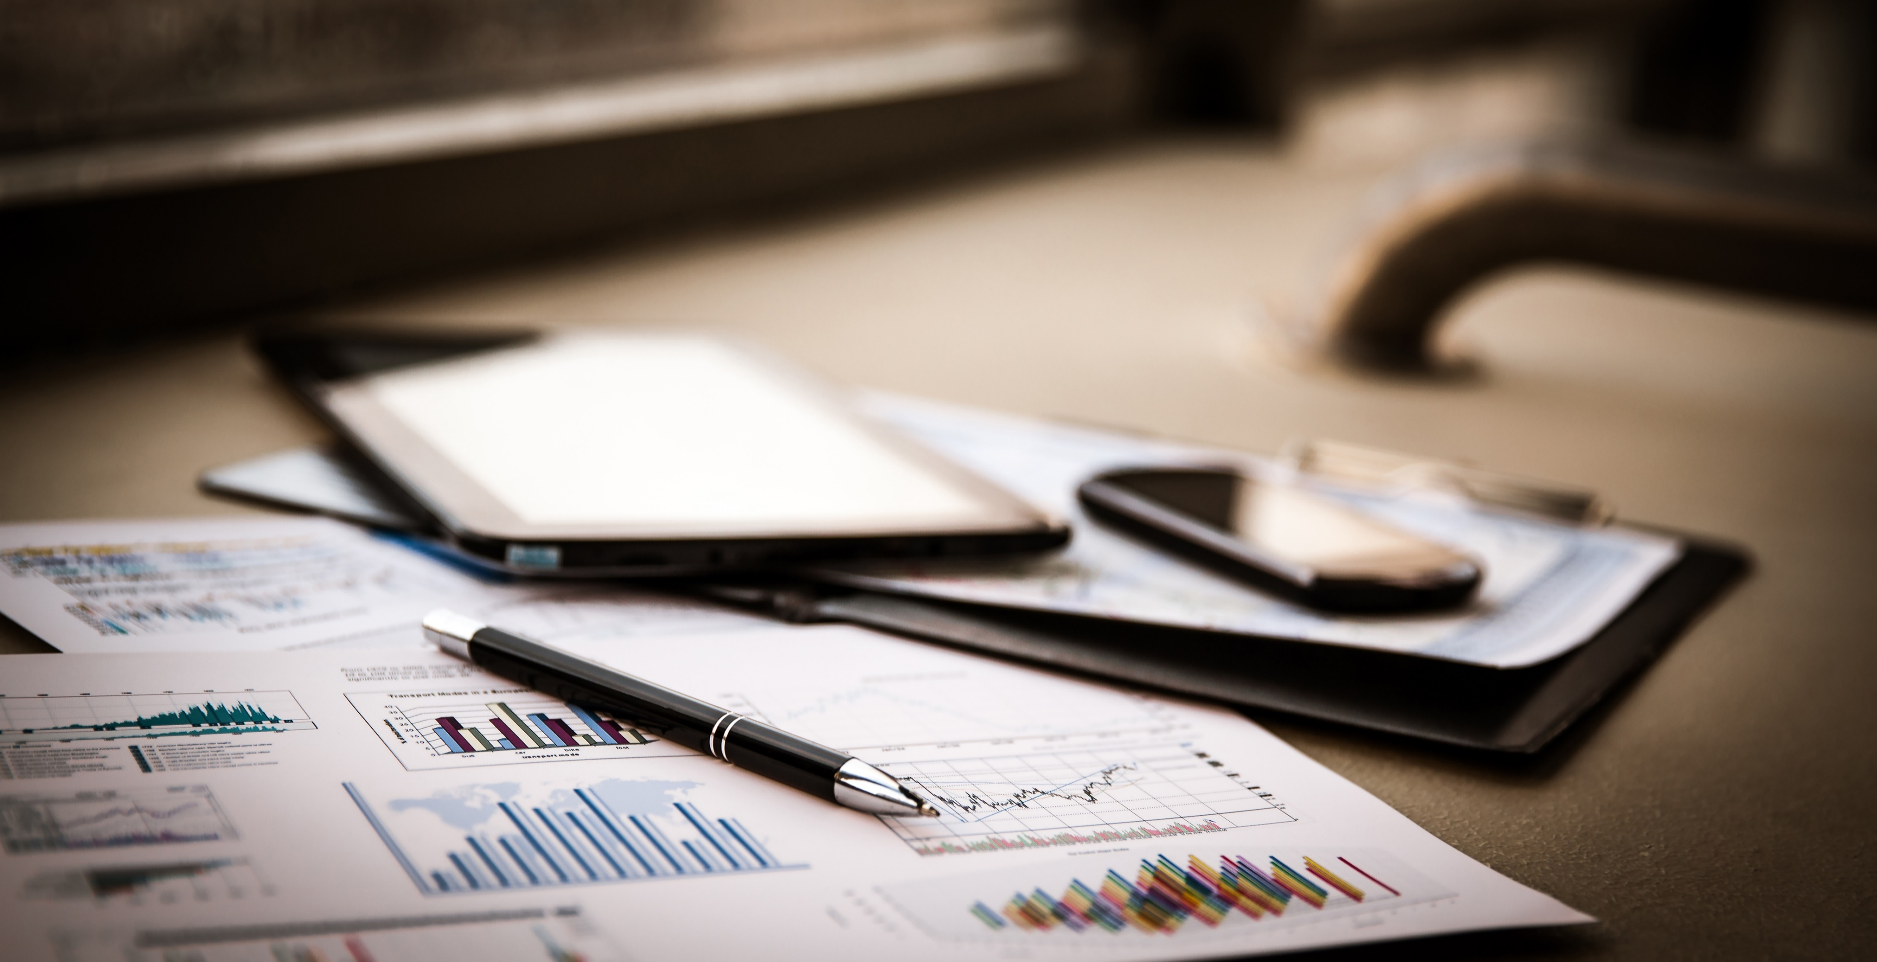
Recommendations and Takeaways
Meet with your team regularly
Understand your teams' strengths and identify any challenges
Manage the project together and share responsibilities
Consider anything and everything
Ask lots of questions within your team
Learning and Understanding
Notes:
Perspective and self awareness that this project is very complex

Slide 27
Q&A
1
2
3
4
5
6
7
Thank you for listening!
Notes:
Perspective and self awareness that this project is very complex

