Slide 1
Effect of Salinity on Corrosion Products on Carbon Steel and Chemical Inhibitor Performance in Geothermal Environments
Harry Tookey, Richard Barker, Robert Kay, Peter Wilkie, Alistair Kirkpatrick, Geoff Hughes, Joshua Owen

Slide 2
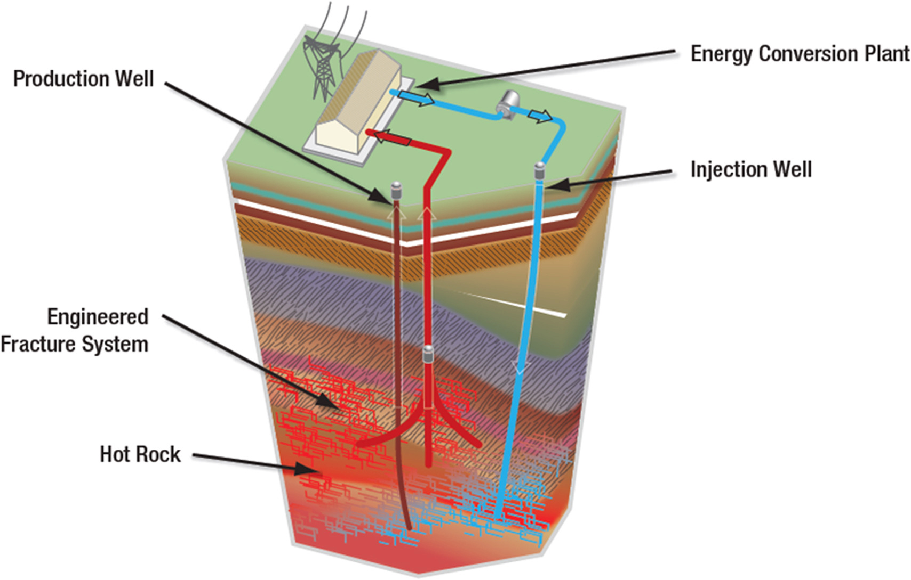
Background – Research Context
Geothermal systems are a reliable energy source that are less carbon-heavy than fossil fuels
Ecological impact from corrosion-related failures can impact biodiversity through water pollution
Many corrosion inhibitors are toxic and environmentally harmful
A large range of operating conditions presents challenges when developing and evaluating potential new inhibitors
Example of geothermal energy plant ^{[1]}
[1] M. A. Quraishi, D. S. Chauhan, and F. A. Ansari, "Development of environmentally benign corrosion inhibitors for organic acid environments for oil-gas industry," of Molecular Liquids, vol. 329, 2021,

Slide 3
Background – Geothermal Conditions
Conditions in geothermal sites can vary greatly in terms of temperature, Total Dissolved Solids (TDS), and pH
Understanding the corrosion mechanism and products requires individualised testing
Site | Temperature (°C) | TDS (g/L) | pH
Neunrandenburg ^{[2]} | 65-85 | 130-134 | 6.0 ± 0.1
Soultz-sous-Forêts^{[3]} | 165 | 100 | 5.03
Rittershoffen^{[4]} | 160 | 101 | 6.27
Rihen^{[4]} | 87 | 15.6 | 6.92
[2] A. Westphal, S. Lerm, R. Miethling-Graff, A. Seibt, M. Wolfgramm, and H. Würdemann, "Effects of plant downtime on the microbial community composition in the highly saline brine of a geothermal plant in the North German Basin," Applied Microbiology and Biotechnology, vol. 100, no. 7, pp. 3277-3290, 2016/04/01 2016
[3] N. Mundhenk, P. Huttenloch, T. Kohl, H. Steger, and R. Zorn, "Metal corrosion in geothermal brine environments of the Upper Rhine graben – Laboratory and on-site studies," Geothermics, vol. 46, pp. 14-21, 2013/04/01/ 2013
[4] B. Sanjuan, R. Millot, C. Innocent, C. Dezayes, J. Scheiber, and M. Brach, "Major geochemical characteristics of geothermal brines from the Upper Rhine Graben granitic basement with constraints on temperature and circulation," Chemical Geology, vol. 428, pp. 27-47, 2016/06/15/ 2016
Notes:
Maybe make it more broad in terms of all high salinity systems

Slide 4

Background – Corrosion Products on Carbon Steel
CO₂ that is dissolved in the geothermal fluids accelerates the corrosion of carbon steel pipes
In certain environments, FeCO₃ can precipitate onto the pipe walls creating a protective layer
A detailed understanding of how the FeCO₃ layer protects the carbon steel surface and interacts with chemical inhibitors is required for the development of alternative chemical inhibitors
CO₂ Equilibrium Reactions
$$CO_{2\left(aq\right)}+H_{2}O_{\left(l\right)}↔H_{2}C{O_{3}}_{\left(aq\right)}$$
$$H_{2}CO_{3\left(aq\right)}↔H_{aq}^{+}+HCO_{3\left(aq\right)}^{−}$$
$$HCO_{3\left(aq\right)}^{−}↔H_{\left(aq\right)}^{+}+CO_{3\left(aq\right)}^{2−}$$
Cathodic Reaction
2H⁺+2e⁻→H_{2(g)}
H₂
H⁺
CO₃²⁻
H⁺
Fe²⁺
Precipitation Reaction
Fe²⁺+CO₃²⁻→FeCO₃
Anodic Reaction
Fe_{(s)} →Fe²⁺ + 2e⁻

Slide 5
Background - Aims
Objectives
Understand how the FeCO₃ layer forms in high-salinity geothermal conditions
Investigate the physical characteristics of FeCO₃
Understand the impact chemical inhibitors have on FeCO₃ formation
Research Gaps
Studying how the combination of high-salinity environments and varying pH impact FeCO₃ formation
High-salinity is quite unknown for these materials and inhibitors

Slide 6
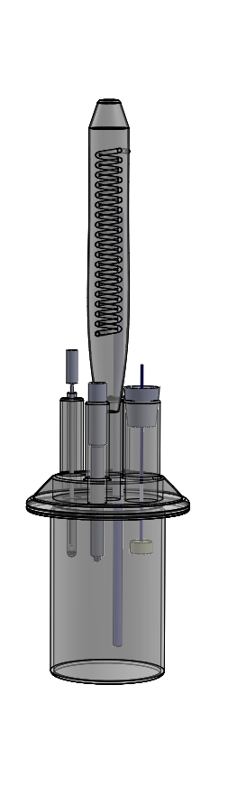
Methodology – Experimental Setup
Conditions
2 wt.%, 12 wt.%, 24 wt.% NaCl Brine
pH 6.2 and 6.8
80 °C
CO₂ Saturated
Temperature Probe
X65 Sample Encased in Resin
Combined Reference and Counter Electrode
CO₂ Inlet
Glass beaker bubble cell setup used for testing with a combined reference and counter electrode

Slide 7
Results – Corrosion Rate of Carbon Steel
pH 6.8
pH 6.2
R_{ct}⁻¹ data on a semi-logarithmic scale for X65 carbon steel in CO₂ saturated brine at 80 °C, pH 6.8 and 2 wt.%, 12 wt.% and 24 wt.% NaCl
R_{ct}⁻¹ data on a semi-logarithmic scale for X65 carbon steel in CO₂ saturated brine at 80 °C, pH 6.2 and 2 wt.%, 12 wt.% and 24 wt.% NaCl
Notes:
6.8 then 6.2

Slide 8
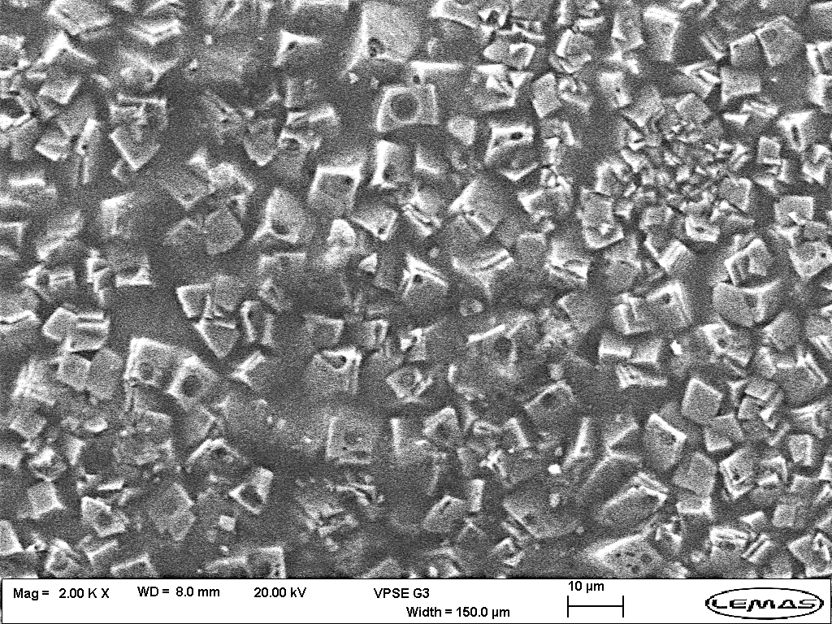
Results – Surface Analysis
SEM Image of the carbon steel surface after 24 hrs in 2 wt.% NaCl brine, pH 6.8, 80 °C
SEM Image of the carbon steel surface after 24 hrs in 12 wt.% NaCl brine, pH 6.8, 80 °C
SEM Image of the carbon steel surface after 24 hrs in 24 wt.% NaCl brine, pH 6.8, 80 °C
As salinity increases the FeCO₃ crystals appear smaller and more compact

Slide 9
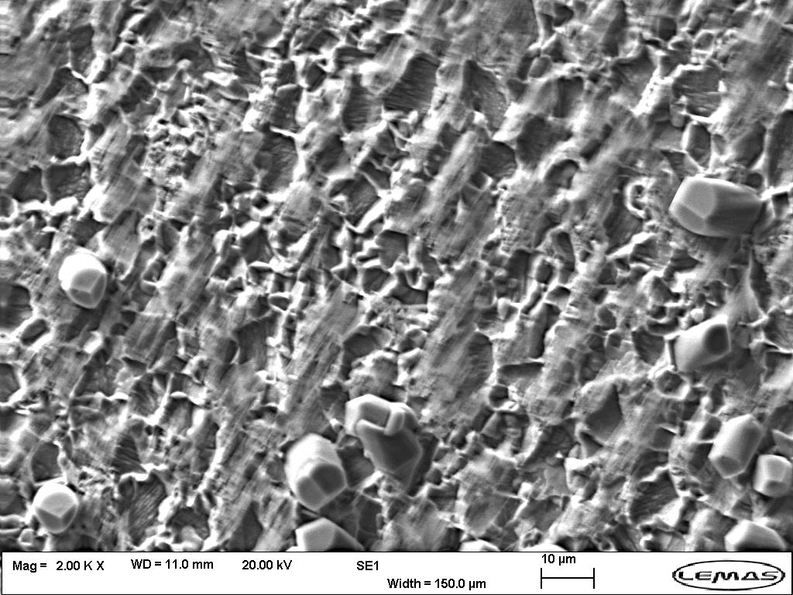
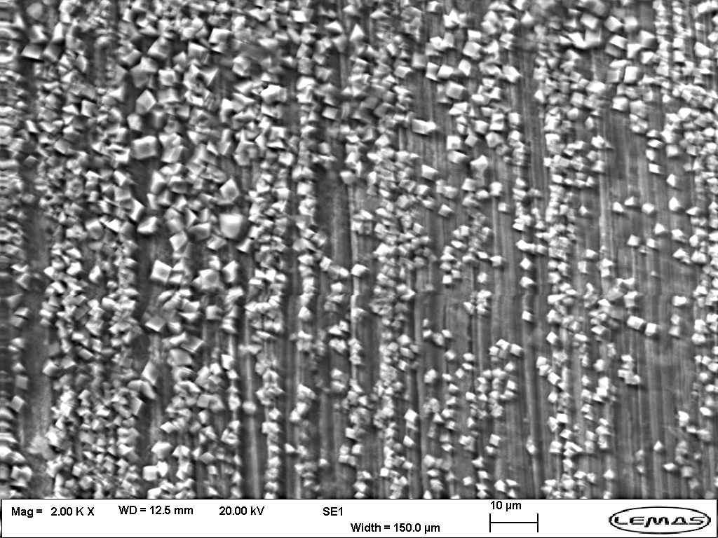
Results – Surface Analysis
SEM Image of the carbon steel surface after 24 hrs in 2 wt.% NaCl brine, pH 6.2, 80 °C
SEM Image of the carbon steel surface after 24 hrs in 12 wt.% NaCl brine, pH 6.2, 80 °C
SEM Image of the carbon steel surface after 24 hrs in 24 wt.% NaCl brine, pH 6.2, 80 °C
On the 12 wt.% FeCO₃ more present and form in the grooves from the sample preparation

Slide 10
Methodology – Inhibitor Dosage
R_{ct}⁻¹ data on a semi-logarithmic scale for X65 carbon steel in CO₂-saturated brine at 80 °C, pH 6.2 and 2 wt.% NaCl with incremental dosing of inhibitors A and B
Notes:
A- A combination of quaternary amine surfactant and an amino acid polymer
B- A combination of a quaternary amine surfactant and an ethoxylated amine salt
FIX SCALE

Slide 11
Results – Corrosion Rate with Chemical Inhibitor
Inhibitor A
Inhibitor B
R_{ct}⁻¹ data on a semi-logarithmic scale for X65 carbon steel in CO₂ saturated brine at 80 °C, pH 6.2 and 2 wt.%, 12 wt.% and 24 wt.% NaCl with 10ppm of Inhibitor A introduced 1 hour into the test
R_{ct}⁻¹ data on a semi-logarithmic scale for X65 carbon steel in CO₂ saturated brine at 80 °C, pH 6.2 and 2 wt.%, 12 wt.% and 24 wt.% NaCl with 10 ppm of Inhibitor B introduced 1 hour into the test

Slide 12
Results – Surface Analysis of Inhibitor A
SEM Image of the carbon steel surface after 24 hrs in 2 wt.% NaCl brine with 10 ppm of Inhibitor A
SEM Image of the carbon steel surface after 24 hrs in 12 wt.% NaCl brine with 10 ppm of Inhibitor A
SEM Image of the carbon steel surface after 24 hrs in 24 wt.% NaCl brine with 10 ppm of Inhibitor A
Notes:
Inhibitor A at top and Inhibitor B on the bottom

Slide 13
Results – Surface Analysis of Inhibitor B
SEM Image of the carbon steel surface after 24 hrs in 2 wt.% NaCl brine with 10 ppm of Inhibitor B
SEM Image of the carbon steel surface after 24 hrs in 12 wt.% NaCl brine with 10 ppm of Inhibitor B
SEM Image of the carbon steel surface after 24 hrs in 24 wt.% NaCl brine with 10 ppm of Inhibitor B
Notes:
Inhibitor A at top and Inhibitor B on the bottom

Slide 14
Results – Comparison of Uninhibited and Inhibited
24 wt.% NaCl
12 wt.% NaCl
Final R_{ct}⁻¹ 2.82x10⁻⁴
Final R_{ct}⁻¹ 1.29x10⁻⁴
Final R_{ct}⁻¹ 9.38x10⁻⁵
Final R_{ct}⁻¹ 5.03x10⁻⁵
Final R_{ct}⁻¹ 7.10x10⁻⁵
Final R_{ct}⁻¹ 3.52x10⁻⁵
R_{ct}⁻¹ data on a semi-logarithmic scale for X65 carbon steel in CO2-saturated brine at 80 °C, pH 6.2 and 24 wt.% NaCl with 10ppm of Inhibitor A and Inhibitor B introduced 1 hour into their respective tests
R_{ct}⁻¹ data on a semi-logarithmic scale for X65 carbon steel in CO2-saturated brine at 80 °C, pH 6.2 and 12 wt.% NaCl with 10ppm of Inhibitor A and Inhibitor B introduced 1 hour into their respective tests

Slide 15
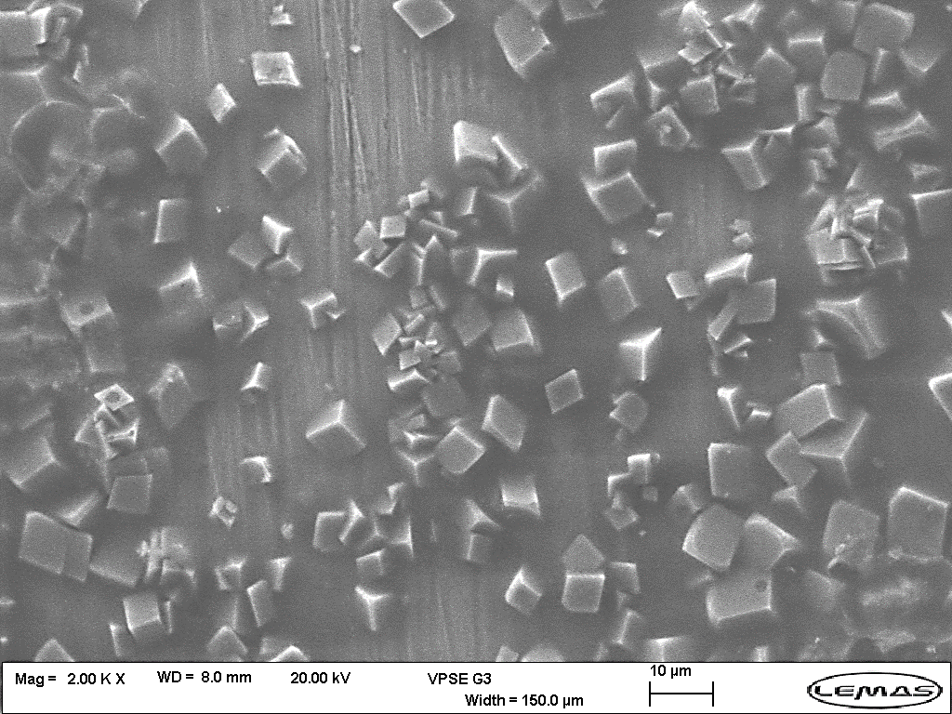
Results – Surface Analysis
SEM image of the carbon steel surface after 24 hrs in 24 wt.% NaCl brine with no chemical inhibitor
SEM image of the carbon steel surface after 24 hrs in 24 wt.% NaCl brine with 10 ppm of Inhibitor A
SEM image of the carbon steel surface after 24 hrs in 24 wt.% NaCl brine with 10 ppm of Inhibitor B

Slide 16
Conclusions
Effect of Salinity on Corrosion Products on Carbon Steel
The concentration of NaCl has an impact on the rate of formation of corrosion products
The reduction in R_{ct}⁻¹ does not appear to be linear to the increase in NaCl concentration
Higher NaCl concentrations appear to reduce the size of FeCO₃ crystals
Effect of Salinity on Chemical Inhibitor Performance
Increase NaCl can impact the final R_{ct}⁻¹ value depending on the inhibitor composition
At higher NaCl concentrations can result in similar performance to the chemical inhibitors

Slide 17
Next Steps
Introducing the chemical inhibitor with different active surface percentages
Impact of chemical inhibitor dose
Investigate how one-through flow cell testing compares
Evaluate alternative chemical inhibitors

Slide 18
Thank You For Listening
Any Questions?
mnhpft@leeds.ac.uk

