Slide 1
ICORR YEP 2024 CASE STUDY:
Failure of Power Station Dump Condensers:
What Really Happened
Roger Francis, Chris Mockler and Tim Healiss

Slide 2
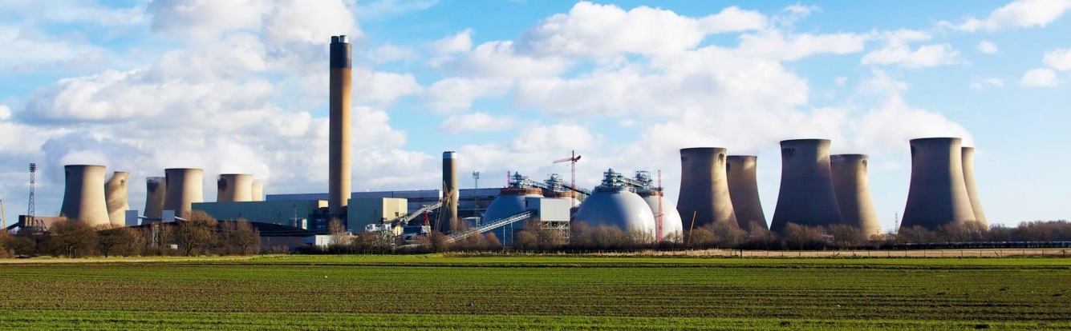
INTRODUCTION
A fossil fuelled power station was two-shifting, necessitating shut down for 8 hours every 24 hours.
The high pressure superheated steam was quenched with high purity water in a series of dump condensers so that it could be used as boiler feed water on restart. This is standard power station practice.
The steam was diverted from the superheater discharge to the dump condensers, and the dump heads vibrated as the hot, high pressure steam was quenched.

Slide 3
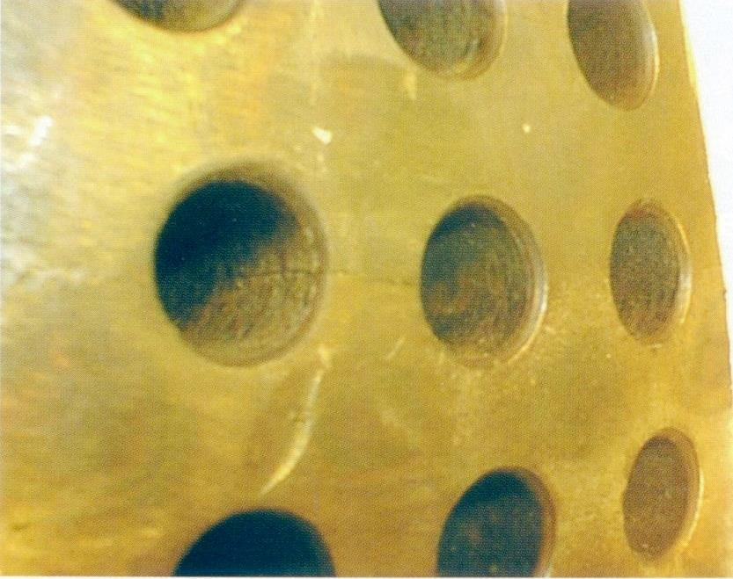
OPERATION
The dump condensers consisted of hemi-spherical domed heads ~0.7m diameter and 25 mm thick with 12 rows of 12 mm diameter holes.
The steam came from inside the head and was sprayed with high purity water (boiler feed quality) on the outside of the head.
This was a large power station with several dump condenser heads.
The dump heads were in stainless steel, with some in 316L (UNS S31603) and others in 316Ti (UNS S31635).

Slide 4
OPERATING CONDITIONS
Steam inlet temperature ~530°C.
Final steam temperature ~150°C.
Quench water temperature ~20°C.
Discharge pressure = that at the superheater discharge to the HP turbines.
The boiler feed water was low chloride (<2 mg/L) and contained typical feed water additives, such as pH control, oxygen scavenger, and anti-fouling chemicals.
We did not have a water analysis but were assured that the boiler feed water met the specification.

Slide 5
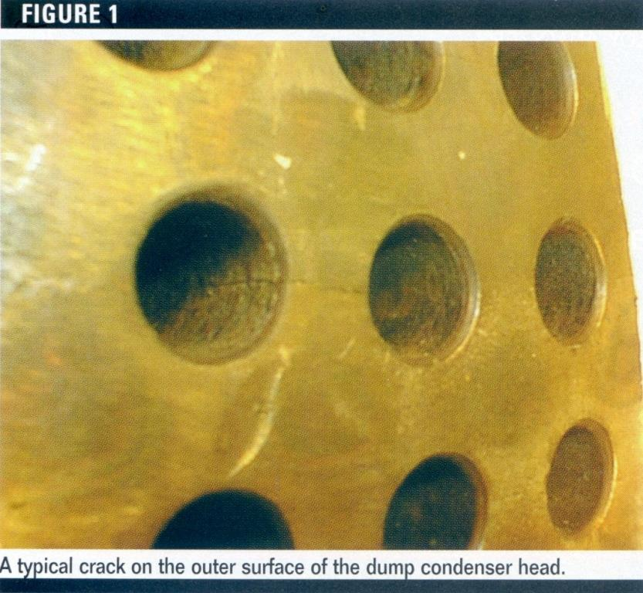
OPERATION
After a few months a 316L head failed, followed by further failures of 316L heads. Later failures were in 316Ti. The failures took the form of cracks.
Crack

Slide 6
HISTORY 1
There were several interested parties:
  A) The State Electricity company
  B) The French company who designed the heads
  C) The company that supplied the heads
After the first failures all parties commissioned separate laboratory examinations and testing to determine the cause of the failures.
There was no agreement between the laboratories on the cause of the cracks, although 2 of the 3 labs thought that the cracks propagated by thermal or vibrational fatigue.
The authors’ laboratory belonged to the same group as company C and we were asked to look at a sample of a failed head and give our comments.

Slide 7
ALLOYS
ALLOY | COMPOSITION (wt.%)
 | C | Mn | Si | Cr | Ni | Mo | N | Ti
316L | 0.03 | 2.0 | 0.75 | 16-18 | 10-14 | 2-3 | 0.1 | -
316 | 0.08 | 2.0 | 0.75 | 16-18 | 10-14 | 2-3 | 0.1 | -
316Ti | 0.08 | 2.0 | 0.75 | 16-18 | 10-14 | 2-3 | 0.1 | 5xC+N
The only difference between 316L and 316Ti is the high carbon content in 316Ti, but the Ti will preferentially form titanium carbides and nitrides, preventing sensitization on heating.
All laboratories agreed that both the 316L heads and the 316Ti heads met the compositional requirements.

Slide 8
MECHANICAL PROPERTIES 1
The graph shows the minimum 0.2% proof stress for the alloys up to 550°C, taken from Stahlschlussel (1992).
It is clear that 316Ti is significantly stronger than 316L at all temperatures.

Slide 9
MECHANICAL PROPERTIES 2
The higher 0.2% proof stress of 316Ti compared with 316L is also reflected in the higher allowable stresses for 316Ti in the ASME VIII div 1 pressure vessel code.
The dump heads were hot formed without a subsequent solution anneal.
However, all the reports agreed that both alloys met the minimum mechanical properties for each grade.
The absence of a solution anneal had obviously not affected their mechanical properties in any significant way.

Slide 10
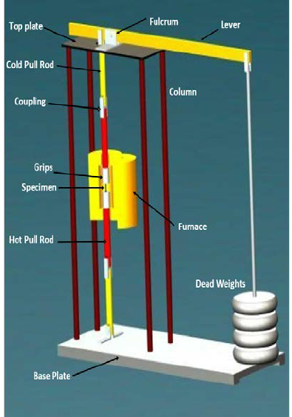
FAILURE MECHANISMS 1
CREEP
ASTM data shows that 316 has a slightly higher creep strength than 316L at 538°C, but these figures are higher than the 0.2% proof stress at that temperature.
As design codes limit the design service stress to some fraction of the 0.2% proof stress (e.g. 2/3), it is unlikely that creep played any part in the dump head cracking.

Slide 11
FAILURE MECHANISMS 2
SENSITIZATION
At elevated temperatures it is possible for chromium carbides to form on the grain boundaries of stainless steels. These reduce the corrosion resistance and can increase the susceptibility to cracking.
Alloy 316L has a low carbon content to prevent this, and the titanium in 316Ti will preferentially form titanium carbides.
Microsections of the heads showed a fully austenitic structure with NO precipitates on the grain boundaries.
Hence, sensitization was not regarded as a cause of the cracking.

Slide 12
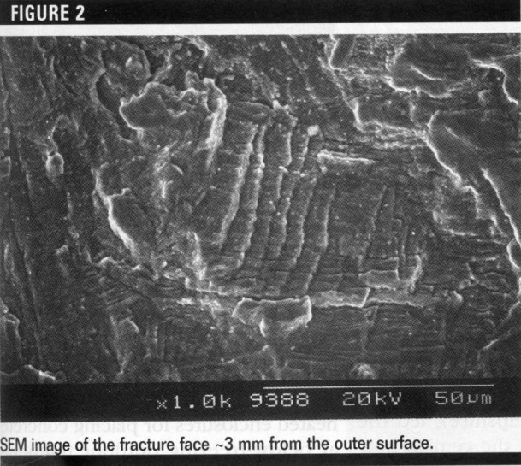
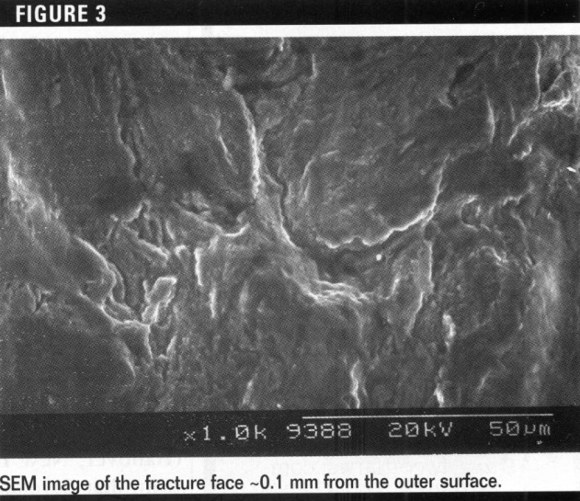
FAILURE MECHANISMS 3
FATIGUE
The SEM picture from 3mm below the surface clearly shows the typical “beach marks” of fatigue.
However, the picture close to the surface shows cracking but not that typical of fatigue.
Hence, it can be concluded that crack propagation was by fatigue.

Slide 13
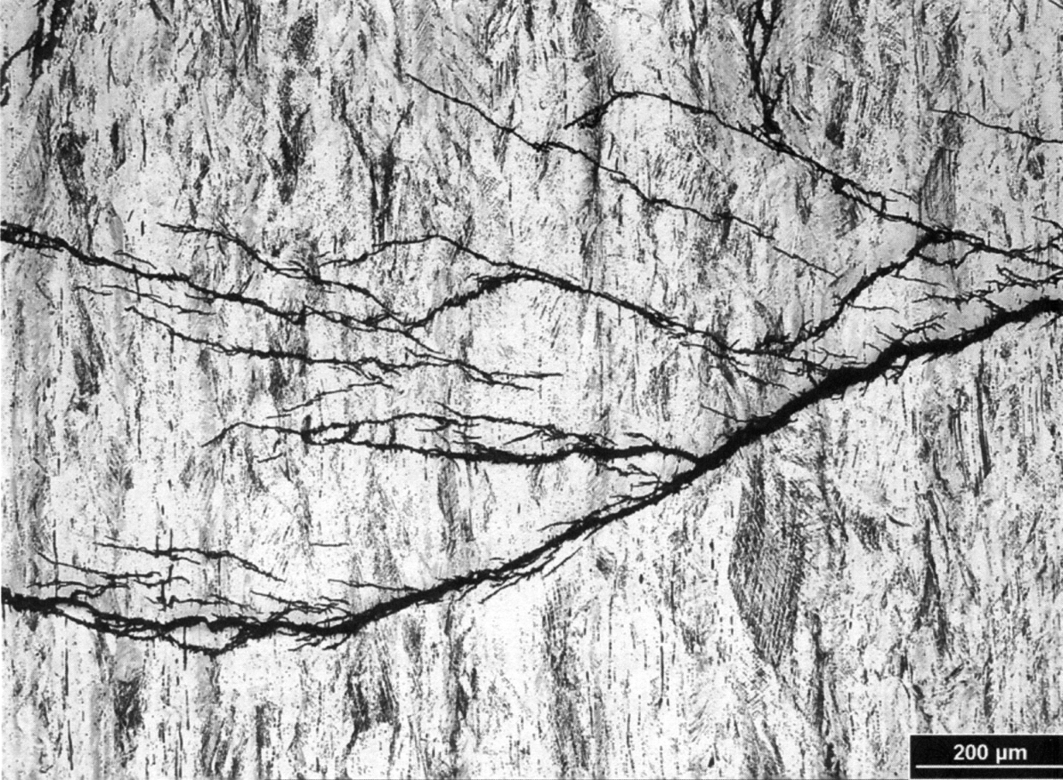
FAILURE MECHANISMS 4
SCC
Typical chloride SCC cracks in 300 series alloys are transgranular and fine with many branches.
The cracks in the dump heads were intergranular, broad and blunt ended, with very few branches.
This appearance is much more typical of fatigue cracks.
Also the low chloride content and deaeration of the water suggest that SCC would be difficult to initiate.
SCC cracks in 300 series stainless steels often start from small pits, which can act as stress raisers.
No such pits were seen , so SCC was ruled out as the cause of the crack initiation.

Slide 14
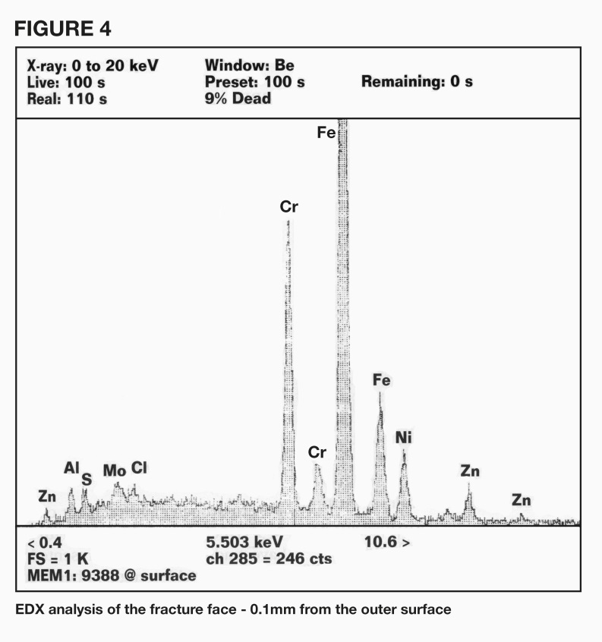
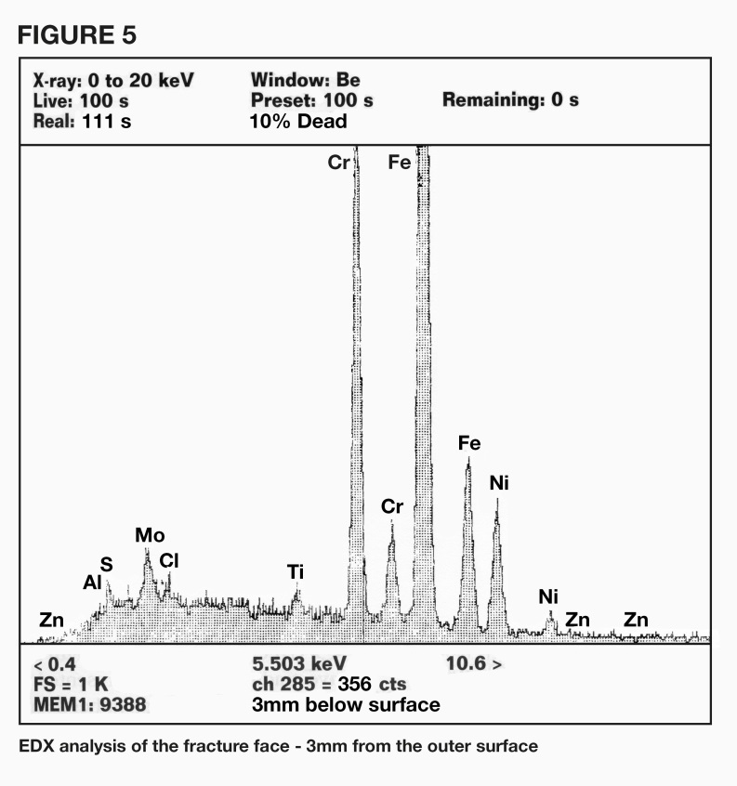
FURTHER EXAMINATION 1
In addition to the iron, chromium nickel and molybdenum from the alloy, zinc was identified on the surface, which was not present 3mm from the surface.

Slide 15
FURTHER EXAMINATION 2
Spot tests for zinc on the surface did not detect any.
To confirm the presence of zinc, a small sample was dipped into 10% hydrochloric acid, so that only the near surface was immersed.
The solution was then analysed by atomic absorption and zinc was found.
This test was repeated in triplicate and all samples showed the presence of zinc.
The manner of the testing also strongly suggests that the zinc was on the surface and was not uniform but in small isolated patches.

Slide 16
CAUSE OF FAILURE
The presence of zinc on the surface and the fact that it would be molten at the steam inlet temperature, strongly suggest that liquid metal embrittlement of the dump head occurred.
This would seriously weaken the grain boundaries, and cracking could then be initiated by thermal fatigue.
Cracking could then propagate by continued thermal fatigue and/or vibrational fatigue, as the steam was being quenched.
The higher strength of the 316Ti explains why the 316L heads failed first.
The ASM Handbook volume 11 says that ferritic steels (including 9%Cr) are not susceptible to liquid metal embrittlement by zinc.
As 9%Cr steels are used in the superheaters at power stations, it was suggested that a 9%Cr steel be used for replacement heads.

Slide 17
WHAT HAPPENED NEXT
We asked if we should determine the source of the zinc, but were told by company C that our report had removed any blame from them and it was up to the power station to do this.
Because of the sporadic nature of the zinc on the outside surface, we suspected that the zinc occurred as contamination during installation.
The power station opted to replace the dump heads with 9%Cr steel as they failed.
We do not know what actions were taken to keep the station operational until the new heads were available.

Slide 18
POSTSCRIPT
By sheer chance I was visiting Canada a year or so later and met one of the engineers who had designed the dump heads.
I discussed the failures we had seen and said that 9%Cr was immune to zinc embrittlement and was also lower cost than 316L or 316Ti.
He said he would change the material selection for the dump heads in future projects.

