Slide 1
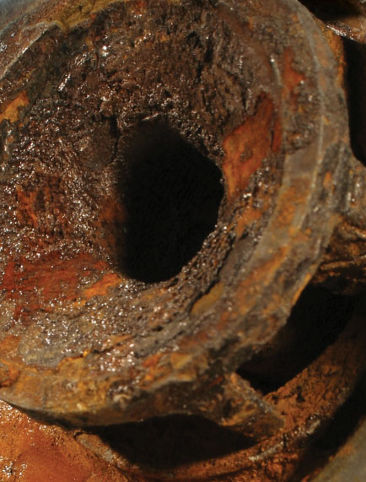
The role of hydrodynamics on the corrosion of mild steel in oxygen-containing water
Finlay Spence
Institute of Functional Surfaces

Slide 2
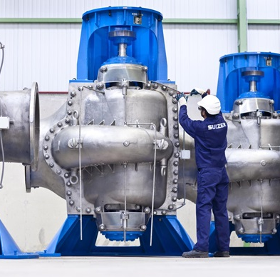
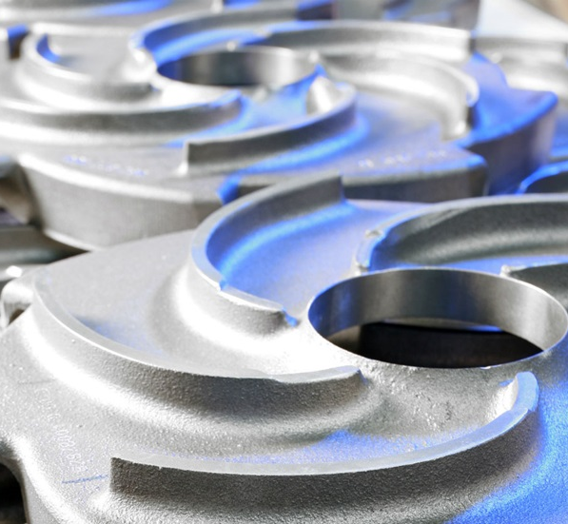
Background & Aim
Conditions commonly encountered in industrial applications, e.g. drinking water distribution, district heating, desalination
Limited understanding of how flow affects corrosion rate, especially in complex geometries such as pumps
Uncertainty means stainless steel is often used; very expensive due to large size of pumps
Aim:
Build comprehensive understanding of how hydrodynamic factors influence corrosion rate of mild steel, in particular:
Determination of velocity – corrosion rate relationship
Develop robust mathematical model for prediction of corrosion rate
Clear guidance for use of mild steel in pumps
2

Slide 3
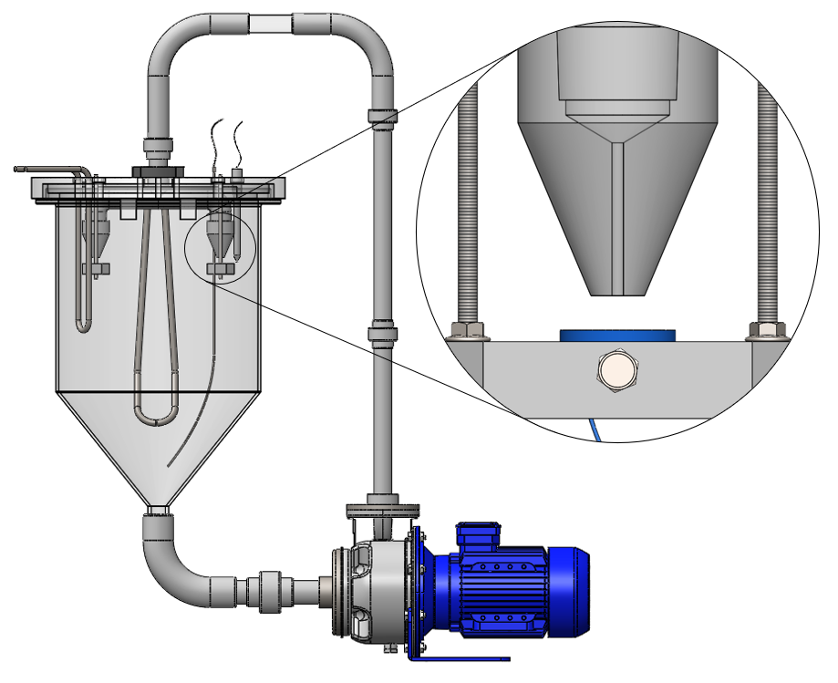
Method
Experiments carried out using a submerged impinging jet system to establish corrosion behaviour
High flow velocities possible; non-uniform flow to simulate complex geometry
Test conditions:
Jet velocity: 6-14 m/s
Temperature: 30-70 °C
Solution chemistry: DI water, 200 ppm NaCl (drinking water level)
S275 steel sample
Duration: 7 hours
Steel sample mounted in resin
3

Slide 4
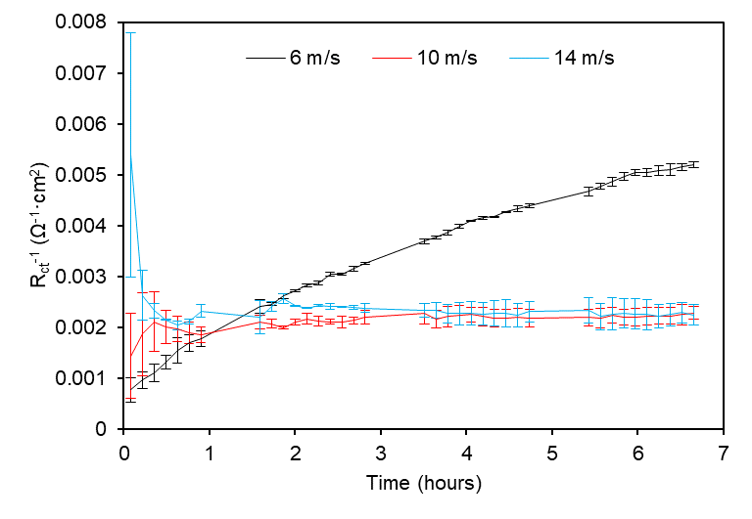
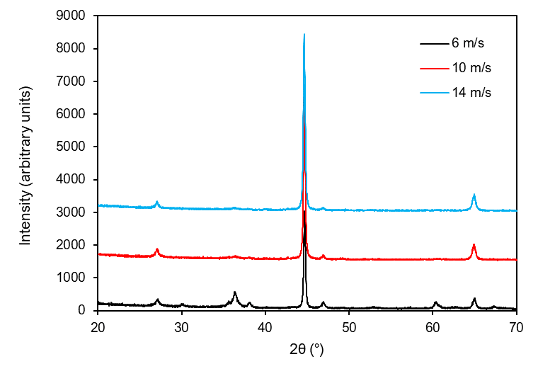
Results at 30 °C
Initially highest at 14 m/s, lowest at 6 m/s.
R_{ct}⁻¹ tends to similar values at 10 and 14 m/s.
R_{ct}⁻¹ continuously increases at 6 m/s.
Linear polarisation data @ 30 °C
X-ray diffraction peaks @ 30 °C
FeO(OH)
Fe₃O₄
Fe₃O₄
4

Slide 5
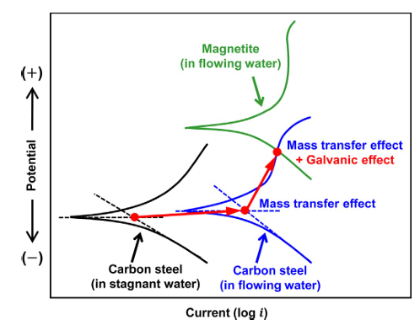
Magnetite Galvanic Effect
Magnetite is a semi-conductor, can form a galvanic couple with exposed steel
Mild steel has lower potential than magnetite, so anodic reaction is accelerated on it
Corrosion rate acceleration is dependent on cathode-anode ratio
Surface of dried steel sample, post-test at 6 m/s, 30 °C
Song et al. Galvanic effect of magnetite on the corrosion behavior of carbon steel in deaerated alkaline solutions under flowing conditions. Corrosion Science. 2018, 131, pp. 71-80.
5

Slide 6
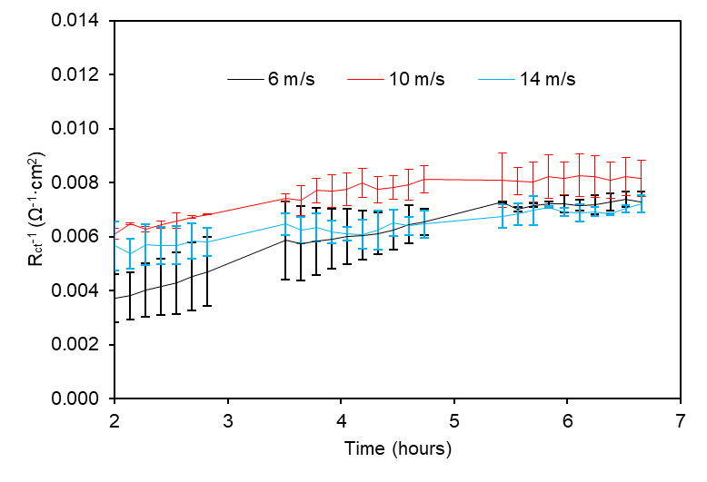
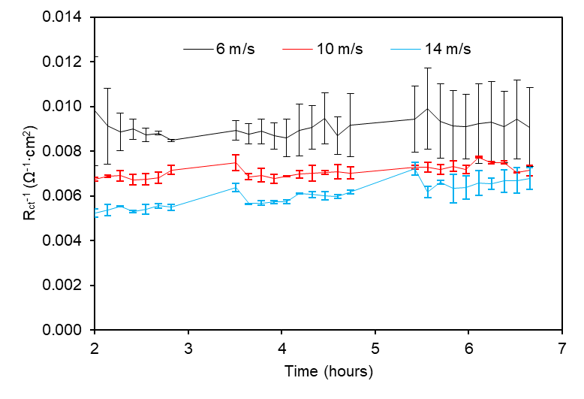
Results at 50 °C and 70 °C
Galvanic acceleration of corrosion rate also occurs at higher temperatures
At 70 °C, the corrosion rate acceleration is less apparent
Linear polarisation data @ 50 °C
Linear polarisation data @ 70 °C
6

Slide 7
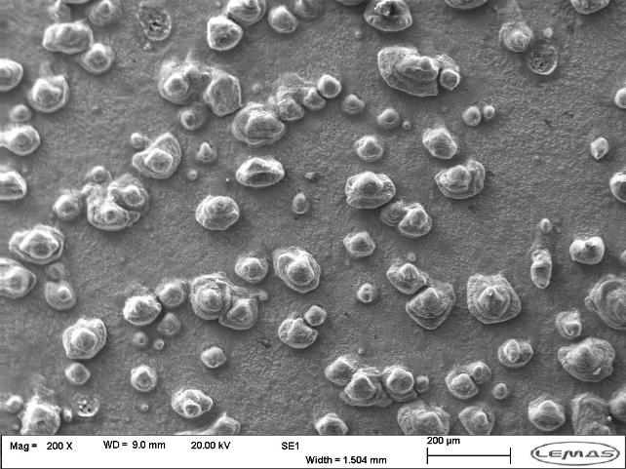
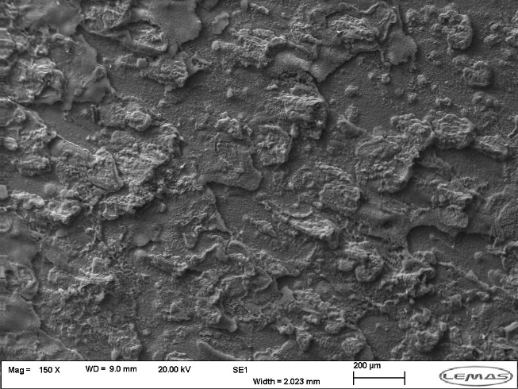
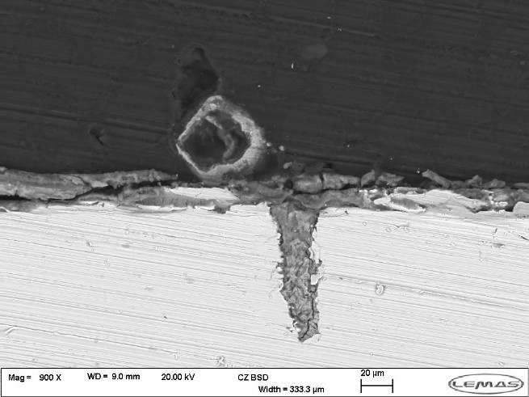
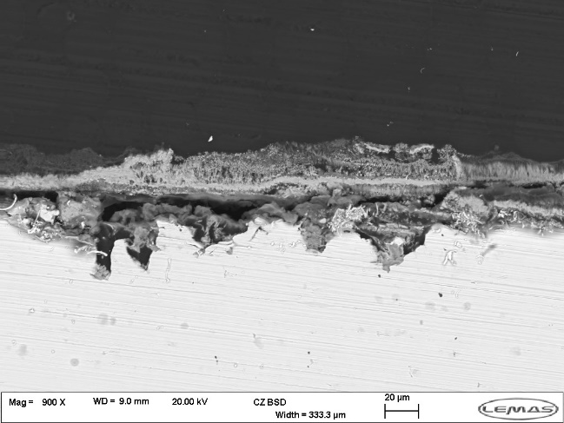
Surface Images at 50 °C
100 μm
Top view
100 μm
Top view
50 μm
Cross section
50 μm
Cross section
7

Slide 8
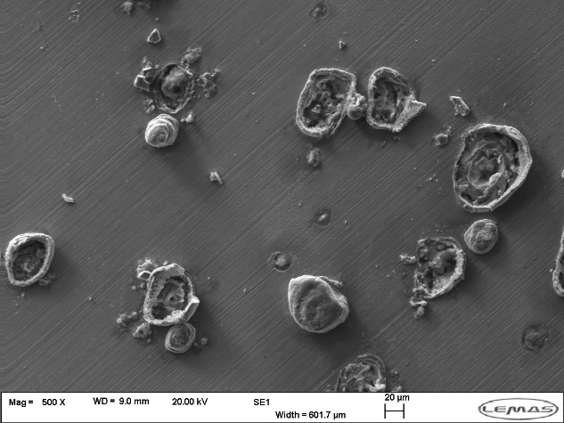
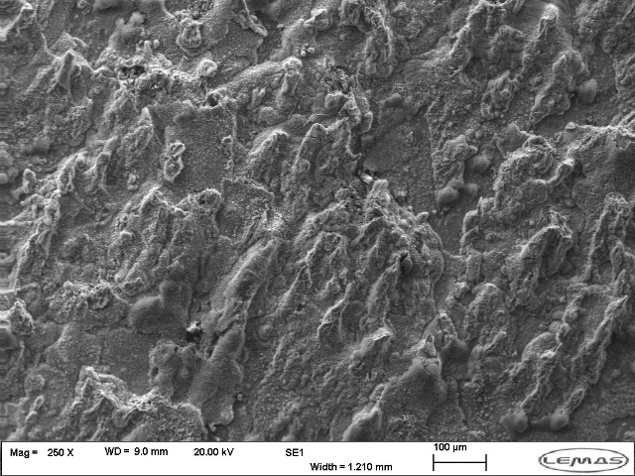
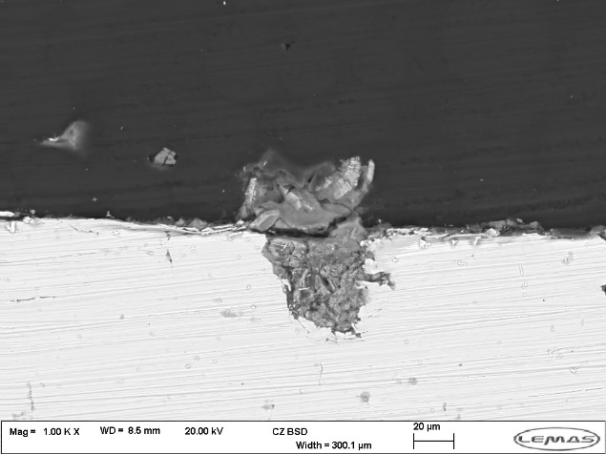
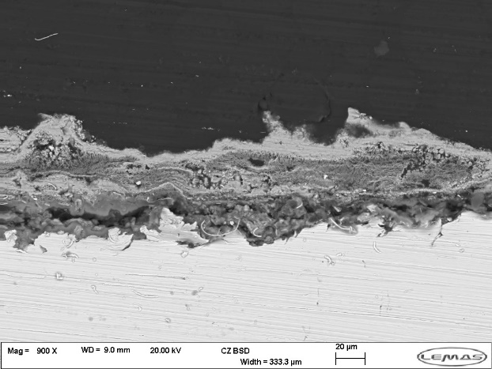
Surface Images at 70 °C
50 μm
Top view
100 μm
Top view
50 μm
Cross section
50 μm
Cross section
Cross section
8

Slide 9
Impinging Jet Hydrodynamics
Vortex rings form at the boundary between impinging jet and surrounding fluid.
These travel downstream and impinge on the steel around the central region
Locally accelerates mass transfer in this region
Turbulent kinetic energy (m²/s²)
9

Slide 10
Conclusions
Galvanic effect of magnetite is a significant factor for corrosion rate
The important effect of velocity is initially to bring more oxygen to the surface
Once corrosion product layer has been established, effect of velocity is to control magnetite growth / dissolution.
Vorticial structures generated by impinging jet locally accelerate corrosion product dissolution.
At higher temperatures, corrosion rate increased because of reaction rates but also counterbalanced by greater dissolution.
10

Slide 11
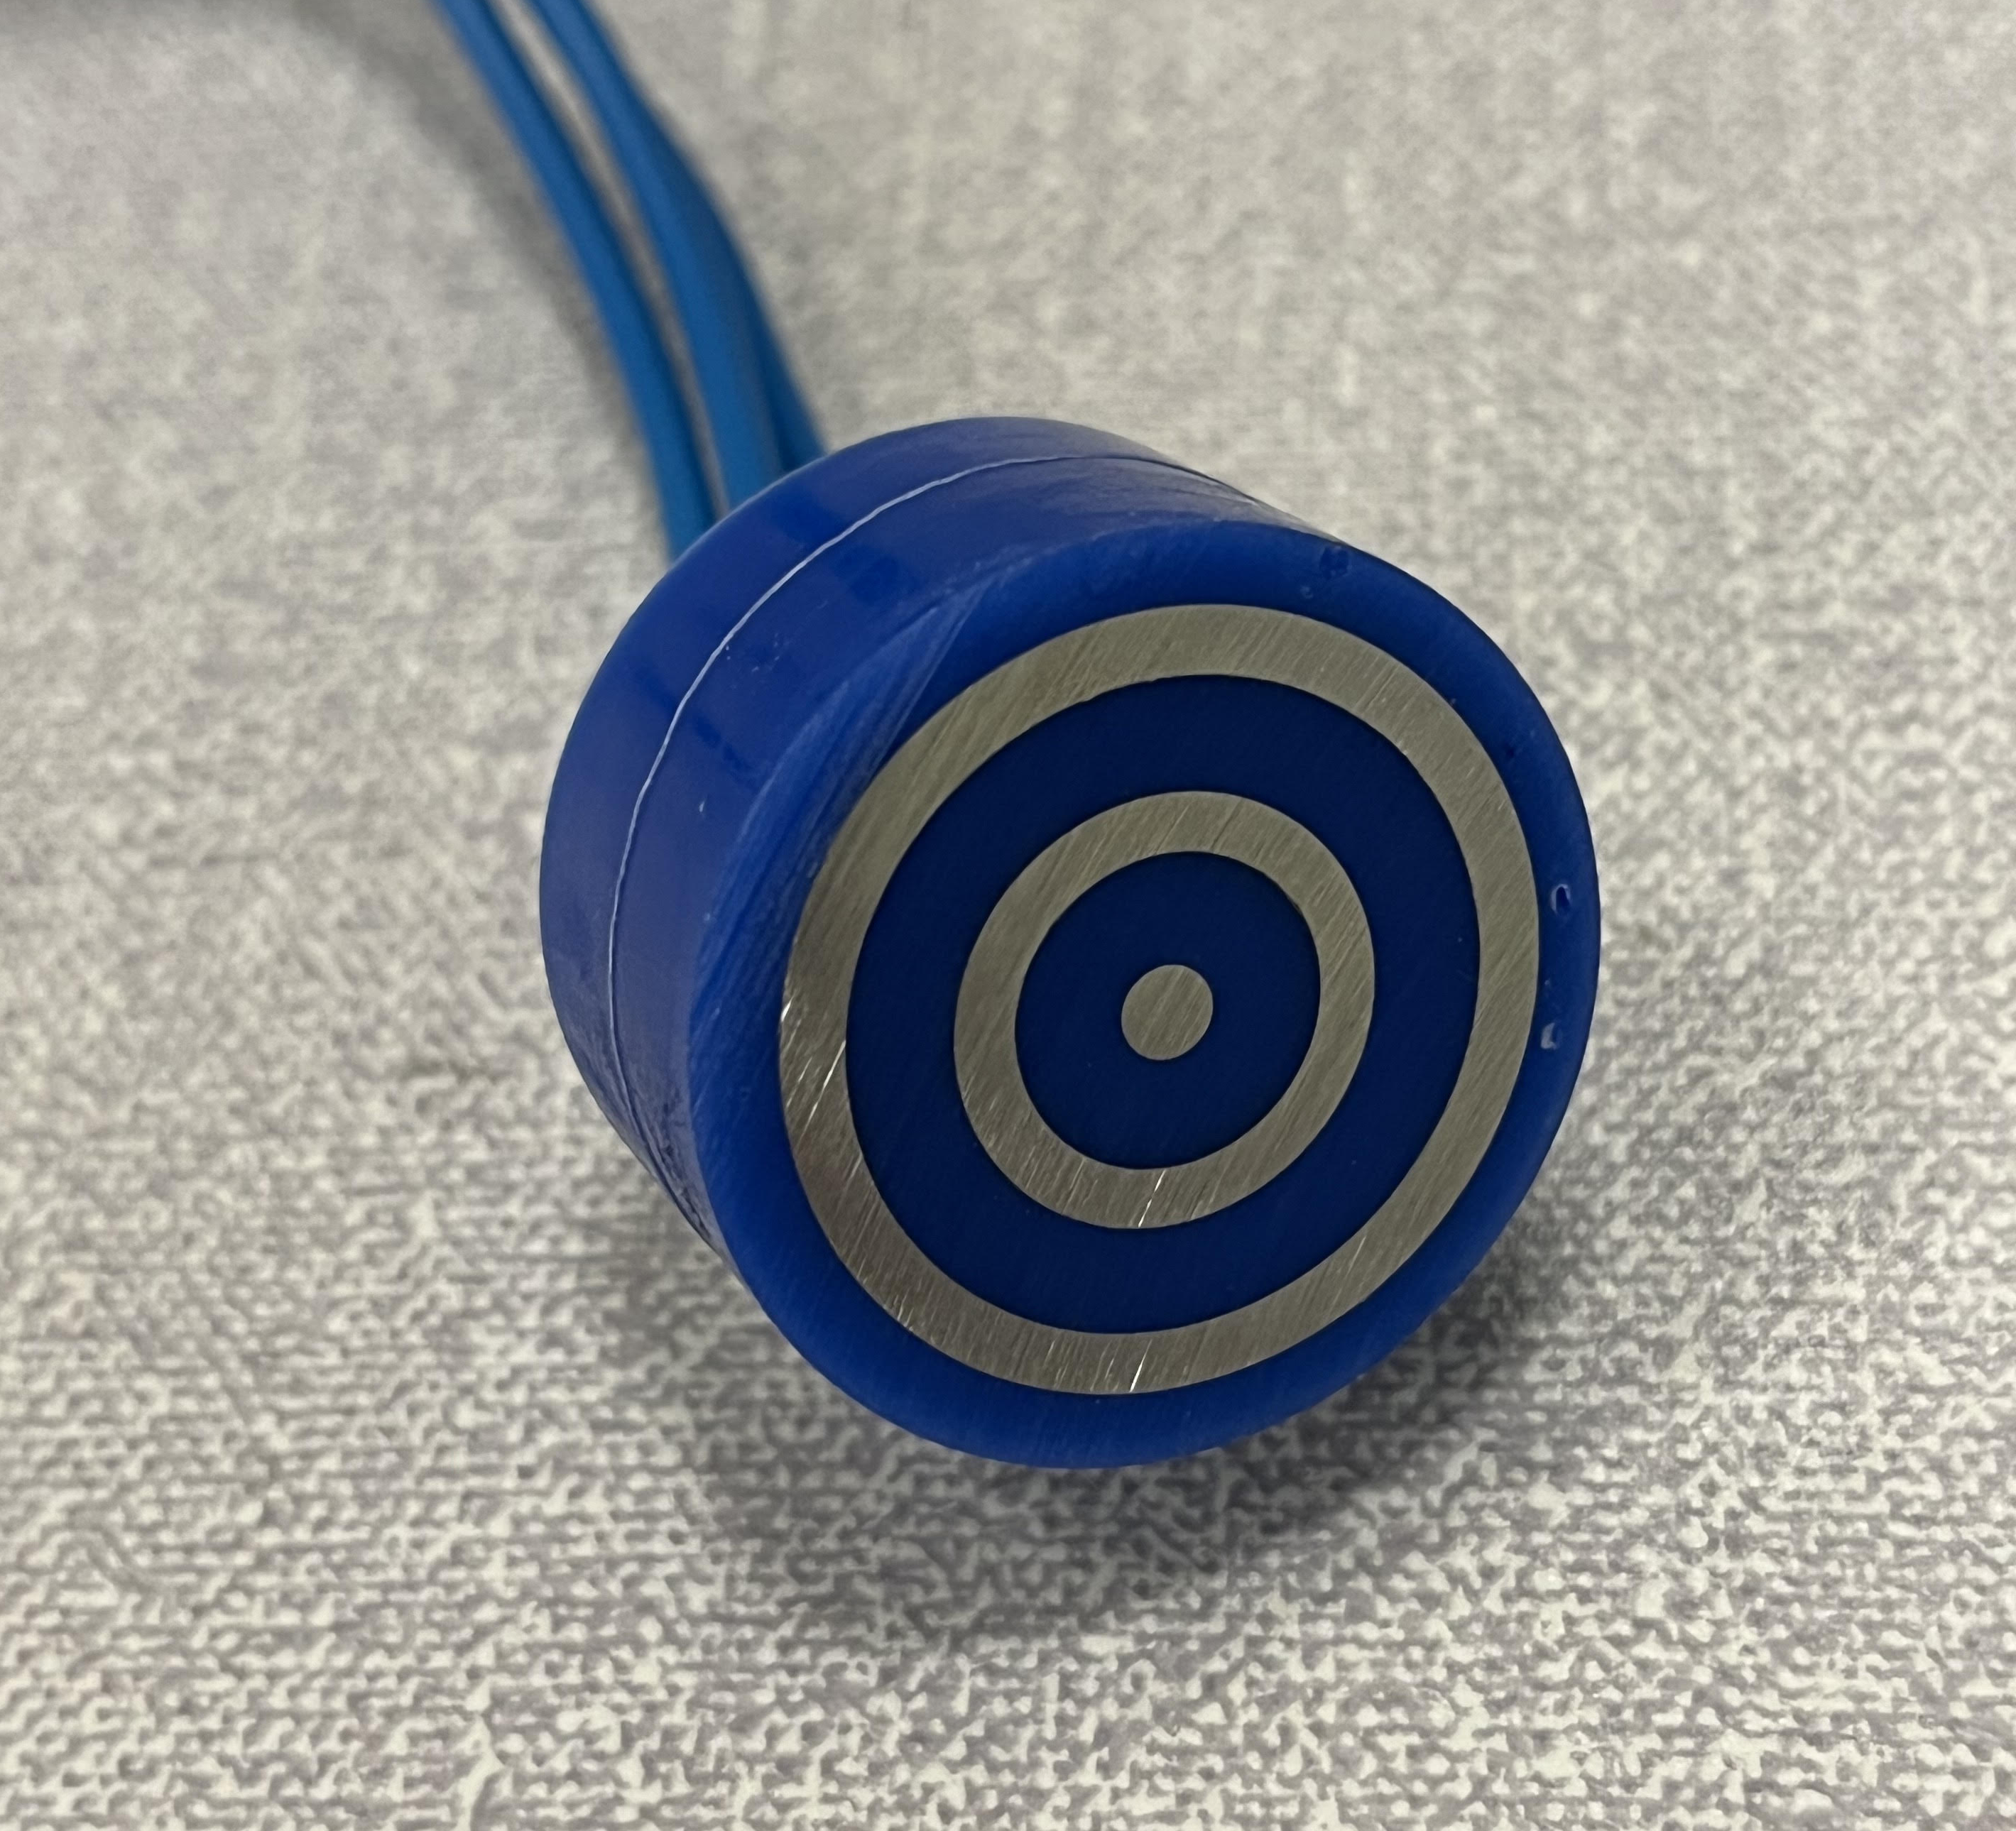
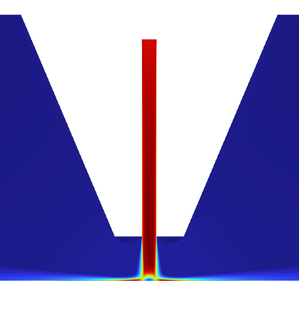
Future Work
Ring electrode study
Determination of accurate corrosion rate – velocity relationship
Measurement of galvanic currents between different regions
Longer term tests – is galvanic effect self sustaining?
Modelling corrosion rates using CFD
Create a predictive model
Accounts for galvanic interactions
Velocity (m/s)
11

Slide 12
Thank you for listening
Acknowledgements
12

