Slide 1
In-Situ Measurement and Detection of Diffusible Hydrogen in Ferritic and Austenitic Stainless Steels
T. Hillman¹ , M. Leites¹ , B. Clowes² , R. Bernard² , D.L. Engelberg¹
¹Department of Materials, School of Natural Sciences, Metallurgy & Corrosion, The University of Manchester, Oxford Road, M13 9PL, UK
²Sellafield Ltd., Sellafield, Seascale, CA20 1PG, United Kingdom

Slide 2
Contents
Overview
Hydrogen (forms and conditions)
Hydrogen Detection Routines
Laser-Induced Breakdown Spectroscopy
LIBS Systems
Cumulative Shot Behaviour
Handheld Calibrations
LIBS-Devanathan-Stachurski
Conclusions

Slide 3
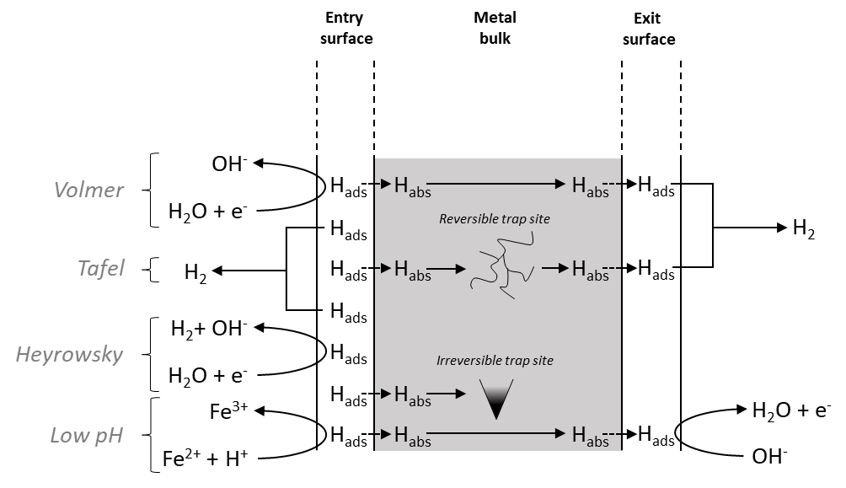
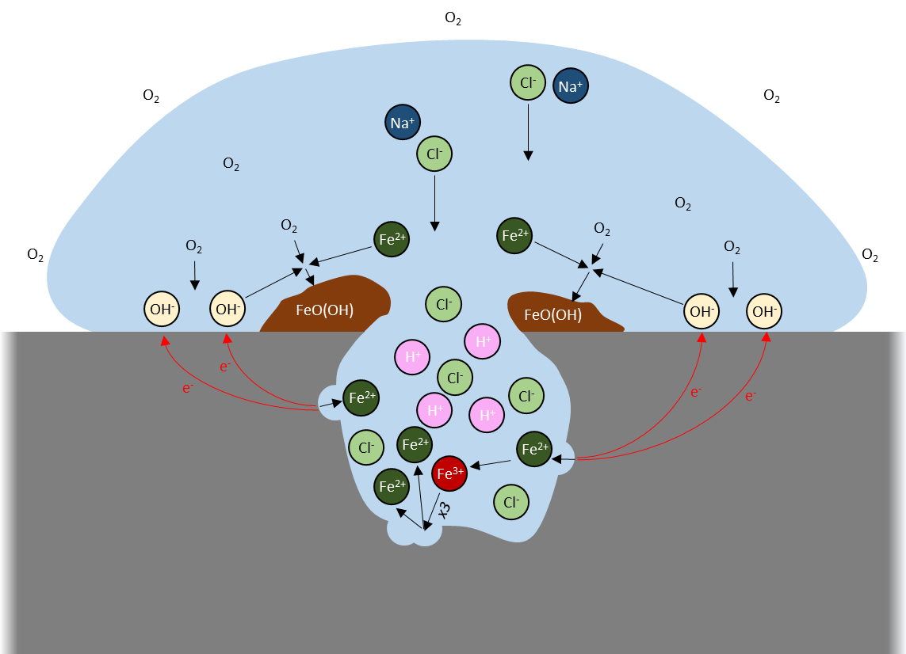
Hydrogen – Introduction (Forms & Conditions)
Hydrogen Gas (H₂): molecule size / gaseous size (0.24 nm)
Permeation/diffusion in polymers.
Hydrogen Atoms (H): dissolved in metal (atom size: 0.1 nm)
Mobility: in metal octahedral/tetrahedral sites for lattice diffusion; dependent on trap sites & their availability.
Hydrogen in ionic form:
(H⁺) - Acidity in water (hydronium ion / controls pH-value); pitting & crevice corrosion (anoxic conditions).
$$Fe+2H_{2}O→Fe{(OH)}_{2}+H_{2}$$
$$3Fe{(OH)}_{2}→{Fe}_{3}O_{4}+H_{2}+2H_{2}O$$
(H⁺) - ion-conductive membranes (Nafion – Sulfonated tetrafluoro ethylene; but also H₂)
(H⁻, H-^{σ}) - Metal-hydrides NiH, ZrH, MgH₂ etc. (0.28 nm)
Hydrogen bound in compounds (covalent):
Methanol (CH₃-OH); alcohols, organics other petrochemical / polymers.
NH₃, other feedstock/storage/transport media.
Natural Gas H₂S (odorant) / Methane (CH₄), Ethane (C₂H₈),…
H./H₂ generation at cathodic sites

Slide 4
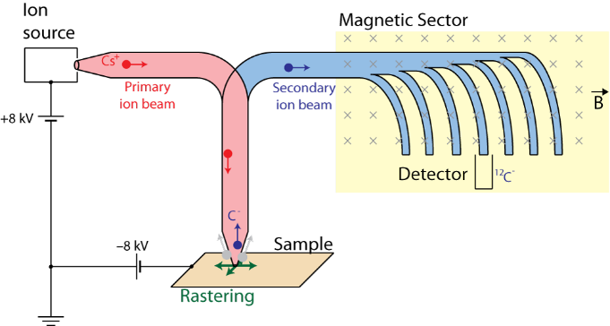
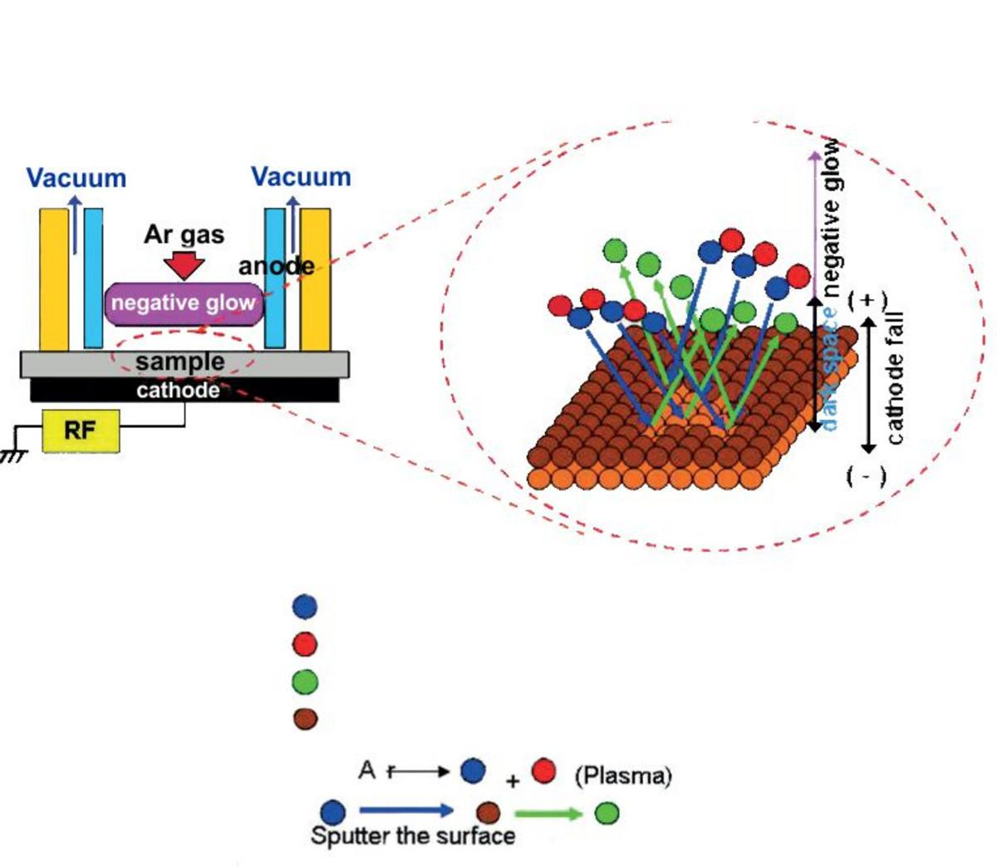
Overview Ex/In-Situ Techniques – H Concentration / Location Measurement
Lab Techniques
Atom Probe Tomography
SIMS/Nano-SIMS
Scanning Kelvin Probe
GD-OES
Destructive – Extraction
Hot gas & melt extraction
TDS/TDA
Microstructure
Microprinting (Ag decoration)
PANI
Electrochemistry
Devanathan-Stachurski (H-Permeation)
“Quasi-non-destructive”
Laser-Induced Breakdown Spectroscopy
nanosims.asiaa.sinica.edu.tw/
Horiba Scientific
M. Koyoma, et al, Scripta Materilia, 129 (1) (2017) 48-51

Slide 5
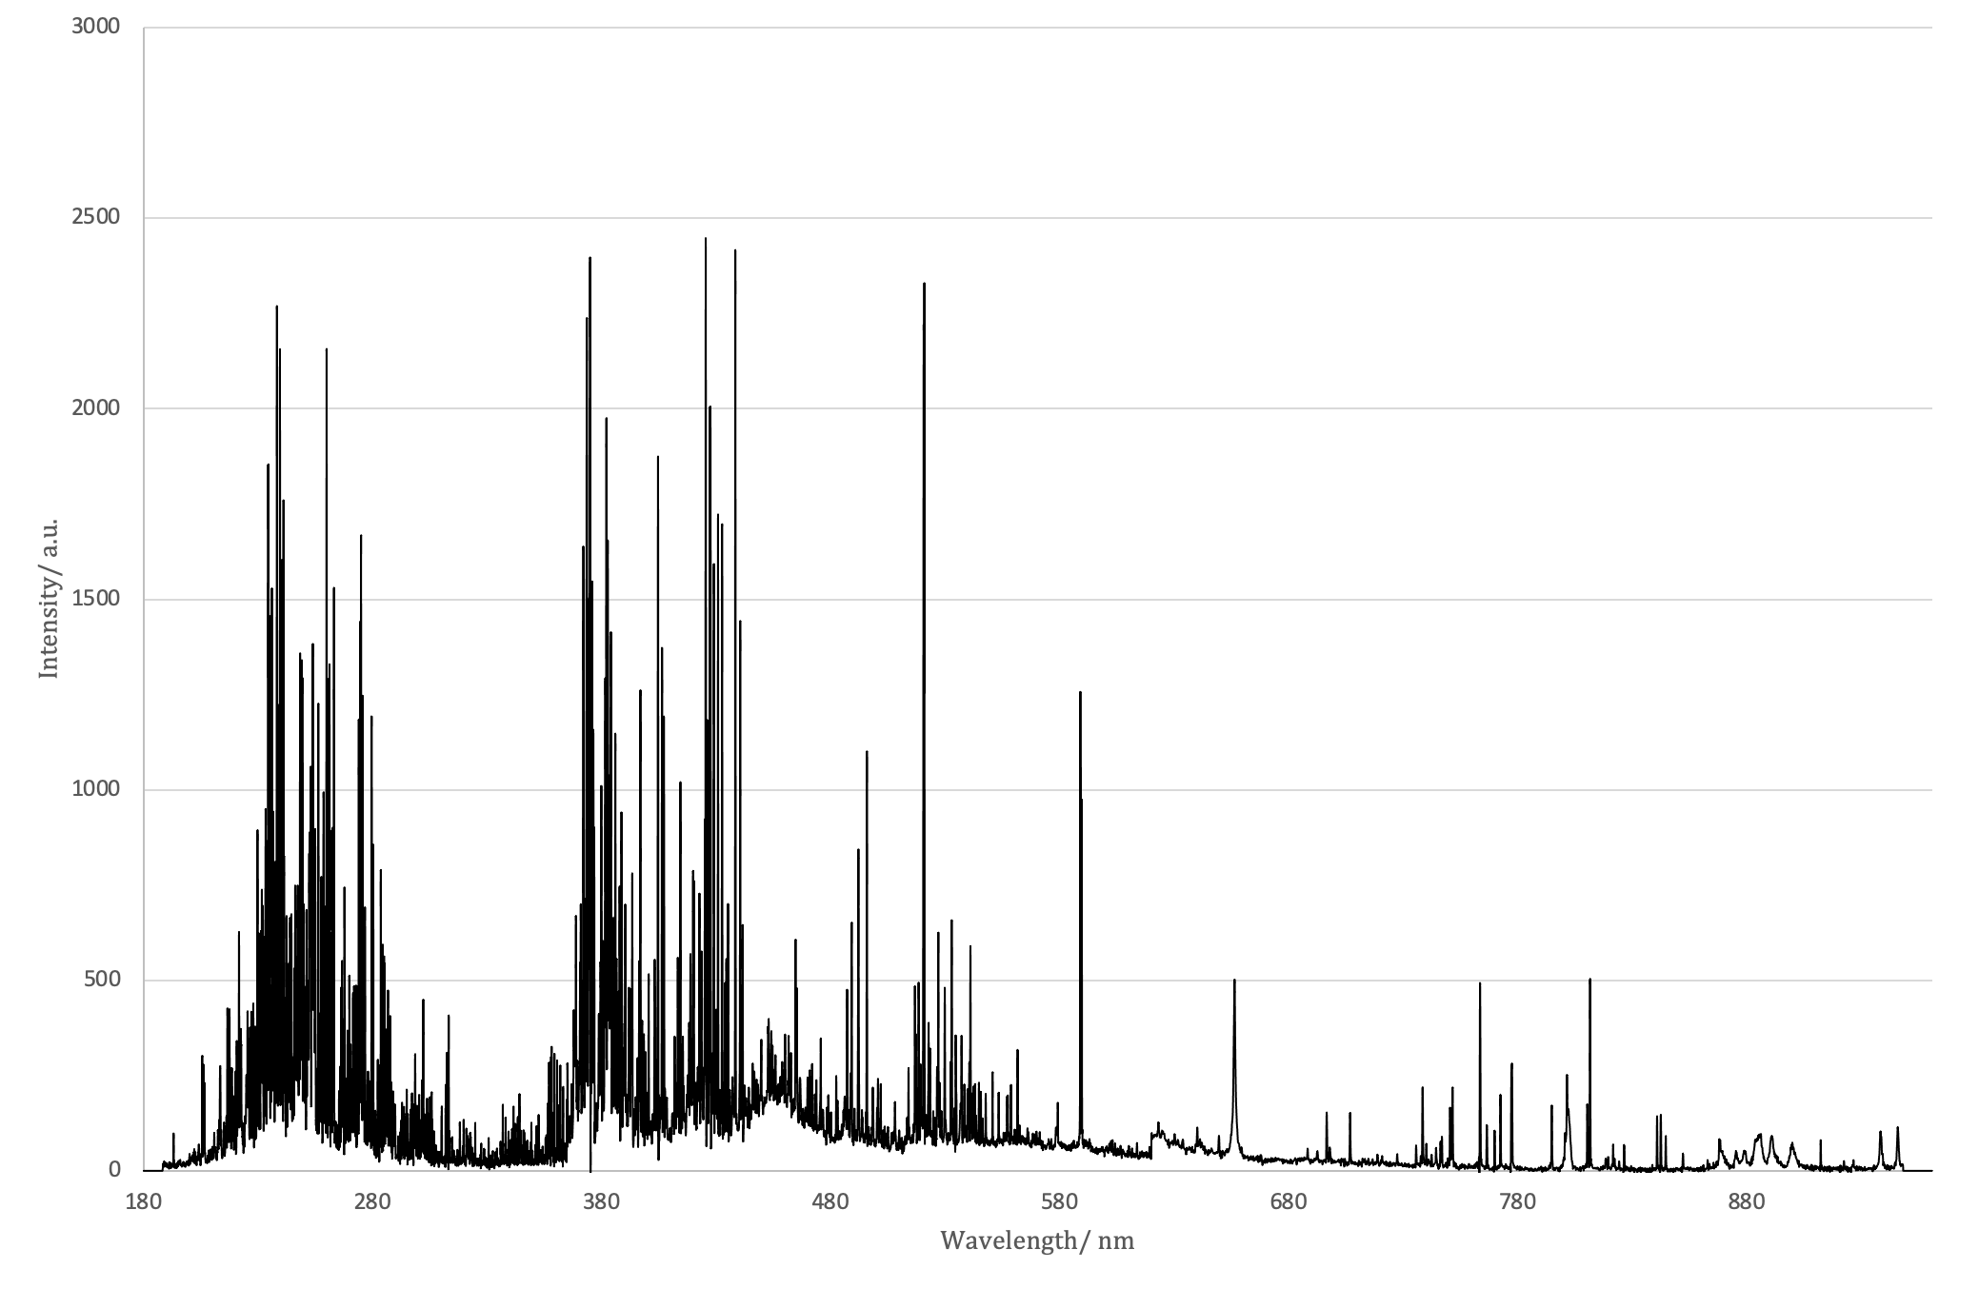
Laser-Induced Breakdown Spectroscopy (LIBS)
LIBS
Detection
Spectrum (Ex. 316L)
Nd:YAG laser (1064 nm)
Excitation
Relaxation
Argon shielding gas
Emission
Plasma
plume
Hα

Slide 6
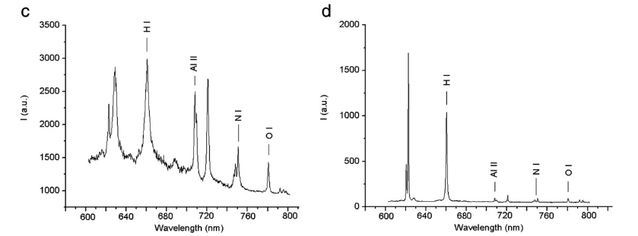
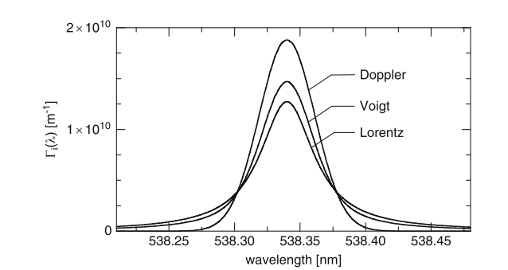
LIBS – Raw Data Processing
Where necessary baseline correction
Normalisation of spectra [0;1] (if required)
Peak fitting with combined Voigt function
Analyse H at Hα peak at 656.25nm
1
Doppler broadening (Gaussian):
Stark broadening (Lorentz):
¹Reinhard Noll, Laser-Induced Breakdown Spectroscopy Fundamentals and Applications. Springer Heidelberg Dordrecht London New York, 2012.

Slide 7
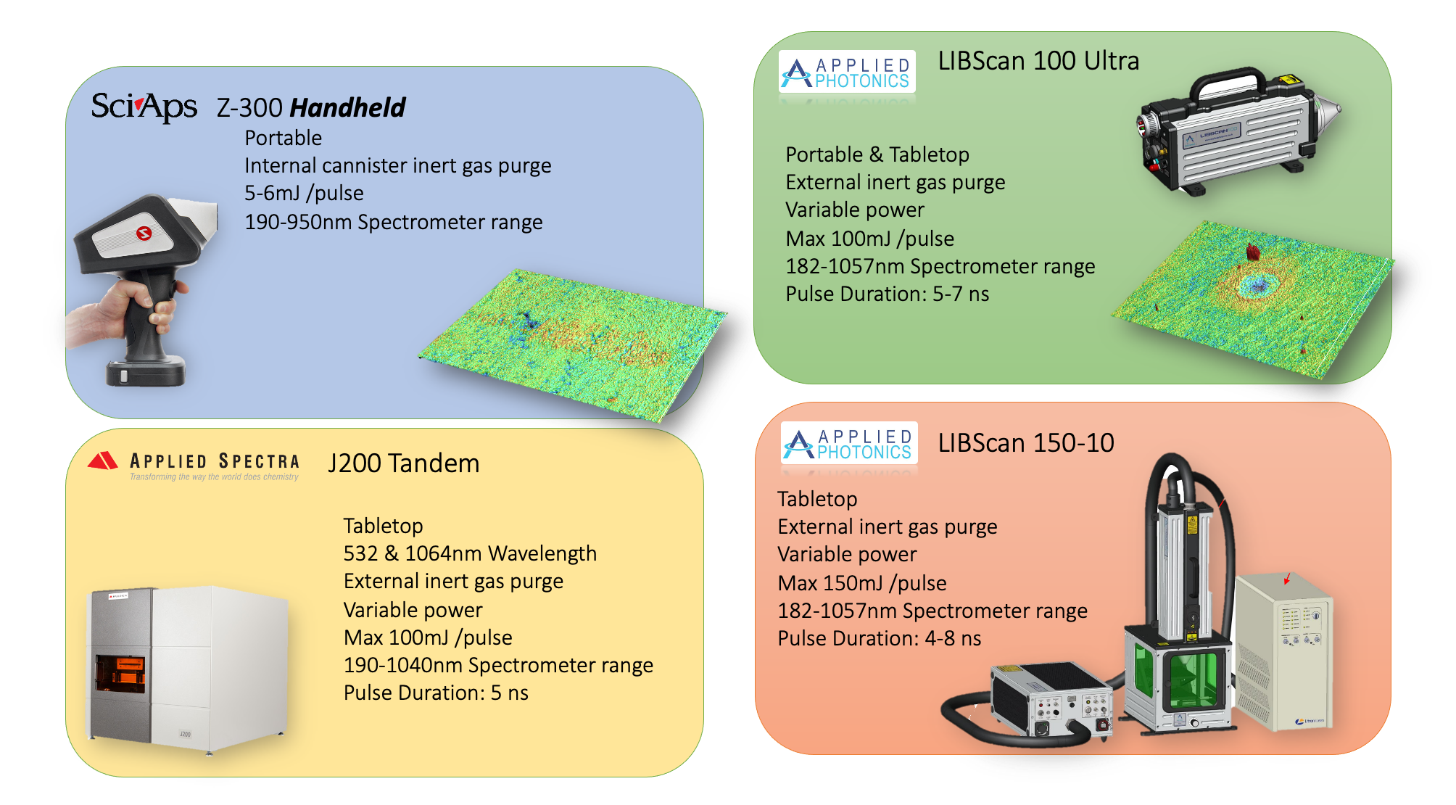
Manchester LIBS Systems

Slide 8
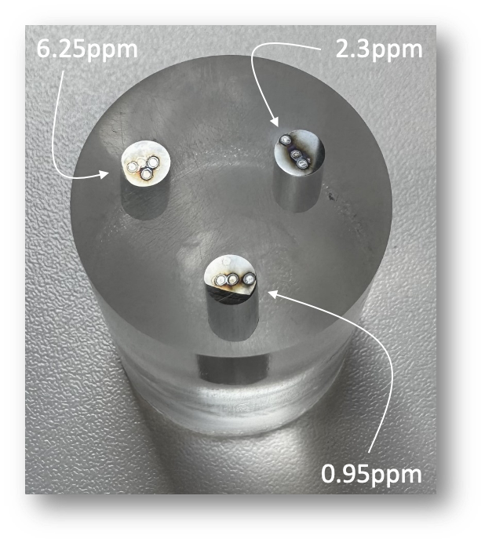
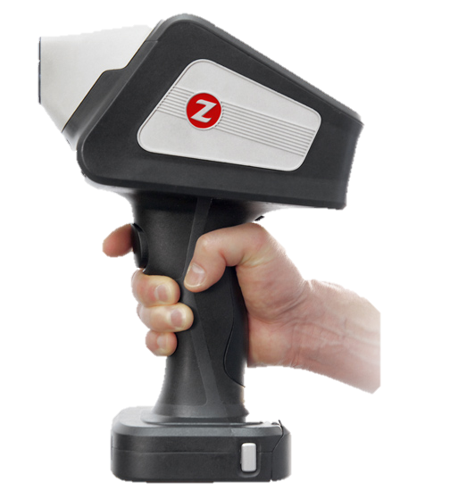
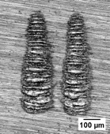
Z300 Handheld Calibration
Calibration for in-situ H-LIBS use
SciAps Z300
Hydrogen stainless steel standards (6.23ppm – LECO; 2.3ppm, 0.95ppm – SciLab)
Integration time, delay = 1 ms, 250ns
Resolution < 0.1mm x 1 mm
Ar purge
Normalize Hα at 656.2nm to Ar(I) at 763.5nm
Laser power = 5-6 mJ pulse⁻¹

Slide 9
Hydrogen Permeation-type LIBS
+
$$\vec{E}$$
REFLUX
Thermometer
$$H_{2}$$
–
+
$$H_{ads}$$
Pt counter
–
+
$$H_{ads}$$
$$O_{2}$$
+
–
–
$$H_{abs}$$
$$H_{ads}$$
–
+
Sample
–
+
–
+
$$H_{2}O⇌H^{+}+{OH}^{−}$$
LIBS acquisition
0.5M Na₂SO₄
Heating

Slide 10
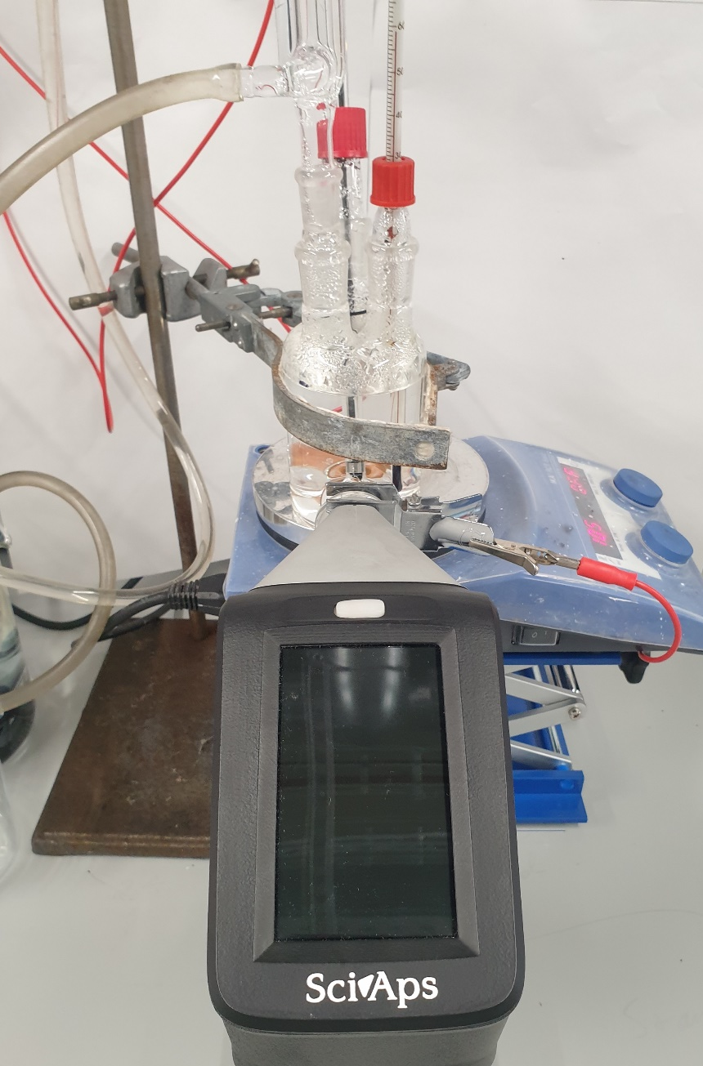
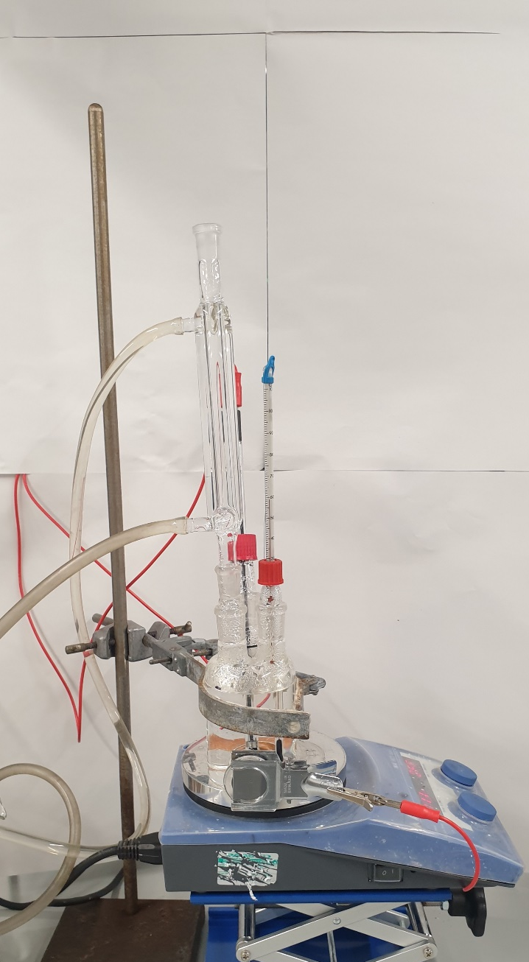
Hydrogen Permeation-type LIBS
Thermometer
Reflux condenser
Heating (80°C)
SciAps Z300 handheld LIBS
1064 Nd-YAG laser
5-6mJ pulse⁻¹
1 shot per location
2 locations

Slide 11
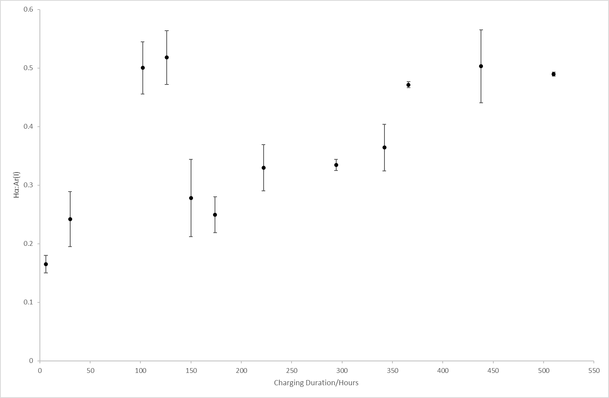
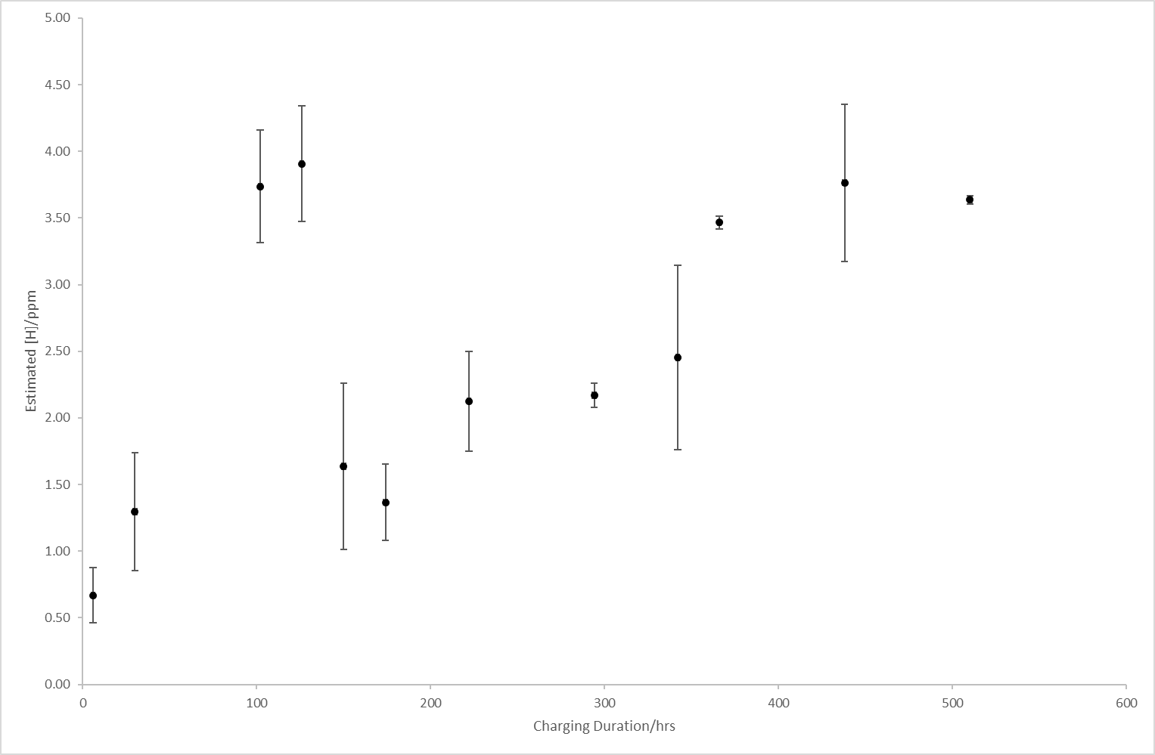
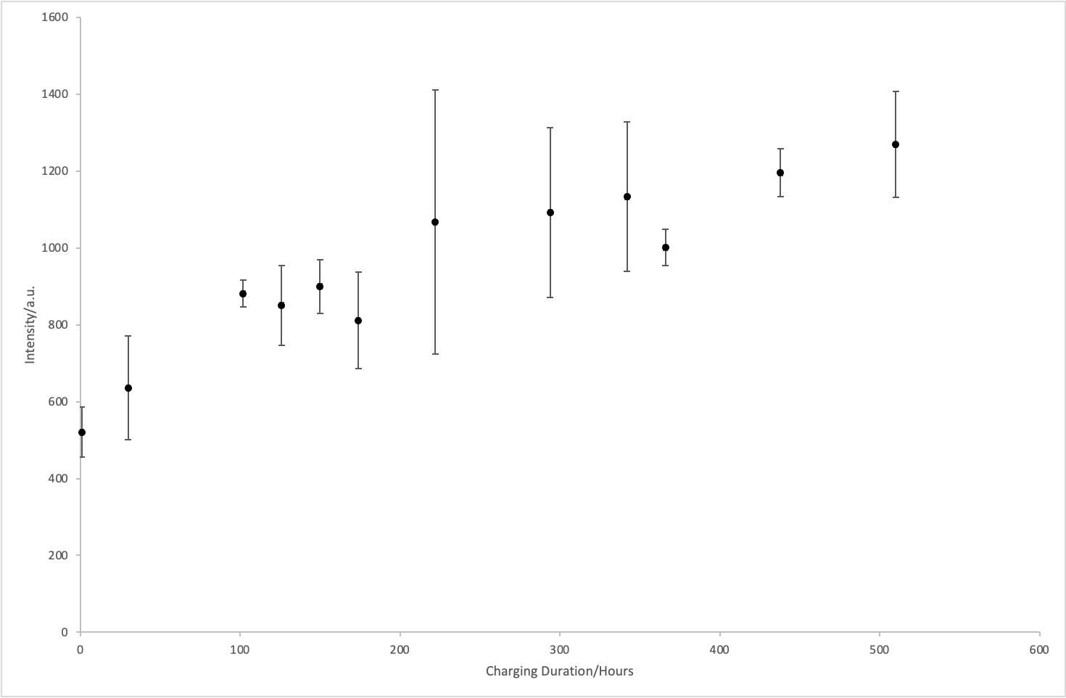
Hydrogen Permeation-type LIBS
Intensity = 0.1058[H] + 0.1049
??
??
Normalise to Ar(I) at 763.5nm

Slide 12
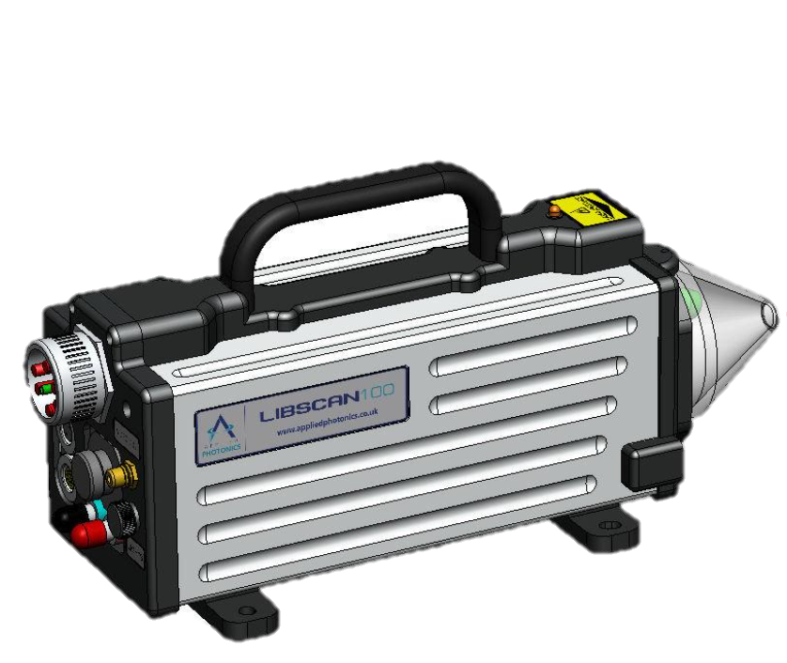
Cumulative Shot Hydrogen Analysis
To investigate the efficacy of multi-shot/depth profiling LIBS for hydrogen analysis
LIBScan 100 Ultra
Hydrogen stainless steel calibration standards (6.23ppm – LECO DH603; 2.3ppm, 0.95ppm – SciLab Eltra OH)
30 consecutive shots per sample
Resolution < 0.5mm
140mJ, 1Hz laser pulse
Hα peak at 656.25nm normalised to Fe(I) line at 495.75nm

Slide 13
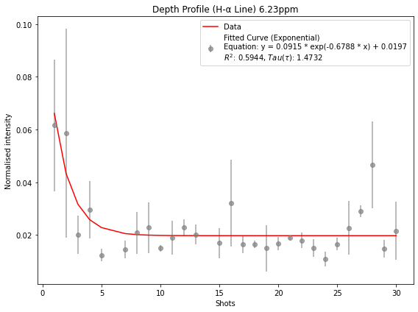
Cumulative Shot Hydrogen Analysis
High initial normalised intensities
Large variance in errors
Increased scattering of incident and re-emitted light?

Slide 14
Cumulative Shot Hydrogen Analysis
High initial normalised intensities
Large variance in errors
Increased scattering of incident and re-emitted light?
General decrease in intensity
H depletion and enrichment (at greater depths?)

Slide 15
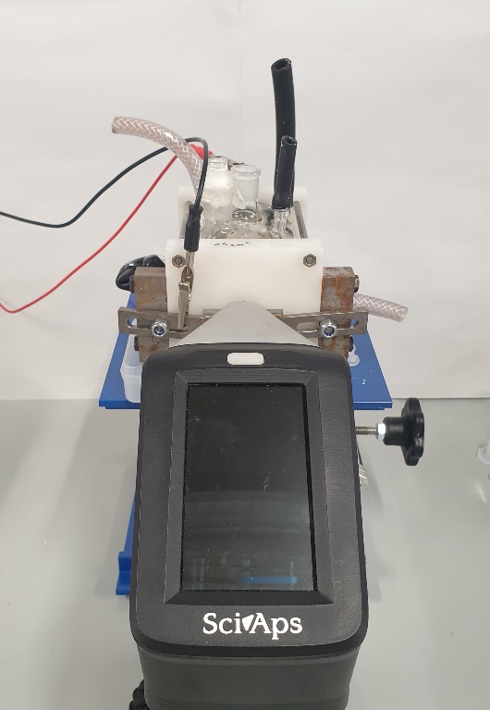
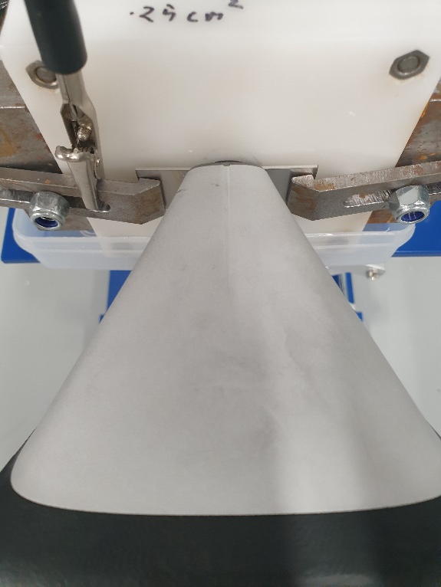
Conclusions
Hydrogen detection with LIBS still being refined
Rapid (<5s), local (<<0.5mm) and in-situ H detection possible. Normalisation techniques still being explored…
Standardisation possible, yet still room to improve (global standardisation of a local technique)
Cumulative shots reveal some “movement” of H atoms within steel standard matrix
Devanathan-type LIBS possible – cannot expect a classical permeation curve just yet!
NEXT STEPS:

Slide 16
Thank you for listening

Slide 17
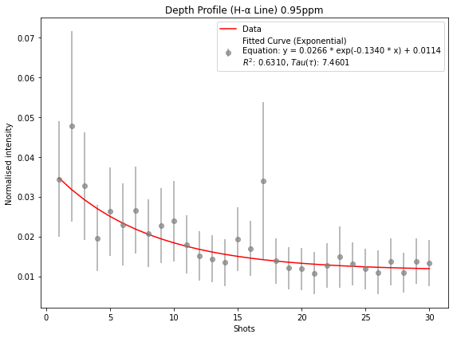
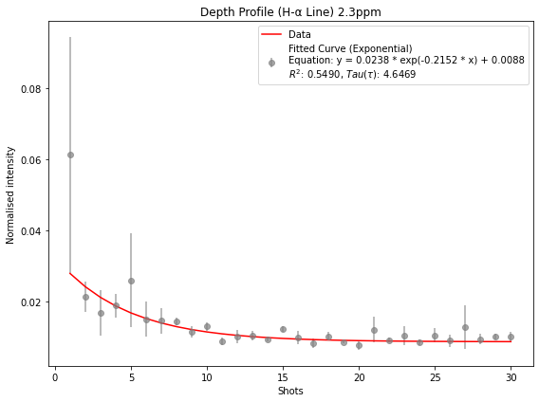
Cumulative Shot Hydrogen Analysis

