Slide 1

Advancing Subsea Pipeline Corrosion Inspection
Current Capabilities and Future Needs
NEIL M COWIN MSc, C-Eng
A DEVELOPED STRATEGY FOR FURTHER NDE MANAGEMENT IN MARINE AND OFFSHORE FACILITIES

Slide 2
Contents
Corrosion Threats in Coated Pipelines
NDT Strategies for Non-piggable Pipelines
Case Histories
General Guidance and API Standards
Path Forward

Slide 3
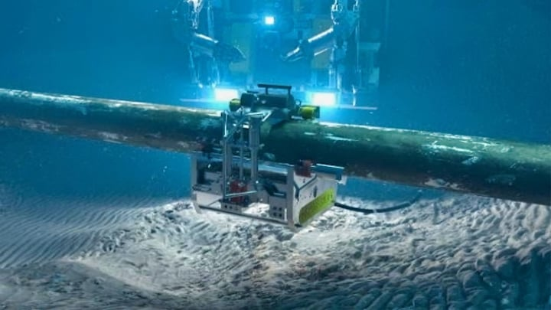
Subsea NDE assessments on varying facilities covered many practices. Visual inspection ,%UT , radiography, LRUT, PEC, ECI, ACFM, Thermography.
Corrosion Threats in Coated Pipelines
Coating Types:
  Fusion-Bonded Epoxy (FBE)
  Cement Cladding
  3-Layer Systems + Cathodic Protection (CP)
Primary Corrosion Drivers:
    Produced water retention (with CO₂, H₂S, scales, and deposits)
    Microbiologically Influenced Corrosion (MIC): Anaerobic bacteria in risers insulated for waxy crudes
    Vapor-phase & condensation effects
    Exacerbation by CO₂, H₂S, and chloride salts
Integrity Risks:
    Damage to outer coatings → ingress of water/salts
    Reduced CP protection effectiveness
    High corrosion rates observed on carbon steel (CS) and alloys (304, 316L, martensitic, Duplex 22–25 Cr)
    Cracking risk in 40–120 °C temperature range
Inspection History:
    Pipelines coated to FBE specs before cement/3-layer systems
    Early inspections limited (partial UT with sampling boxes in the 1980s–1990s; partial ROV coverage)
    Alloy threats not fully assessed for SCC/CSCC under coatings and insulation

Slide 4
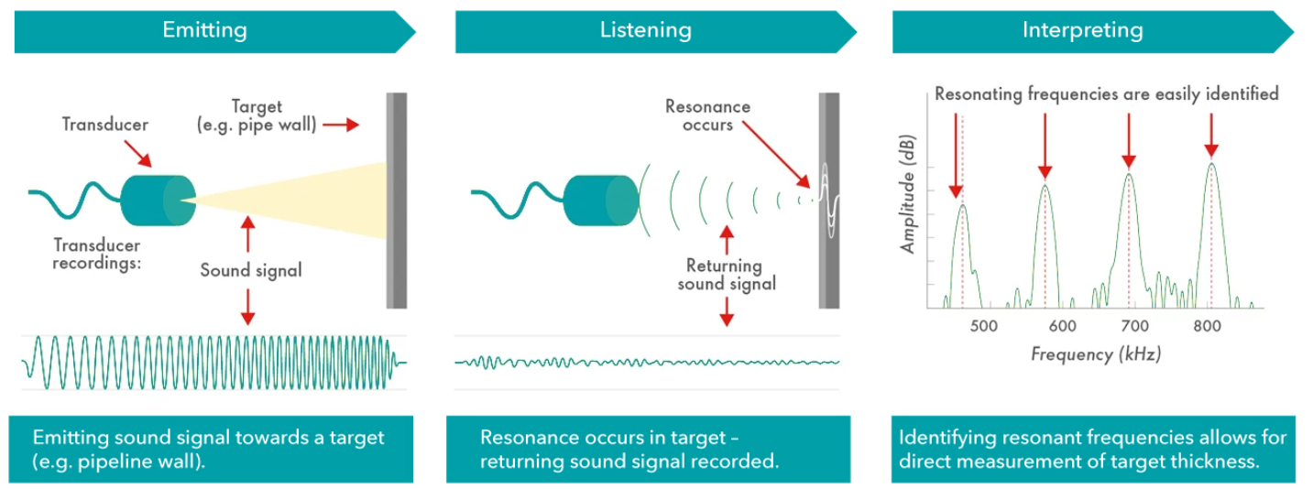
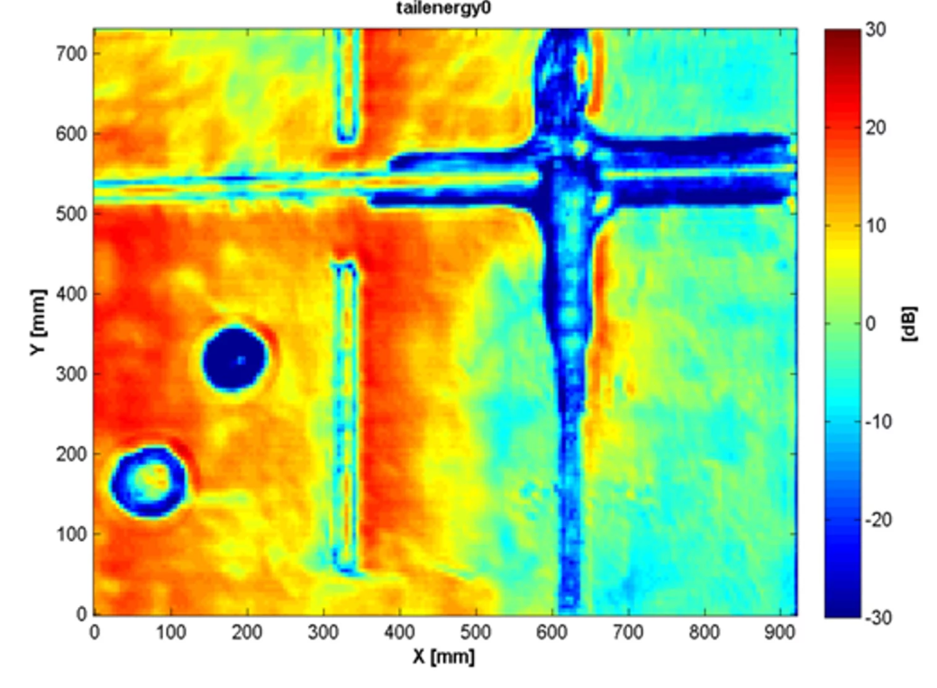
NDE Strategy for Non-Piggable Subsea Pipelines
Acoustic Resonance Technology
Objective: Inspect 40-year-old coated subsea lines where pigging is not feasible
Scope: Pipelines, risers, flexibles, bundles
Prioritization:
  High-risk streams first (gas & HC production)
  Then secondary streams & utilities
  Focus on insulated systems (dew point, wax control)
NDE Techniques:
  Pulsed Eddy Current (PEC) – wall loss through coatings
  Guided Wave UT (LRUT) – long-range screening
  ACFM – crack detection at welds, ROV-deployable
  EMAT – corrosion under supports, no couplant needed
  CP Surveys – potentials & gradients to assess coating/anode health
Flexibles & Bundles: Annulus testing, fatigue/curvature monitoring
Process Data Correlation: Inhibitor performance, water cut, salts, Fe counts, bacteria

Slide 5
NDE Equipment for Non-Piggable Pipelines
Metallurgy Risks:
Carbon steel: highest corrosion threat
Low alloy & duplex grades: cracking risks in chloride + H₂S environments
  Cracking window: 40–120 °C, H₂S partial pressure > 3.5 mbar (0.05 psia), hardness > 22 HRC
Coating Characteristics:
  FBE as base protection across all systems
  Cement cladding: 20–50 mm
  3-layer PE/PP systems: up to 6 mm
  Insulation layers: 4–6 in. (≈152 mm) on some lines
Subsea Mapping & Context Tools:
  ROV & side-scan sonar → pipeline burial & contact objects
Multibeam echosounder (MBE): cross-profiles of pipeline & seabed
Laser Spotscan (2D): pipeline + seabed profiling
NDE Deployment Factors:
  Focus on areas with low velocity (<1 m/s) → water dropout → first 5 km of lines
  Early adoption: rope access & crawlers (1990s, caissons/platform legs)
  Coating removal + AUT/UT crawlers → costly, requires re-coating & CP reassessment
NDE Techniques (External, Through Coating):
  PEC (Pulsed Eddy Current): up to 200 mm insulation/cement, probes for 2500 m depth
  ART (Acoustic Resonance Technology)
  ECI (Eddy Current Inspection)
  Radiography
  Thermography
  Advantage: wall thickness screening without coating removal (development ongoing, correlation improving)

Slide 6
Case Histories
2009/2010
Known projects have been based in Brazil where Exxon and Petrobras have a defined testing scope based upon inspection of new and utilised co-flexibles specifically. This project review has been ongoing for 10 years. Covering ‘UT’ and ‘ECI’ and ‘PEC’ mainly also Radiography onsite and subsea
2005
The development of automated ‘UT’ crawlers and ‘PEC’ and ‘ECI’ ,ART ,were all dependent based upon removal of external coatings by cutting and blasting the pipe subsea. ’UT’ from practical experience does not have the energy/power to gain depth definition through coatings.
2020
The development of Thermography stepped forwards and utilised on bundles inspections. Been ongoing post 5 years.
2022
Development of scanning tools to define screening of pipelines and defects below coating.
2023 -…
We require further investigation of the high resolution frequency electromagnetic probes on the market place for ‘PEC’ and ‘ECI’ specifically. These have the capacity to enable inspection through cement clad and coatings. For non piggable lines this is important to gain ‘WT’ definition. Improve capabilities

Slide 7
SUMMARY OF FINDINGS
Summation of practical results
Summation of techniques
Utilised ‘ECI’ and ‘UT’ crawlers but removed % coatings from pipelines in majority of cases to obtain a % inspection.
Flexibles have been difficult to inspect effectively, due to polymer sheaths. Importance has been to define cracking of armour wires. Assessment of flooding of the annular gap is a defined vacuum test period inspection technique in standards.
Design basis has been to rely on internal inhibition and coatings and core ‘CP’ for protection.
‘NDE’ focus over 20 years previously was a % reliable. Thermography was valued as was ‘ACFM’, ‘ECI’ and ‘PEC’ because of its capabilities through % coatings. It has advanced since.
Assessment by topography review of the seabed profile did not always define defects present. For non piggable pipelines its difficult.
Development of NDE Techniques
15% piggable pipelines
80% process pipelines are non piggable
Develop NDE technology for screening of WT below external subsea pipeline coating’s
7

Slide 8
GENERAL GUIDANCE & API Standard
International standard
International guidance
Recommend following guidance
A Guideline framework for the integrity assessment of offshore pipelines. DNV Technical Report number 44811520
PLEASE NOTE this was part of regulators KP 3 key performance 3 assessment circa 2009 onwards. Especially Risers inspections. Riser’s integrity management and inspections ref DNV-RP-206.
CRUX is design out the threats by ‘process review’ and replace by inspection equipment especially deepwater subsea production to ensure internal pigging requirements.
Recommend API 571-Damage mechanism affecting fixed equipment
The recommendations and guidance
It covers ‘NDE’ and specifications
Technically it does cover onshore facilities more so than offshore
8

Slide 9

Practical understanding and realities of Pipeline external inspections
Non-Piggable Pipelines: Key Challenges & Future Needs
Major threat for gas leaks in North Sea (onshore & offshore)
Traditional corrosion management → inspection techniques (API 571 approach)
40 years of data → removal often best solution
Current practice: remove ~3m coating in low-lying areas, analyse WT% by NDE
  Applied mainly to 6"–10" flowlines
  Cement cladding up to 150mm (5.9") thick creates challenges
Failures linked to process variations, material selection, and limited NDE capability
Future needs:
  Automated NDE for thick coatings
  High-frequency PEC & ECI probes
  Thermography & ACFM (beyond welds)
  Explore Electro-Magnetic Resonance (EMR) for subsea inspections
Path forward: progressive R&D program for screening subsea coated, non-piggable pipelines

Slide 10
Q &A

