Slide 1

AC interference and its risk assessment
Brendan Kelly, DNV, 17th September 2026

Slide 2

Contents
Why AC interference is becoming more important
What is AC interference
Risk assessment for AC interference
Possible improvements to risk assessment for AC interference
Monitoring and mitigation of AC interference
Summary

Slide 3
Why concern over AC interference is increasing

Slide 4
Why concern over AC interference is increasing
Introduction
They can be a direct threat to health; electrical shocks
They can cause corrosion directly (stray current corrosion)
They can also contribute to corrosion indirectly by interfering with the monitoring of CP effectiveness.
Until the 1970’s many considered that there was not a significant threat of AC stray current corrosion of pipelines by overhead power lines (OHPL).
In the 1980’s there were several AC corrosion incidents…
AC corrosion rates up to 2.5 mm/yr have been seen on pipelines in the UK.

Slide 5
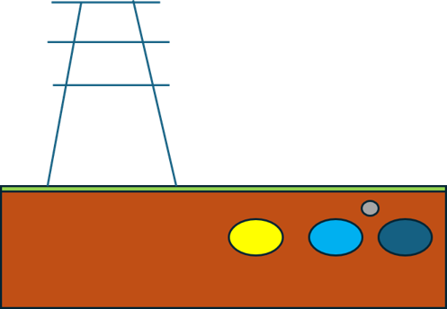
Why concern over AC interference is increasing
Introduction
Stray Currents were becoming more common due to;
Planning restrictions and utilities corridors
Improved pipeline coatings
Stray Currents are becoming more common due to;
  Wind farms;
  Solar farms;
  Battery Energy Storage Sites;
    Additional overhead power lines (OHPL);
    Increased loading on the grid.

Slide 6
Why concern over AC interference is increasing
Introduction
  “Great Grid Upgrade”
  Demand for electricity is expected to increase by 50% by 2035 and to double by 2050*
  Need to move electricity from where it’s produced (often remote, e.g. offshore) to where it’s needed (typically cities)
      New offshore and marine links,
      New onshore infrastructure, and
      Upgrades to existing infrastructure.
* National Grid

Slide 7
Why concern over AC interference is increasing
Introduction
  Dynamic Line Rating
Currently use static line ratings, which are fixed conservative ratings
These often leave capacity unused.
DLR calculates the true, live capacity of overhead lines based on real‑time data, e.g.;
Temperature,
Wind speed,
Solar radiation, and
Cloud cover.
With DLR, high winds cool lines, enabling higher power voltages to flow safely.*
*SSEN Transmission

Slide 8
What is AC interference?

Slide 9

What is AC interference?
AC Interference 3 types
Resistive coupling; ground acts like a resistor
Capacitive coupling; pipeline and powerline act like a capacitor
Inductive coupling; pipeline and powerline act like an inductor

Slide 10
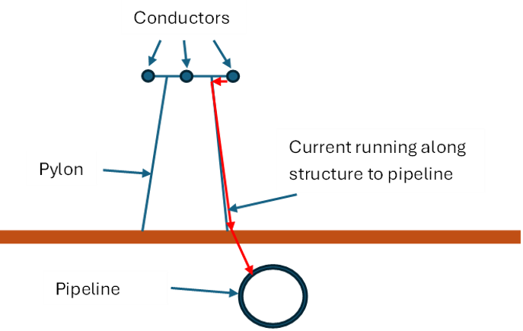
What is AC interference?
AC Interference Resistive coupling
Occurs during fault condition
Fault currents and voltages can be extremely high.
But usually only last for a fraction of a second.
One fault may not be damaging but numerous faults can be.

Slide 11
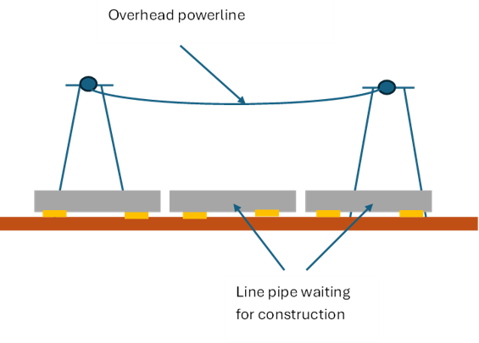
What is AC interference?
AC Interference Capacitive coupling
Line pipe spread along route of new pipeline.
Overhead power line and line pipe act as plates of a capacitor.
Typically, only an issue during construction.

Slide 12
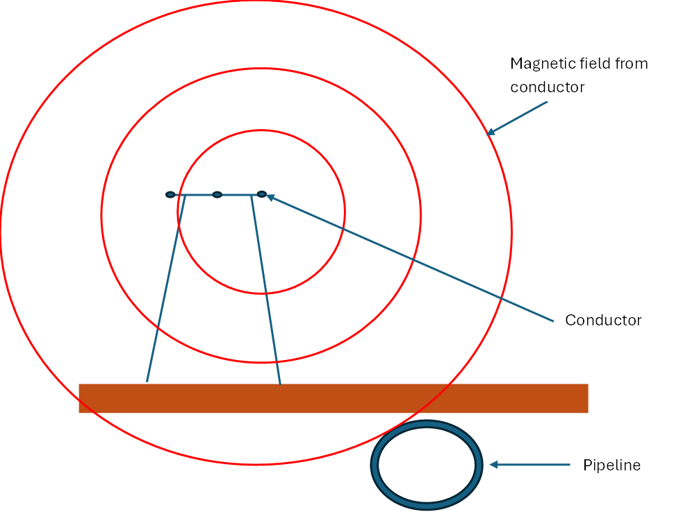
What is AC interference?
AC Interference Inductive coupling
Overhead power line induces magnetic field.
Magnetic field induces (AC) electrical current in pipeline.
Can occur under normal operating (i.e. not fault) conditions.
The form of AC corrosion that is the greatest concern.
Voltages / currents are often fairly low but can be harmful if prolonged.

Slide 13
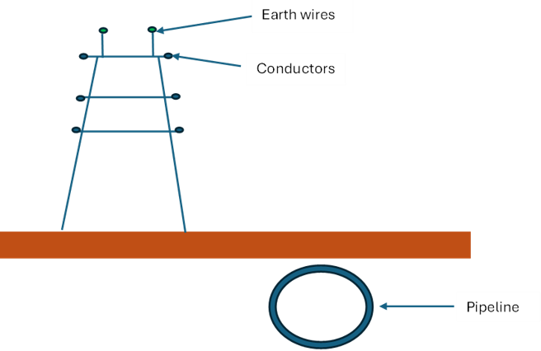
What is AC interference?
AC Interference Inductive coupling
Calculating induced AC voltages is complicated.
Expressions involve imaginary numbers.
Simple arrangements of overhead pipelines may be assessed using hand calculations or spreadsheets.
Expressions needed for each combination of conductor (including earth wires) and pipeline.

Slide 14
What is AC interference?
AC Interference Inductive coupling
Phase must be considered.
Now days, bespoke software is commonly used.
For existing pipeline / overhead power line combinations often just measure voltages.
But even measurement can involve significant cost and effort.
And need to know where the highest voltages will be.

Slide 15
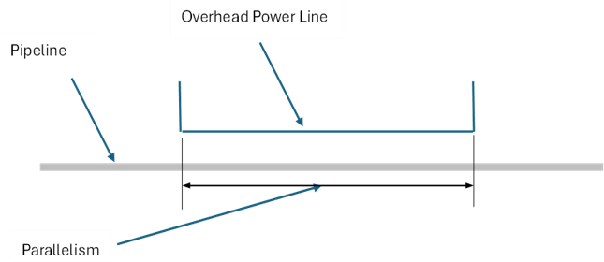
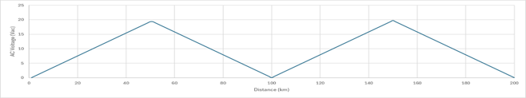
What is AC interference?
AC Interference Inductive coupling – Parallelisms
Arrangements where the pipeline and power line run parallel produce higher induced voltages than simple crossings.
The highest voltages will be at the ends of the parallelism.
Earthing of the pipeline can complicate matters.

Slide 16
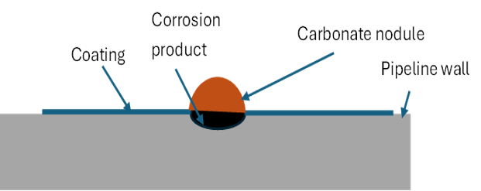
What is AC interference?
AC Interference Inductive coupling – Morphology
Corrosion attack at coating holiday.
Pit is frequently round to match holiday.
Carbonate nodule with high pH above it.
Corrosion product in pit.

Slide 17
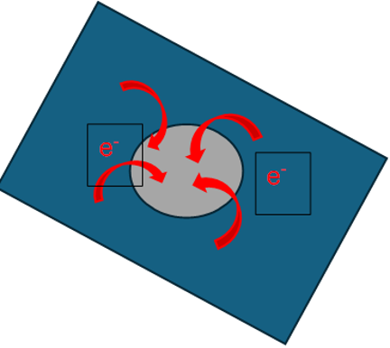
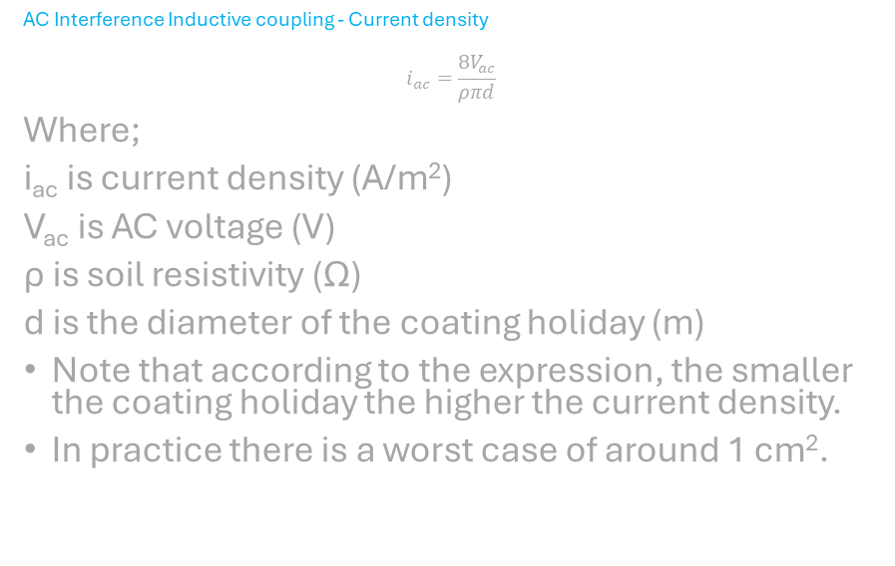
What is AC interference?
AC Interference Inductive coupling - Current density
$$i_{ac}=\frac{8V_{ac}}{ρπd}$$
Where;
i_{ac} is current density (A/m²)
V_{ac} is AC voltage (V)
ρ is soil resistivity (Ω)
d is the diameter of the coating holiday (m)
Note that according to the expression, the smaller the coating holiday the higher the current density.
In practice there is a worst case of around 1 cm².

Slide 18
What is AC interference?
AC Interference Inductive coupling-acceptance criteria
AC voltage <15 V_{rms}
And Correct level of cathodic protection
And
  AC average current density < 30 A/m²
  Or Average cathodic current density < 1 A/m² (if AC average current density < 30 A/m²)
  Or Jac/Jdc < 5 (ideally 3)
All to be averaged over a representative time period, e.g. 24 hours.
From ISO 18086:2019

Slide 19
What is AC interference?
AC Interference Inductive coupling – Health vs corrosion
An acceptable induced AC voltage of 15 V is often quoted.
This is taken from NACE (now AMPP) RP0177.
The limit is based on safety concerns, i.e. the avoidance of harmful electrical shocks.
In low resistivity soils, corrosion can occur at much lower voltages (e.g. 4 V).

Slide 20
Risk assessment of AC interference

Slide 21
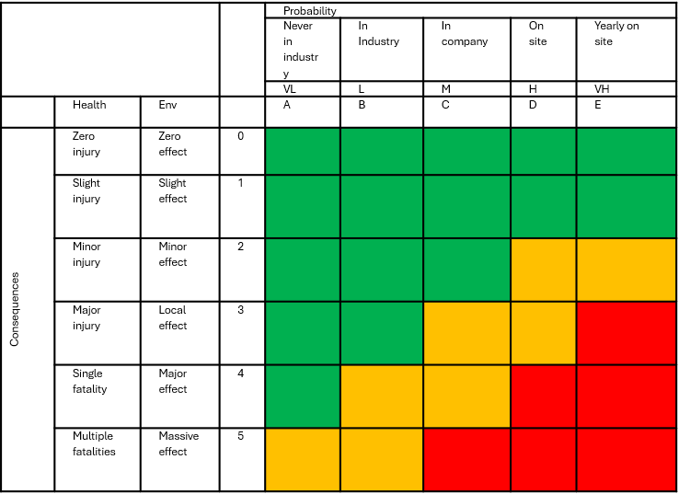
Risk assessment of AC interference
AC Interference – Risk Assessment
There are several levels of sophistication possible for a risk assessment.
These include qualitative, semi-quantitative and fully quantitative.
The level of sophistication depends on;
  The data available
  The effort available and
  The optimisation / removal of conservatism desired.
  Note that a full risk assessment requires consideration of the consequences of failure.
  In this case we will concentrate on the probability of failure.

Slide 22
Risk assessment of AC interference
AC Interference – Probability
How likely it is that something will occur (in this case fail).
An ideal case would be to know the corrosion rate and corrosion allowance.
One divided by the other would give us the remaining life.
Uncertainty could be added, if required to give a probability.
In AC corrosion we're generally limited to determined whether corrosion is likely, or not.

Slide 23
Risk assessment of AC interference
AC Interference – Probability Ranking Factors
Can qualitatively assess the probability of AC interference.
INGAA Foundation Report 2015-04 Criteria for Pipelines Co-existing with Power Lines provides rankings for various factors influencing AC interference.
This study was based on the operation of 345 kV power lines.

Slide 24
Risk assessment of AC interference
AC Interference – Probability Ranking Factors
Can qualitatively assess the probability of AC interference.
Separation Distance (feet) | Severity Ranking of HVAC Interference
D<100 | High
100<D<500 | Medium
500<D<1,000 | Low
1,000<D<2,500 | Very Low
Current (Amps) | Severity Ranking of HVAC Interference
I>1000 | Very-High
500<I<1,000 | High
250<I<500 | Medium-High
100<I<250 | Medium
I<100 | Low

Slide 25
Risk assessment of AC interference
AC Interference - Factors
Soil Resistivity (Ωm) | Severity Ranking of HVAC Interference
ρ<25 | Very-High
25<ρ<100 | High
100<ρ<300 | Medium
ρ>300 | Low
Collocation Length (feet) | Severity Ranking of HVAC Interference
L>5000 | High
1,000<L<5,000 | Medium
L<500 | Low

Slide 26
Risk assessment of AC interference
AC Interference – Factors
A model can be prepared in which the rankings are given numerical values and the product, or average of these can be used to create a score on which the likelihood of corrosion is based.
Crossing Angle (°) | Severity Ranking of HVAC Interference
θ<30 | High
30<θ<60 | Medium
θ<60 | Low

Slide 27
Possible improvements to risk assessment of AC interference

Slide 28
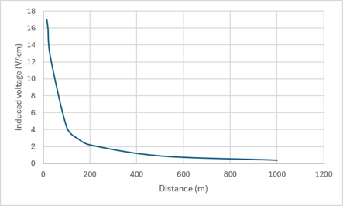
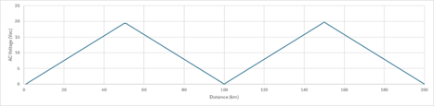

Possible improvements to risk assessment
AC Interference – Calculated approach
Models exist that can determine whether the likelihood of AC corrosion is low, or not. There are three main steps;
  Calculate the induced voltage in the pipeline (V/km)
  Determine the induced voltage at each point (V_{AC})
  Determine the AC current density at an assumed 1 cm² coating holiday (A/m²).
Based on the current density the likelihood of corrosion will be unlikely, possible or likely following the criteria given earlier.

Slide 29
Possible improvements to risk assessment
Risk Assessment Improvements
Improvements to existing models
Additional factors may be added to the assessment.
The weightings given to individual factors can be modified to better reflect the models.

Slide 30
Possible improvements to risk assessment
Risk Assessment Improvements
Future solutions
Use predictive models
Can predict the likeliness of corrosion at individual points rather than general sections or pipelines.
Links to electricity companies could result in live models.
Much modelling can be performed in Excel but bespoke AC interference software can be used to perform calculations.
Integrity software which can perform basic calculations and give graphical representation of a pipeline network is another option.

Slide 31
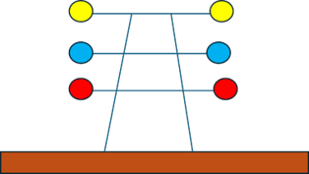
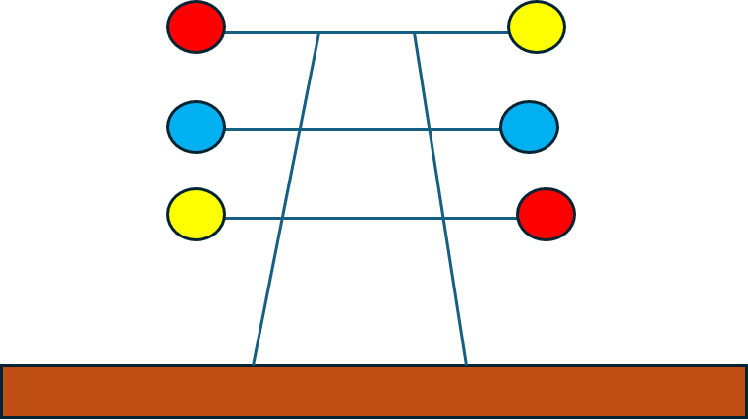



Possible improvements to risk assessment
Limitations
Complicated geometry
  Multiple OHPLs
  Uncertainty over phasing and transposing
Complicated geology
  Changes in soil resistivity with depth and along length of pipeline right of way
Communications with electricity companies
  Variation in current, phasing and transposing
Untransposed
Transposed
Medium soil resistivity
Banded soil resistivity
Mixed soil resistivity

Slide 32
Monitoring and mitigation of AC interference

Slide 33

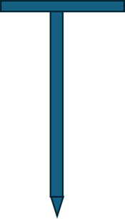
Monitoring and mitigation of AC interference
AC Interference Monitoring
Prediction of significant AC induced voltages should be followed by monitoring.
This can both confirm the magnitude of the voltages and quantify the size of the mitigation measures.
AC coupons are useful for measuring actual voltages (and calculating current densities).
Permanent coupons have an exposed area of steel (1 cm²) embedded in an insulating matrix.
Temporary coupons are usually pointed T-bar with the exposed area on the bottom.
ER probes can measure the corrosion rate.

Slide 34
Monitoring and mitigation of AC interference
AC Interference Monitoring
Monitoring should cover at least 24 hours (from standards) but ideally a week.
Should consider different times of the year too.
Ideally would have permanent coupons that could be remotely monitored.
As the currents carried by overhead power lines become greater and more variable, the need to monitor the induced voltages will become more important.

Slide 35
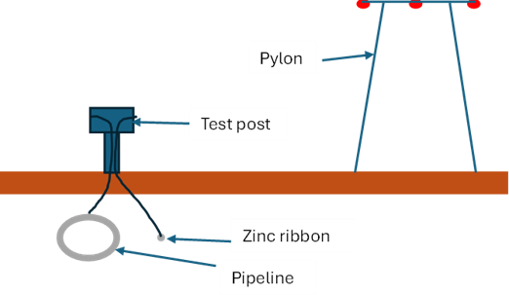
Monitoring and mitigation of AC interference
AC Interference Mitigation
AC currents may be mitigated by earthing the pipeline at the locations with the highest induced currents.
Zinc ribbon is normally used, although copper may also be used.
The earthing ribbon is isolated from the pipeline with a DC decoupling device.
This is useful to reduce the load on the CP system with zinc, but essential with copper.

Slide 36
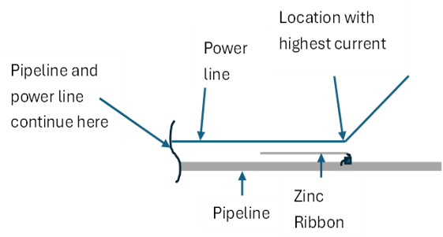
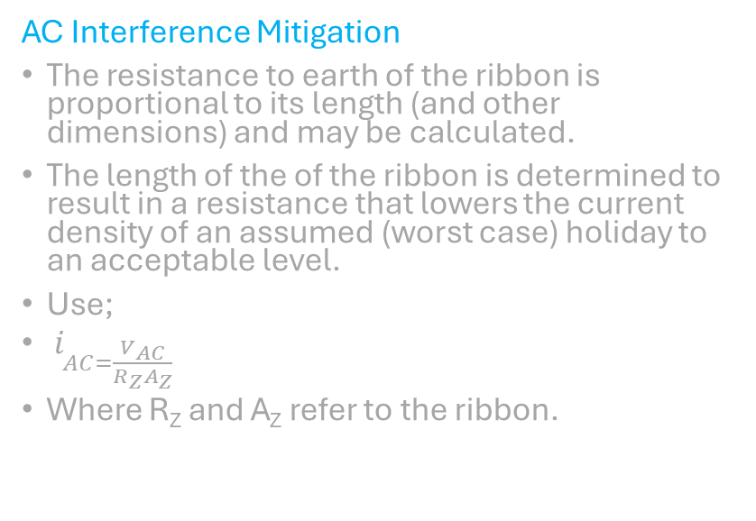
Monitoring and mitigation of AC interference
AC Interference Mitigation
The resistance to earth of the ribbon is proportional to its length (and other dimensions) and may be calculated.
The length of the of the ribbon is determined to result in a resistance that lowers the current density of an assumed (worst case) holiday to an acceptable level.
Use;
$i_{AC=\frac{V_{AC}}{R_{Z}A_{Z}}}$
Where R_{Z} and A_{Z} refer to the ribbon.

Slide 37
Summary

Slide 38
Summary
Summary
AC induced stray currents have been known about for a long time, as has their potential to cause electric shocks. Their potential to cause corrosion is a more recent discovery.
It is likely to become a much greater concern in the future, partly due to the drive to use renewable energy.
  Higher currents
  Variable currents
  More power lines
It is possible to model the likelihood of corrosion; both qualitatively and quantitatively
These models can be refined.
The models can drive monitoring and mitigation of stray currents.
Communication with the electricity company is important.

Slide 39
End

Slide 40
Standards

Slide 41
Standards
ISO 15589-1, Petroleum, petrochemical and natural gas industries — Cathodic protection of pipeline systems — Part 1: On-land pipelines
ISO 21857 - Petroleum, Petrochemical and natural gas industries. - Stray Current Interference on Pipeline Systems
BS EN ISO 18086 Corrosion of metals and alloys. Determination of AC corrosion. Protection criteria
BS EN 50443 Effects of electromagnetic interference on pipelines caused by high voltage a.c. electric traction systems and/or high voltage a.c. power supply systems
BS EN 15280 Evaluation of a.c. corrosion likelihood of buried pipelines - Application to cathodically protected pipelines (Withdrawn)

Slide 42


Stay connected!
Latest updates, events, training and resources
Newsletter
icorr.org/icorr-newsletter/
LinkedIn linkedin.com/company/institute-of-corrosion/
Website
icorr.org
Advancing Corrosion Science & Engineering

